Slide 1
Nutraceuticals as an Alternative Strategy to the Use of Antimicrobials
Michael A. Ballou, Ph.D.
Professor and Chair
Department of Veterinary Sciences
Texas Tech University, Lubbock, TX
Michael.Ballou@ttu.edu
(806) 543-5653

Slide 2
Topics to be covered
Why do pre-weaned calves get sick?
Development of gastrointestinal immunity
Nutrition and immunity of calves
Reduce interaction of potential pathogens with calf
Stimulate gastrointestinal immunity
Stimulate adaptive immune development

Slide 3
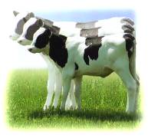
Why do so many calves get sick?
Risk of mortality greatly decreases after the first few weeks of life.
What changed in the calf during this period?

Slide 4
Gastrointestinal Maturation
Some components of the GI immune system develop after birth
Catch-22 Situation
Passive absorption of macromolecules but increases risk for translocation of microorganisms
Ideal situation
Absorb adequate antibodies
No absorption of microorganisms
Rapid maturation of the GI tract

Slide 5
Gastrointestinal Maturation
Many components to the GI immune system
Physical barrier
Chemical barrier
Immunological barrier
Microbial barrier

Slide 6
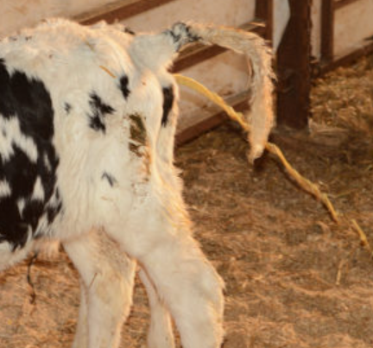
Strategies to improve immunity
What role can nutrition play in reducing enteric disease?

Slide 7
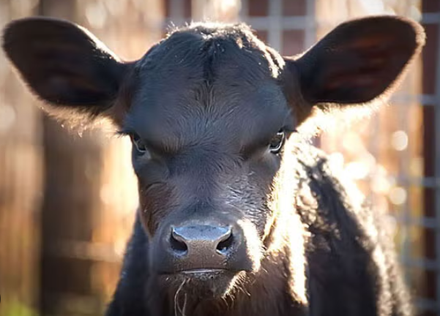
Strategies to improve immunity
Putative nutrition supplements added to milk replacer and/or calf starter
Post-day 1 colostrum
Bovine serum/plasma proteins
Yeast cell walls
Whole cell wall extract
MOS and β-glucan fractions
Live yeast
Yeast cultures
Direct fed microbials
Butyric acid
Hyper immunized egg proteins
Adsorbents

Slide 8
Strategies to improve immunity
General Mechanisms of Action
Competitive inhibition
Binding/Adsorption
Antimicrobial factors
Low pH, Bacteriocins, Organic Acids, Disrupt Cell Wall
Stimulate other mucosal immune defenses
Epithelial growth, mucin production, host defense peptides, secretory IgA, T regs
Alter systemic immune defenses

Slide 9
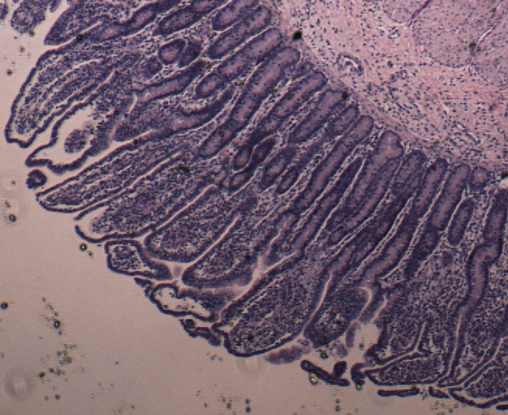
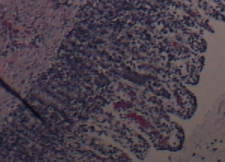
Colostrum
Colostrum: Non-Immunoglobulin

Slide 10
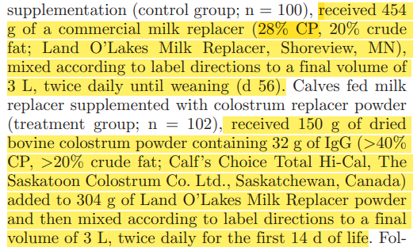
Post Day 1 Colostrum
Post-Day 1 Colostrum
64 g of IgG per day
Low Mortality - 2/202 calves died
$0.20 - $0.30 / g IgG
Chamorro et al., 2017

Slide 11
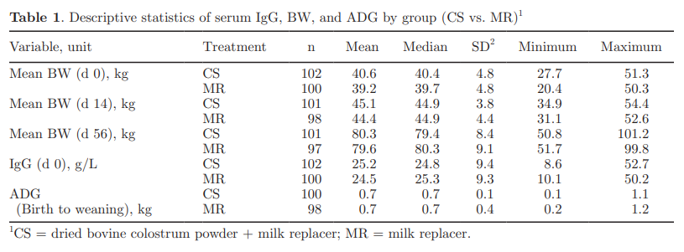
Post Day 1 Colostrum
Post-Day 1 Colostrum
No Difference
19% vs 70%
Chamorro et al., 2017

Slide 12
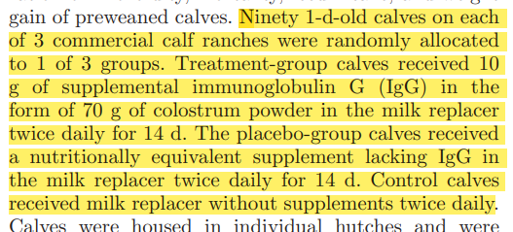
Post Day 1 Colostrum
Post-Day 1 Colostrum
20 g of IgG per day
$0.20 - $0.30 / g IgG
Berge et al., 2009

Slide 13
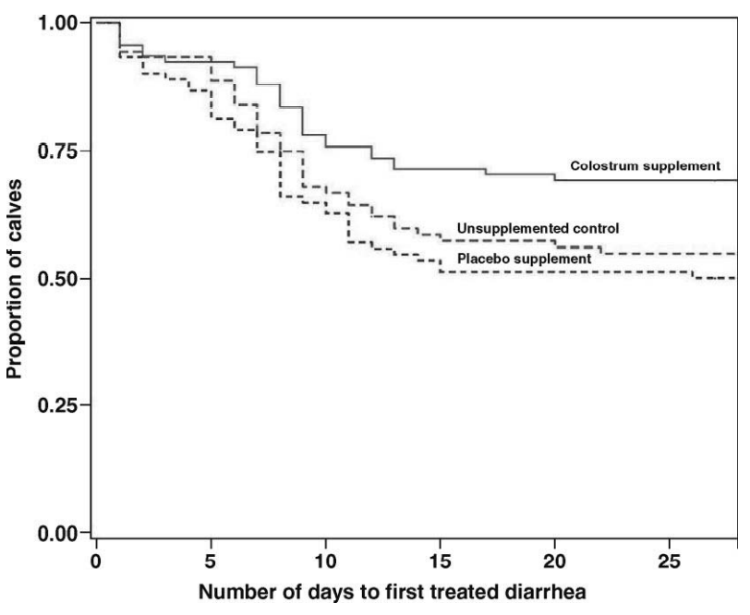
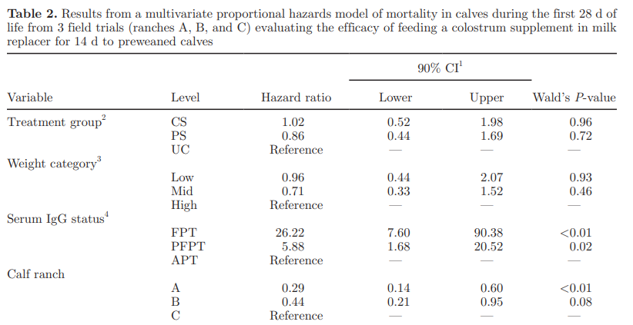
Post Day 1 Colostrum
Post-Day 1 Colostrum
Mortality and Diarrhea
No Difference
25% vs 40-50%
Berge et al., 2009

Slide 14
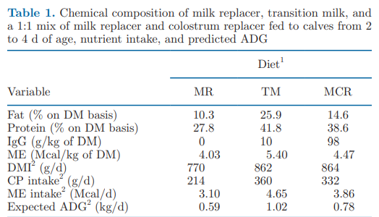
Post Day 1 Colostrum
Post-Day 1 Colostrum

Slide 15
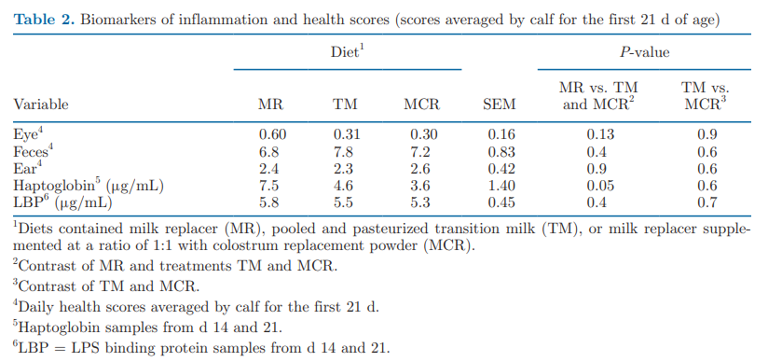
Post Day 1 Colostrum
Post-Day 1 Colostrum
Reduced Inflammation
+6.6 lbs

Slide 16
Post Day 1 Colostrum
Post-Day 1 Colostrum
~20g/L IgG

Slide 17
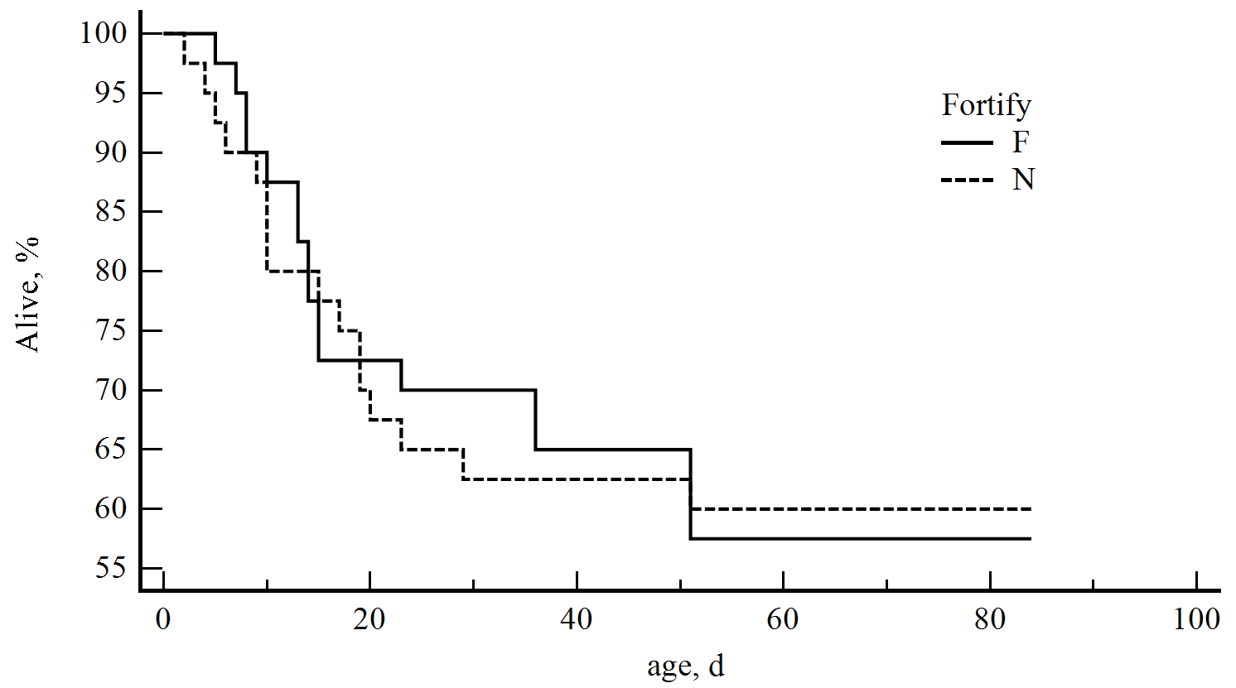
Plasma
Spray Dried Plasma
Fed a plasma-based colostrum supplement
454 in total volume of 2L first feeding in calf ranch
P=0.939
Langenkamp & Ballou (ongoing)

Slide 18
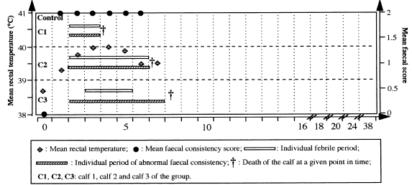
Plasma
Spray Dried Plasma
Approximately 22.2% IgG
Nollet et al. (1999)

Slide 19
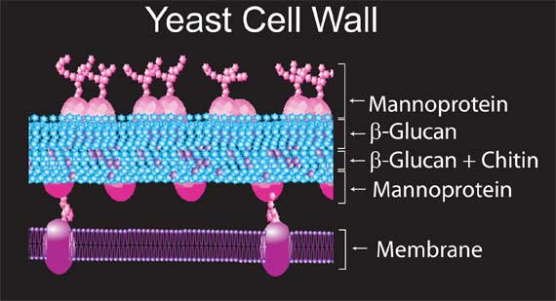
Yeast cell wall fractions
Yeast cell wall
(MOS & β-glucans)
Whole yeast cell wall – insoluble cell wall is extracted from a culture of yeast.
Polysaccharides (30 -60%) – β-Glucan and Mannan Polymers. Yeast cell wall contains typically between 5 to 30% of each.
Proteins (30%) – Most of the protein is linked to the Mannan Polymers

Slide 20
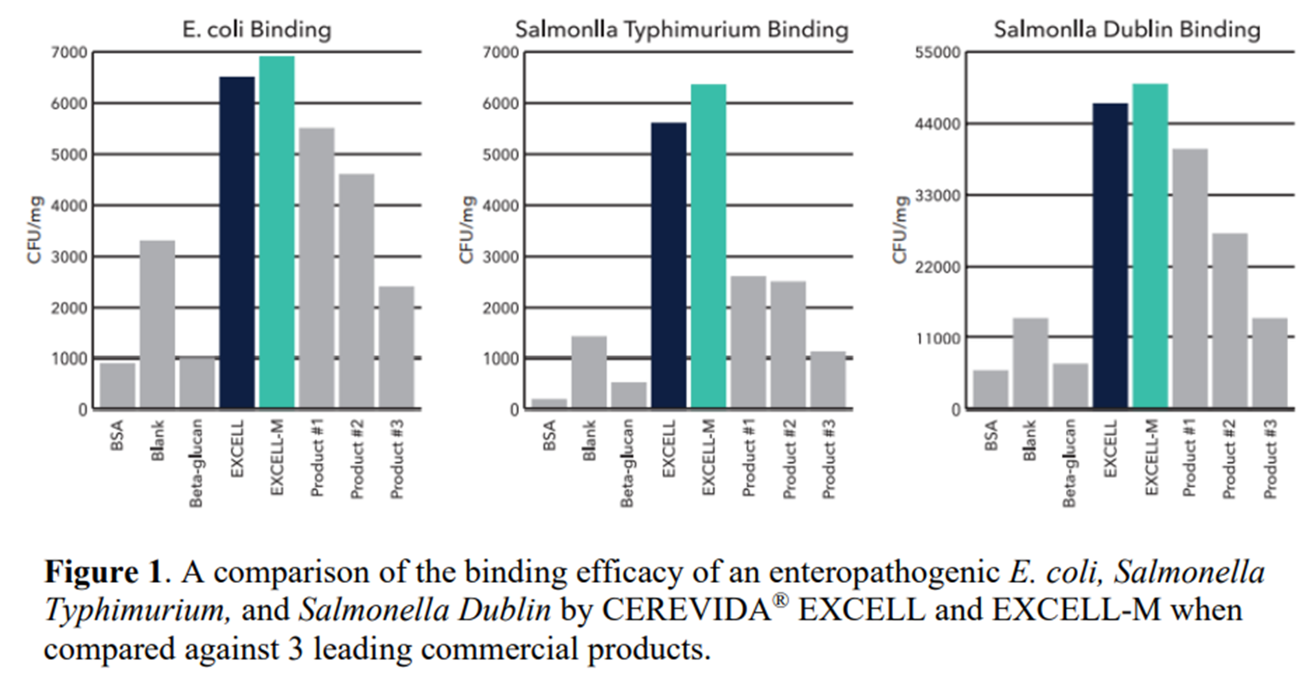
Yeast cell wall fractions

Slide 21
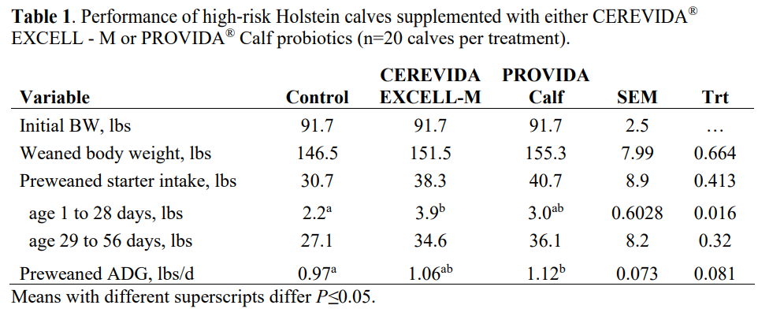
Yeast cell wall fractions
+5.1 lbs
+8.4 lbs
Davis et al. 2023

Slide 22
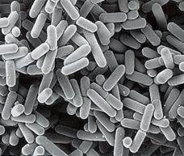
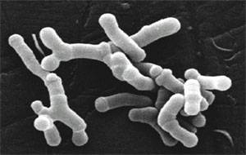
Direct fed microbials
Direct fed microbials
Probiotics – are live microorganisms that are thought to be beneficial to the host organism
Include Lactobacillus sp, Bifidobacterium sp, Saccharomyces sp, Enterococcus, Bacillus sp.

Slide 23
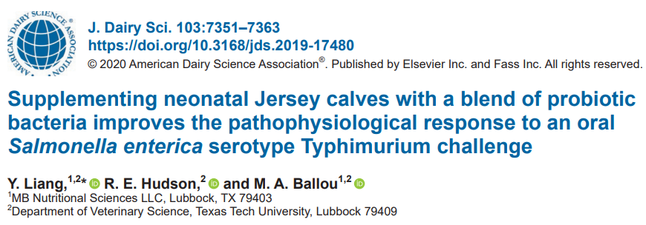
Direct fed microbials
Materials and Methods
Challenged with log-growth Salmonella enterica in morning milk replacer
BW collected on d 0, 7, 14, and 21
Blood collected on d 0, 7, 10, 14, and 21
Histology d 21
Duodenum and Ileum

Slide 24
Direct fed microbials

Slide 25
Direct fed microbials

Slide 26
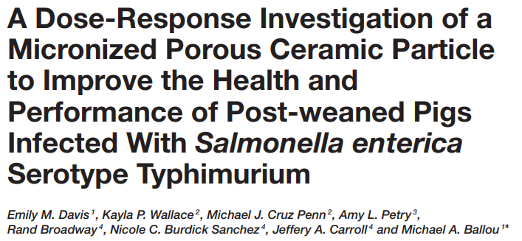
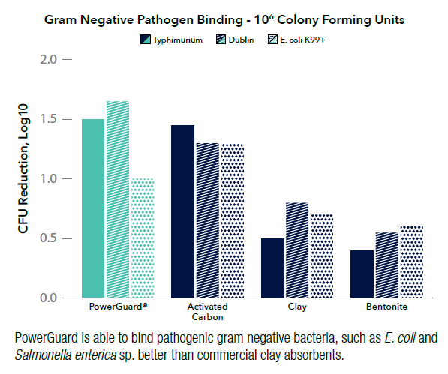
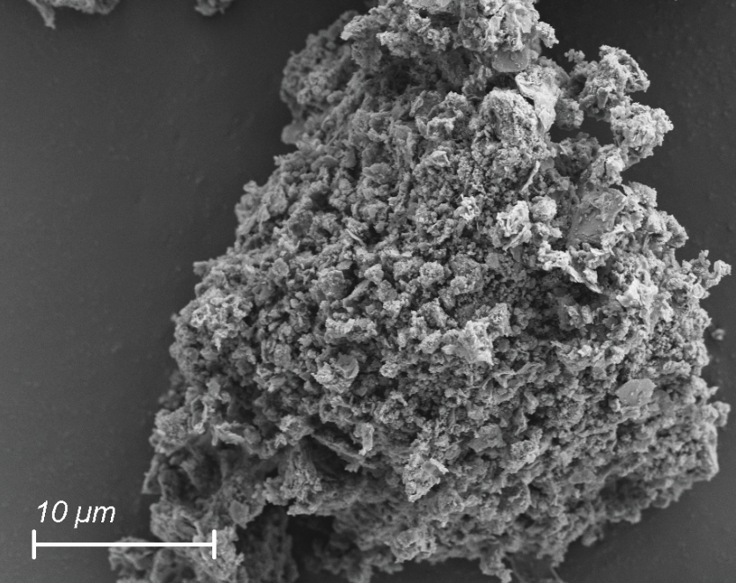
Adsorbents

Slide 27
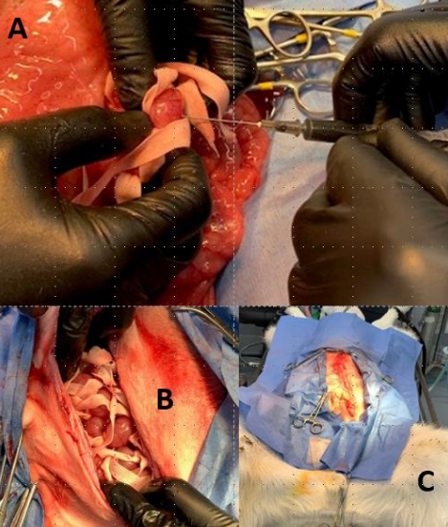
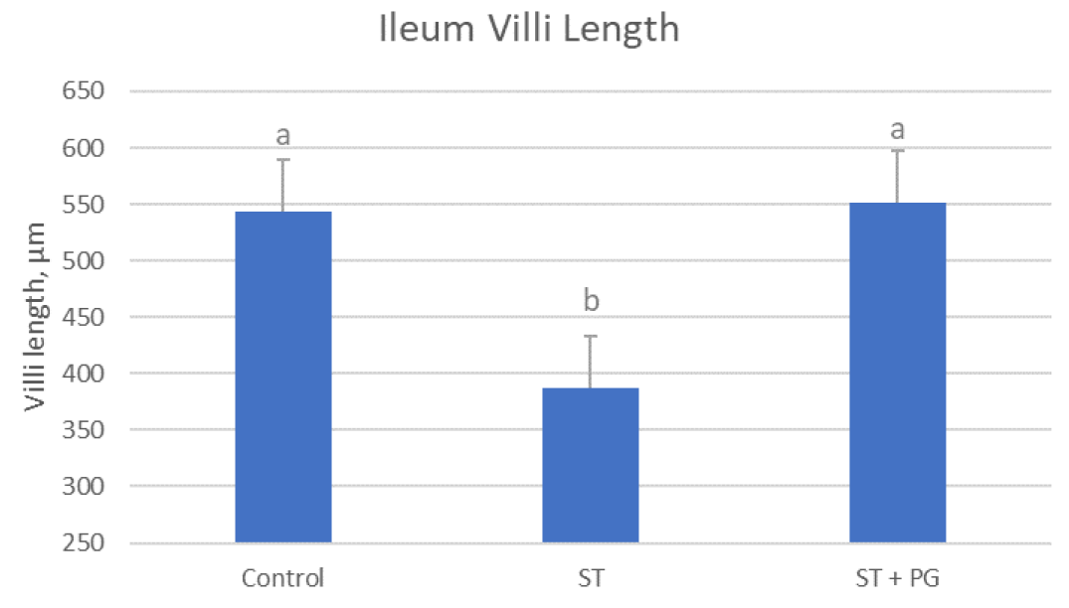
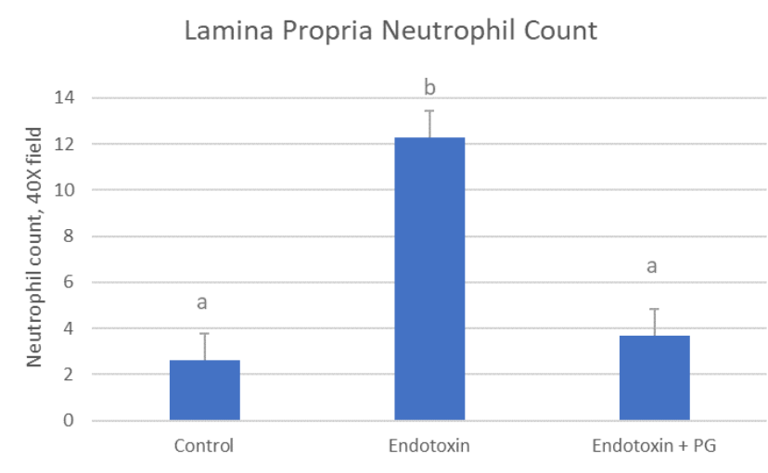
Adsorbents
Davis and Ballou (ongoing)

Slide 28
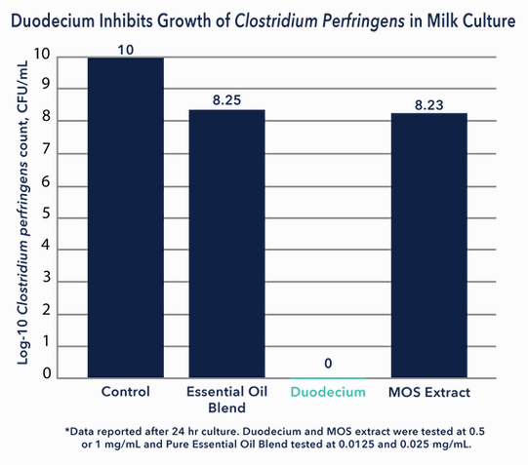
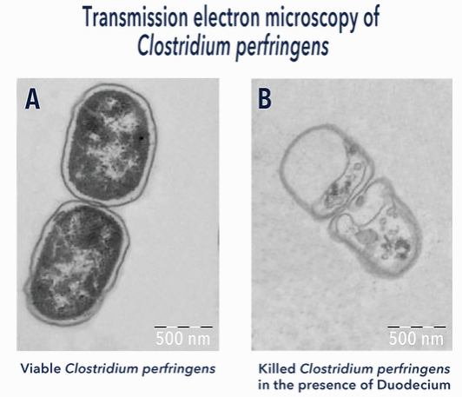
Abomasitis
Ballou (ongoing)

Slide 29
Take Home Messages
Many holes in G.I. immune system and undergoing rapid maturation
Many interactions among host, pathogens, and environment
Nutrition attractive approach
Primary strategies to improve enteric immunity
Reduce interaction of potential pathogen with calf
Improve G.I. immune system maturation

Slide 30
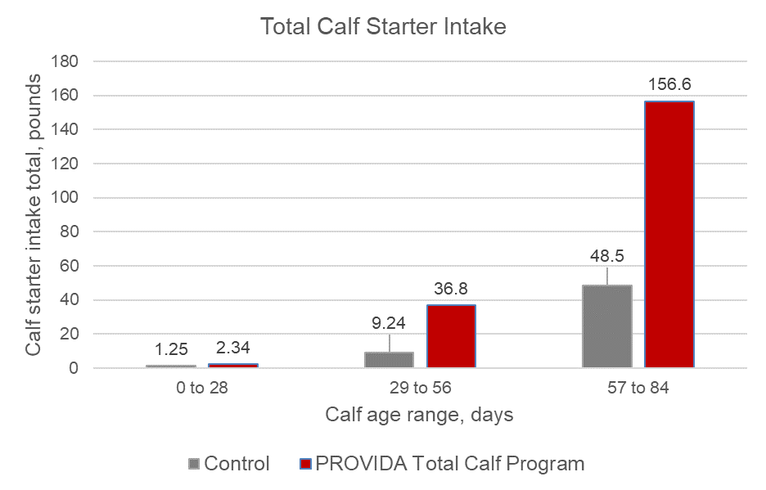
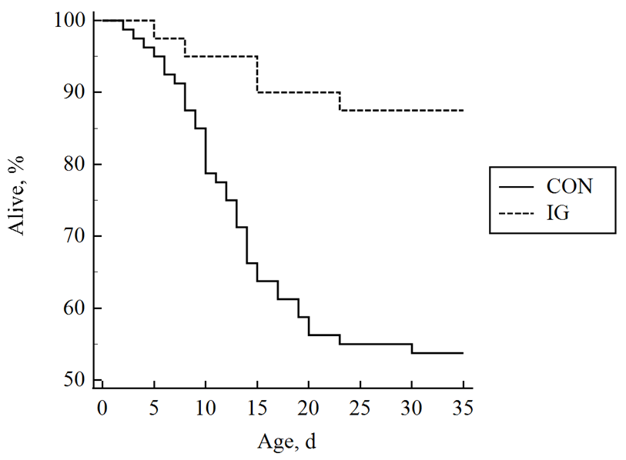
PROVIDA Total Calf IG
Combination Treatment
Control calves fed 22-20 Component, Non-Med
Skim, 7-60 (or Liquid Fat), 99% Lactose
IG supplemented with 45 g/calf/day
21 days then 6 g/calf/day PROVIDA VTM
IG = Plasma, PowerGuard, EXCELL-M, Probiotics, Duodecium, Whey Fractions, DFM, VTM, Lys/Met
n=60/treatment; ~75% FPT
P=0.001
Langenkamp and Ballou, ongoing

Slide 31
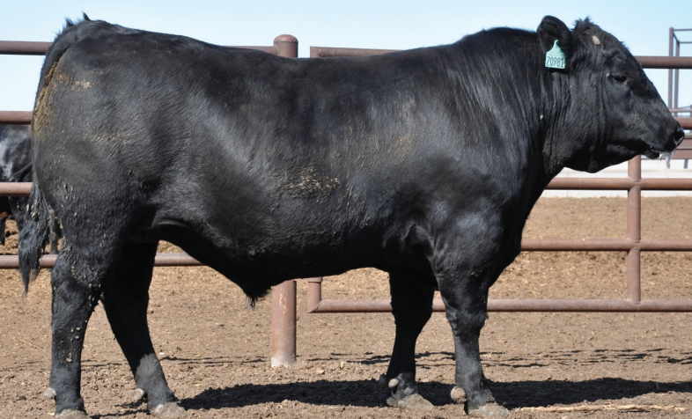
Questions / Conflicts of Interest
Michael A. Ballou, Ph.D.
Professor and Chair
Department of Veterinary Sciences
Texas Tech University
Davis College of Agricultural Sciences and Natural Resources
michael.ballou@ttu.edu
(806) 543-5653
CALF LAND

