Slide 1
The Business of Beef on Dairy Georgia Dairy Conference 2025
Dr. G. Kee Jim

Slide 2
Overview
Historical Role of Holsteins in the Fed Beef Supply Chain
The Perfect Storm (Factors Leading to the “Beef-on-Dairy (BOD)” Phenomenon)
Cattle Inventory Changes in North America
Total Potential Beef on Dairy Supply
Why the BOD Calf has more value than a purebred Holstein or Jersey Calf
Additional Benefits of BOD vs Native Beef
Beef-on-Dairy (BOD) Stakeholders
Advantage to BOD System
Aligning the Value Chain
The Future

Slide 3
Fed Beef Industry Supply Chain
SEEDSTOCK
COMMERCIAL DAIRY INDUSTRY
COMMERCIAL COW-CALF INDUSTRY
BACKGROUNDERS
CALF-RANCH
STOCKER
FEEDLOT
PACKER
PURVEYORS
RETAILERS (Incl. FOOD SERVICE)
CONSUMERS

Slide 4
Historical Role of Fed Holsteins in Fed Beef Supply Chain
Holstein steers accounted for 17 to 22% of fed beef production
Up to 450,000 head slaughtered annually in the US
The selling discount was -$6 to -$10/cwt dressed, which is approximately -$8 to -$12/cwt live because of lower red meat yield from a Holstein carcass
All three major packers slaughtered Holsteins.
Packer contracts were available at a defined future basis relative to beef cattle.

Slide 5
The Perfect Storm
Widespread adoption of sexed semen products
Conception rate with sexed semen is comparable to conventional semen
Improved reproductive performance of the milking herd
Emergence of Jerseys as a meaningful percentage of overall cow numbers due to value of milk components
Male purebred Jersey calf has zero economic value (high cost of production)
Collapse in the value of the day-old Holstein bull calf

Slide 6
Collapse in the Value of the Day-Old Holstein Bull Calf
A major meat packer (Tyson) decided to stop slaughtering fed Holsteins.
Tyson gave six to twelve months’ notices to most feedlots.
Cited reasons:
Emphasis on CAB and/or other “High Choice” programs.
The “Walmart Effect.”
Plant issues such as liver abscesses and height of animals.
Basis between fed beef cattle and fed Holstein cattle widened to -$15/cwt to -$25/cwt depending on geographic location.

Slide 8
California Day-old Holstein Price (2013 to 2019)

Slide 9
Cattle Inventory Changes in North America
The North American beef cow herd is shrinking.
The size of the US dairy herd has been remarkably steady.
The number of both beef and dairy operations is declining, but the remaining players are increasing in size.
Industry consolidation is expected to continue moving forward.
Record high prices for feeder cattle and day-old calves

Slide 10
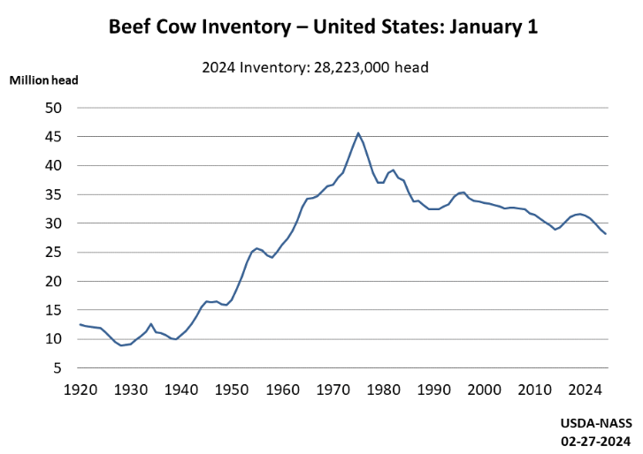
United States Beef Cow Inventory (January 1; x 1,000)

Slide 11
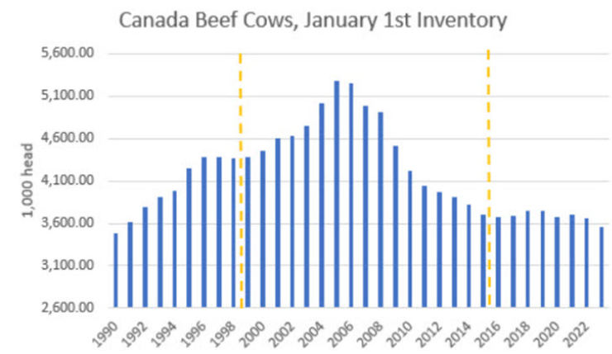
Canadian Beef Cow Inventory (January 1; x 1,000)

Slide 12
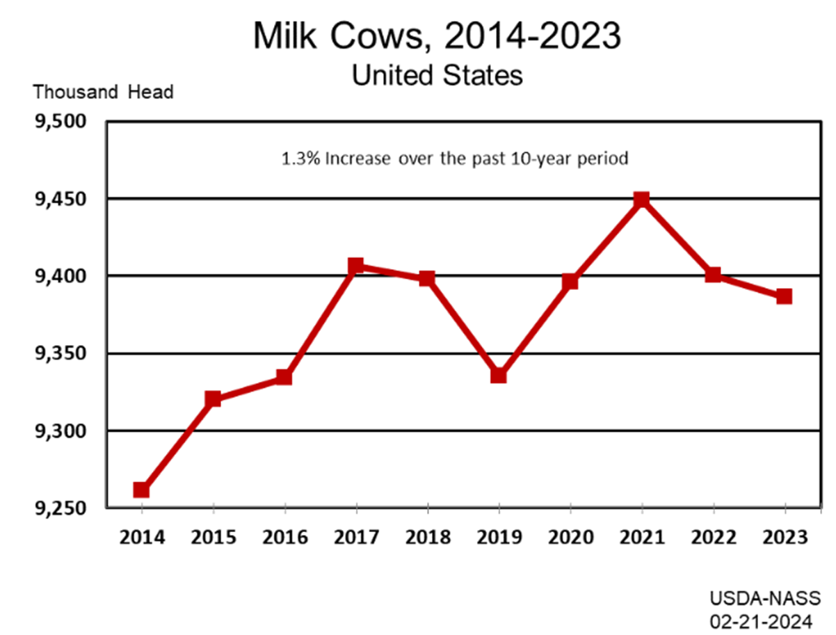
Number of Dairy Cows in the US (x 1,000)

Slide 13
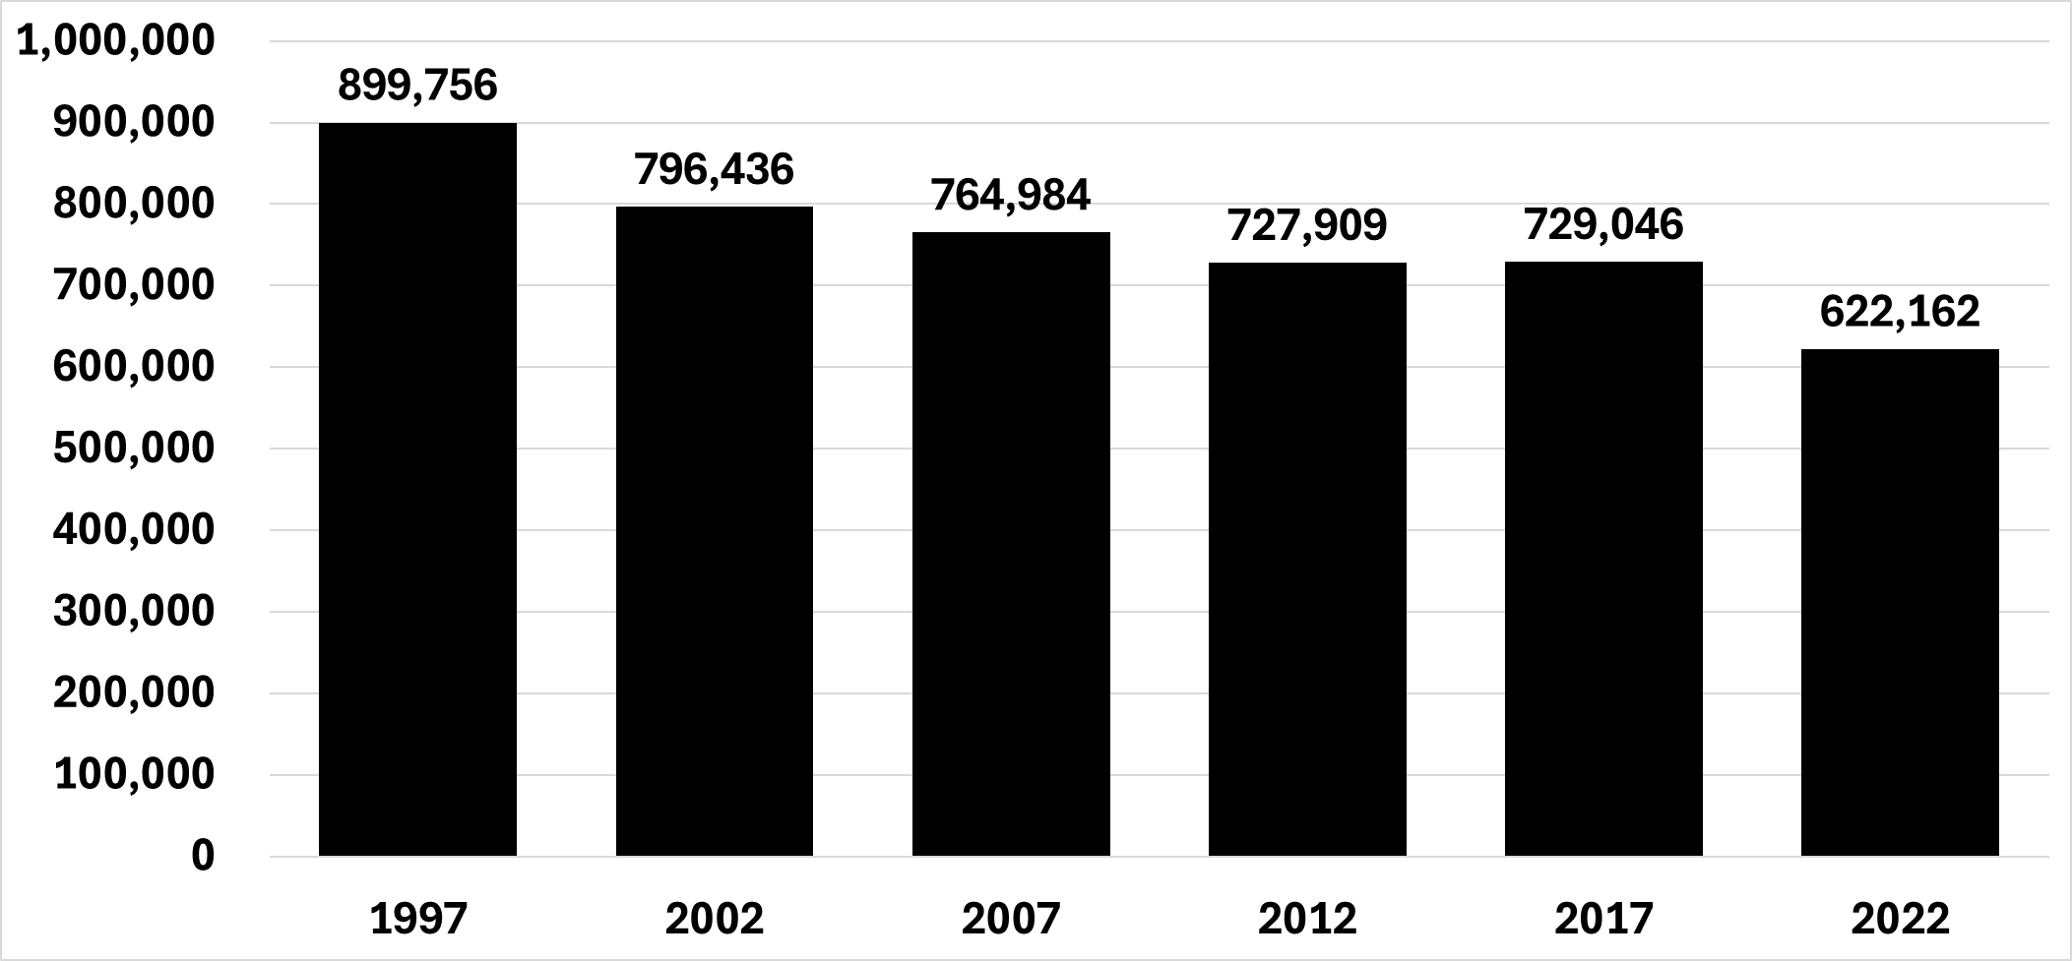
Number of Farms Reporting Beef Cows in USA
Census of Agriculture, 2022

Slide 14
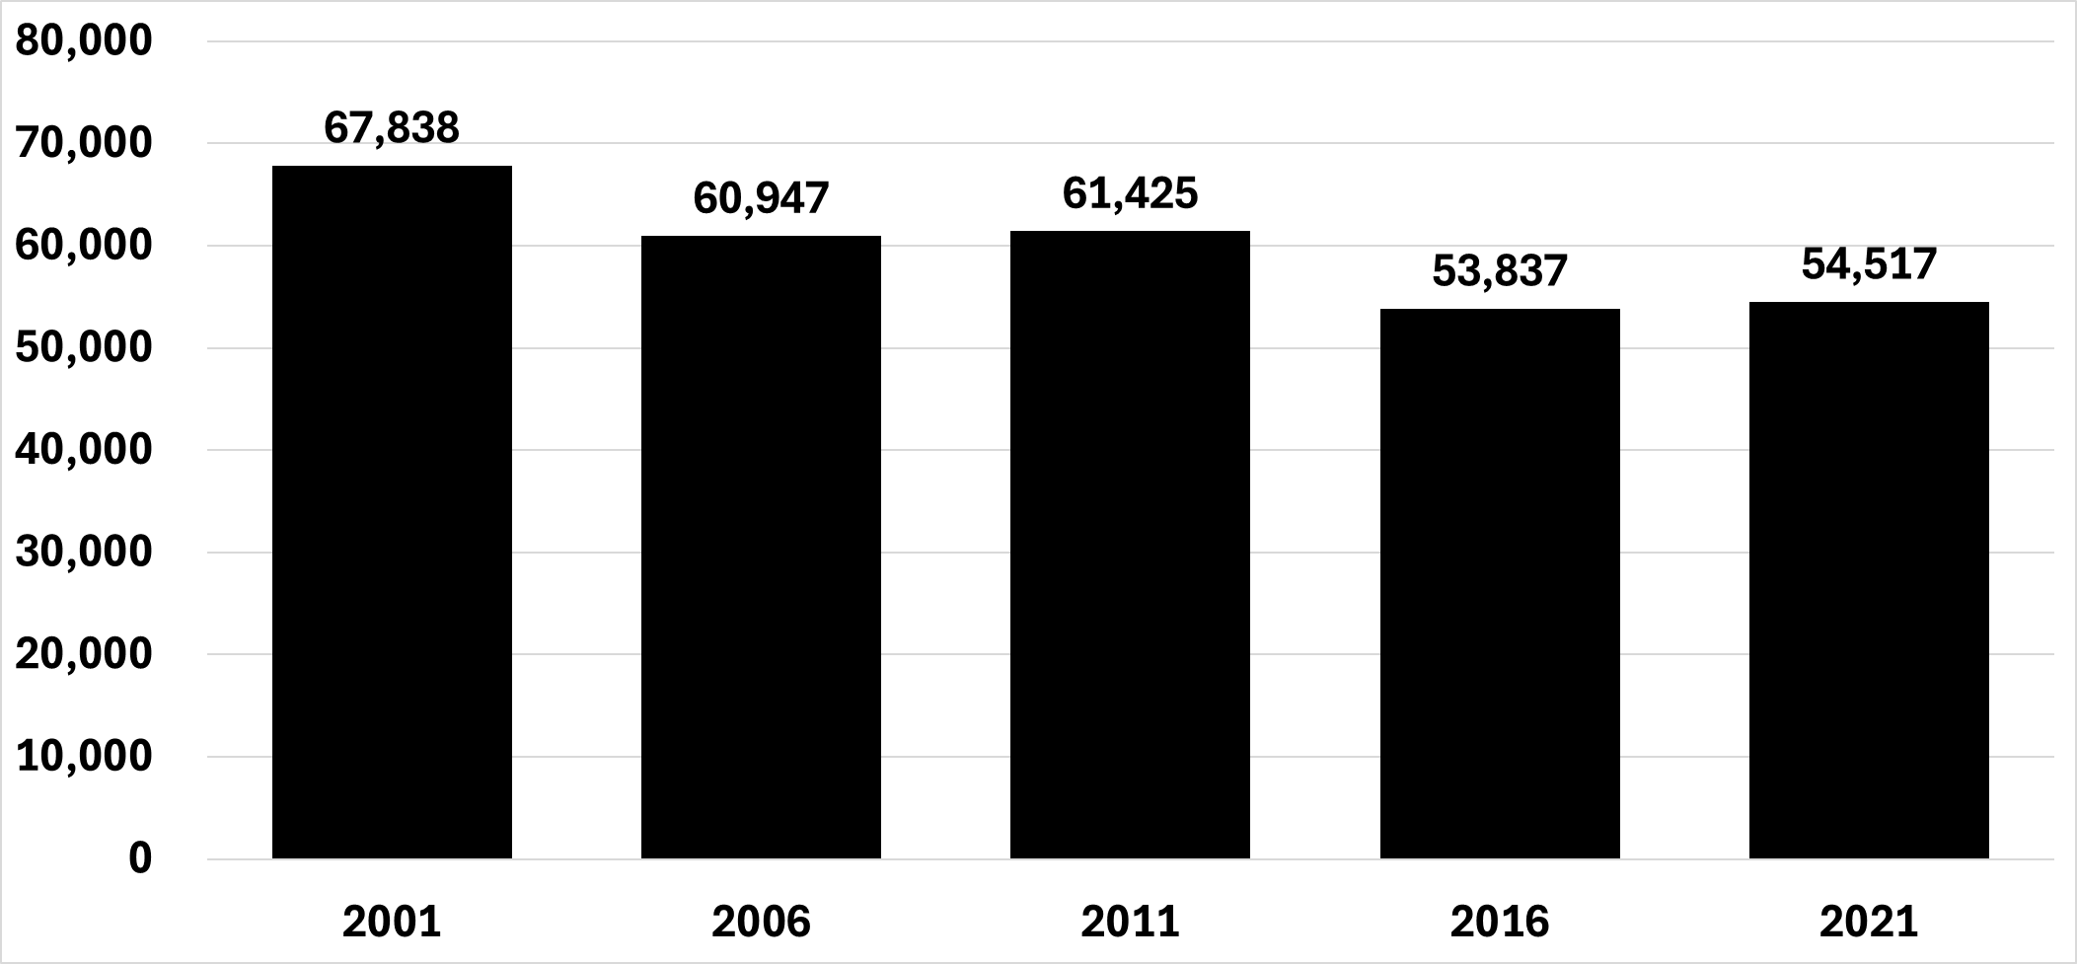
Number of Farms Reporting Beef Cows in Canada
Census of Agriculture, 2021

Slide 15
United States Feeder Price $/cwt USD (850 lb)

Slide 16
Alberta Canada Feeder Price $/cwt USD (850 lb)

Slide 17
Total Potential Beef-on-Dairy Supply in North America
9.4MM dairy cows in the US
Approximately:
80% Holstein → 7,500,000 cows
10% Jersey → 940,000 cows
10% Crosses/Other → 940,000 cows
At steady state, approximately 40% of the herd can be bred to beef bulls:
Potential for 3,760,000 beef-on-dairy calves annually

Slide 18
Why the BOD Calf has Greater value than a Purebred Holstein or Jersey Calf
In a word, Crossbreeding
Improved Average Daily Gain (ADG)
Improved Feed Conversion (DMG)
Improved Quality Grade and Yield Grade
Improved Carcass Cutability
Improved Shape of Primal Cuts (ribeye & strip)
Improved Animal Health Outcomes (Morbidity & Mortality)

Slide 19
Additional Benefits of BOD vs Native Beef
Superior Average Eating Experience
Youthful Carcasses
< 18 months of age when slaughtered combined with a long period of high energy dense diet
Reduced carbon footprint

Slide 20
Beef-on-Dairy (BOD) Stakeholders
Four direct stakeholders:
The Dairy
The Genetics Provider
The Calf Ranch
The Cattle Owner/Cattle Feeder
Indirect/downstream stakeholders:
The Packer
Restauranteurs/Grocers
The Consumer

Slide 21
The Dairy Stakeholder
Significant increase in the value of the day-old calf
BOD calf value is up to $300/head more than a purebred Holstein steer
Conception
Calving Ease
Gestation Length
Stillbirths

Slide 22
The Genetics Provider Stakeholder
Historically beef semen sales are limited to seedstock producers
< 2 million doses sold in North America
Total addressable market of approximates 12 million doses in the BOD space
Semen companies have an economic incentive to make an investment in “Better” beef bulls

Slide 23
The Calf Ranch Stakeholder
Profitability is directly related to the occupancy of the calf ranch operation
Benefits from improvements in Animal Health, ADG, and DMG

Slide 24
The Cattle Owner/Cattle Feeder
Profitability is directly related to the occupancy of the feedlot operation
Benefits from improvements in ADG, DMG, Animal Health, and Carcass Traits

Slide 25
The Packer Stakeholder
Reduced Incidence of Liver Abscess
Because of improved ADG
Carcass cutability is comparable to Native beef cattle
Better Quality Grade & Yield Grade compared to Native beef cattle
Improved Shape of Primal Cuts
ribeye & strip loin
Benefit to lower carbon footprint
Likely can be monetized as the carbon credit market develops

Slide 26
Advantage to Beef on Dairy System
Sire
Sire & Dam Linked to Calf
Tracked throughout phases of production
Feedlot
Carcass
Data is all Linked!

Slide 27
Aligning the Value Chain
Beef-on-Dairy programs have thus far failed to achieve full alignment of the value chain.
If the Dairy, Genetics Provider, Calf Ranch, and Cattle Owner/Cattle Feeder can achieve alignment, indirect/downstream stakeholders will benefit.
Opportunities abound
Broken links in the value chain occur when:
Dairies change genetics providers
Dairies change calf buyers
Dairies, calf ranches, and feedlots fail to collect production data
Calves are sold by dairies and/or calf ranches without transmitting accumulated health and production data to the new owner
Once value leaves the system, it does not return.

Slide 28
The Future
Competing proteins have managed to consolidate and achieve vertical integration.
Shorter generational intervals
Lower capital cost per output unit
More narrowly defined geographies for various production segments
Beef-on-dairy offers the opportunity for de facto vertical integration by linking stakeholders in a way that allows value to be transmitted up and down the value chain.

Slide 29
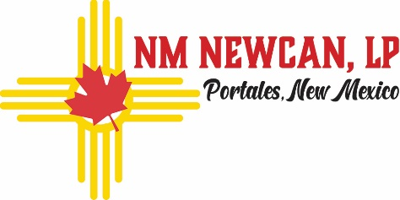
The Closed-Loop Beef-on-Dairy Model
Dairy
CALVES
SEMEN
BULLS/SEMEN
GENETIC EVALUATIONS
DATA
FEEDERS
DATA

Slide 31
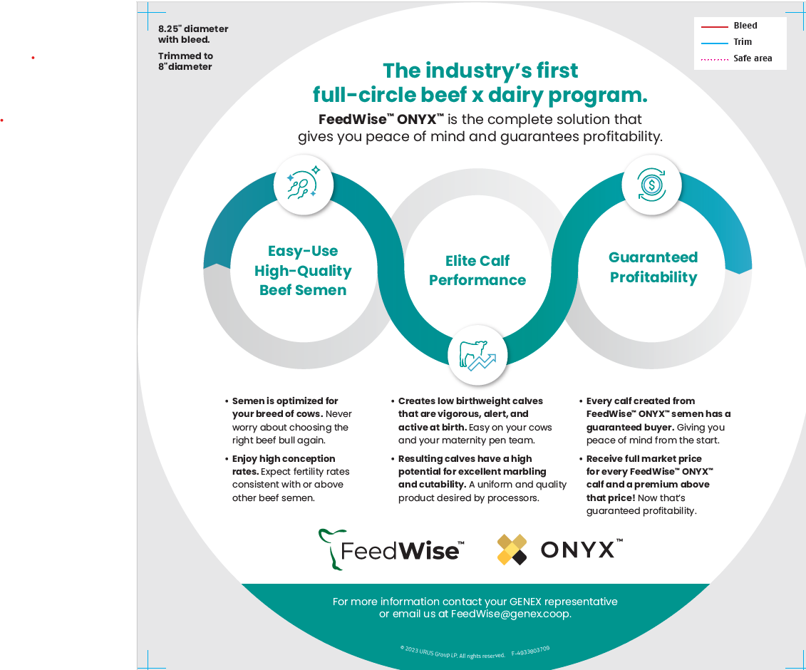

Slide 32
The Future
In search of “curve bending” sires that meaningfully and consistently improve ADG, DMG, Carcass Traits, & Animal Health
Development of direct relationships with grocers and/or restaurateurs.
Achieving sustainable “vertical alignment” to facilitate continued improvement of inputs and processes up and down the value chain.

Slide 33
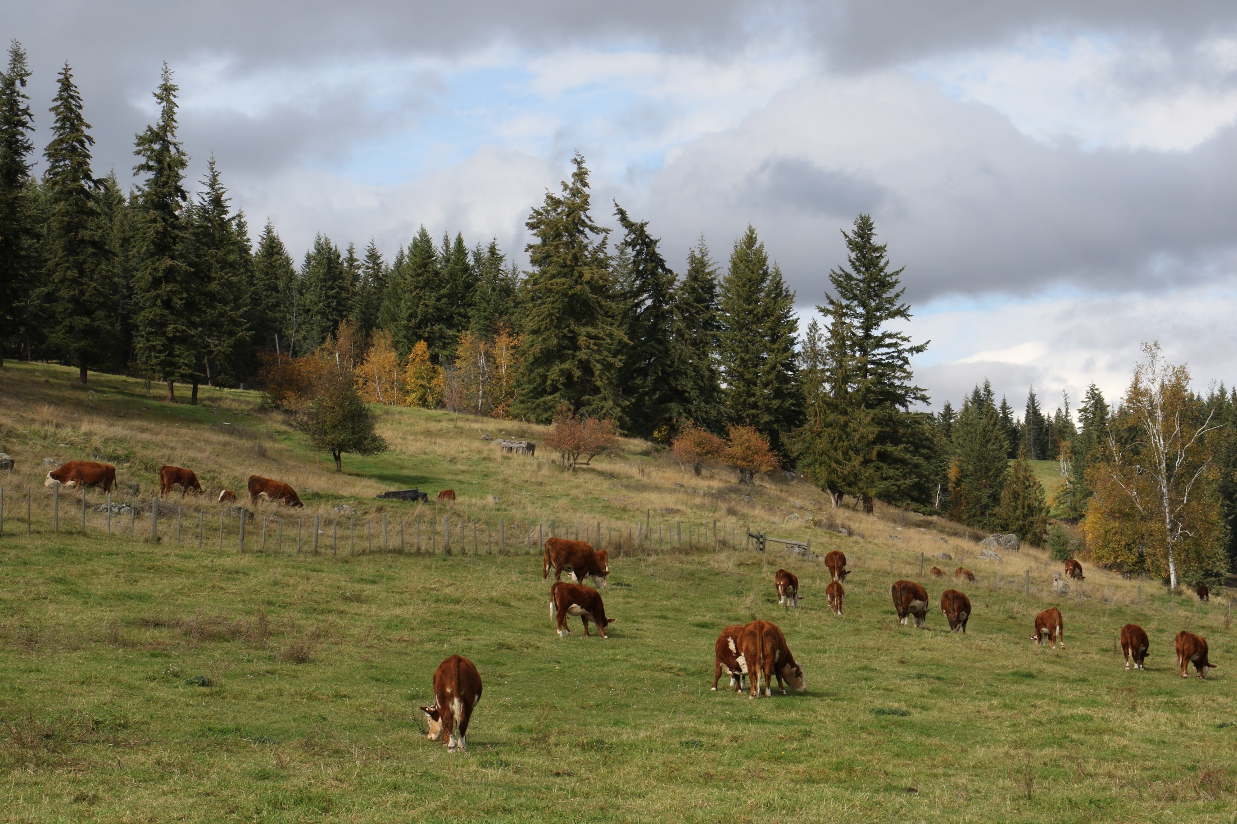
G.K. Jim
Group of Companies

