Slide 1
Change is the only constant,
but it doesn’t have to be a threat
Susan Stroud
Analyst, No Bull Ag
THIS IS A SOLICITATION. Reproduction or rebroadcast of any portion of this information is strictly prohibited without written permission. The information reflected herein is derived from sources believed to be reliable; however, this information is not guaranteed as to its accuracy or completeness. In an effort to combat misleading information, No Bull has performed its due diligence to ensure that all material information is provided within this report, though specific information related to your investment, hedging or speculative situation may not be included. Opinions expressed are subject to change without notice. This company and its officers, directors, employees and affiliates may take positions for their own accounts in contracts referred to herein. Trading futures involves risk of loss. Past performance is not indicative of future results.
NOBULLAG.COM

Slide 2
Change is the Only Constant
NOBULLAG.COM

Slide 3
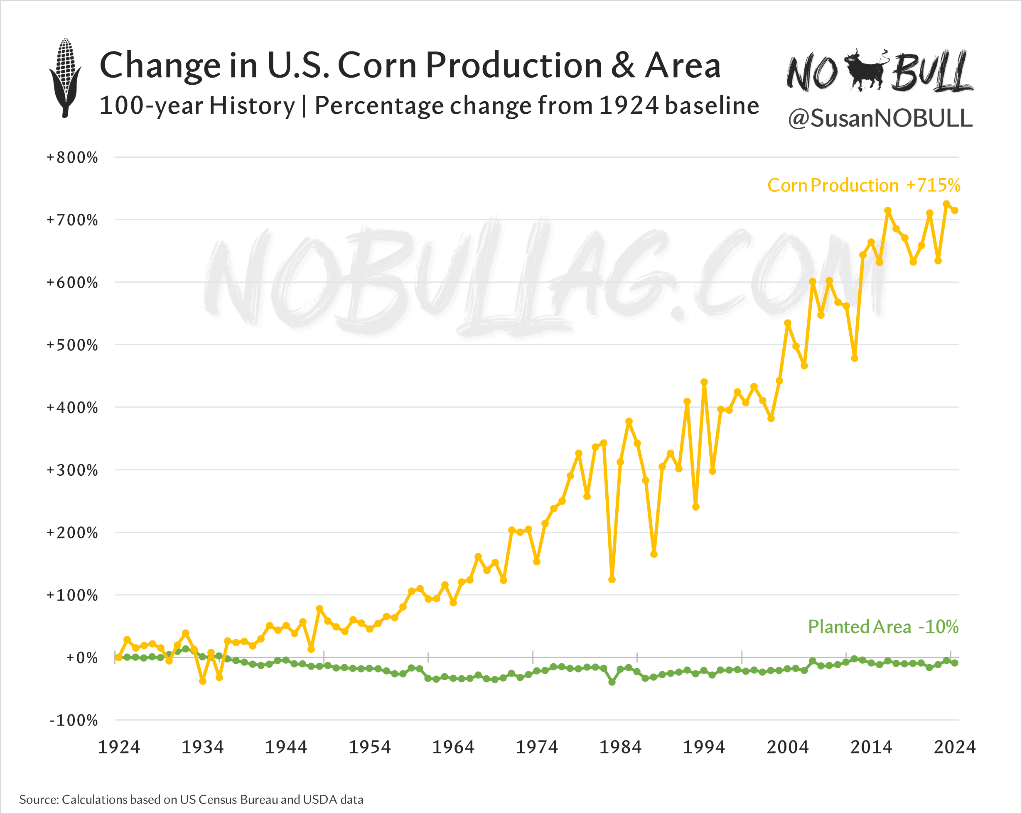
NOBULLAG.COM

Slide 4
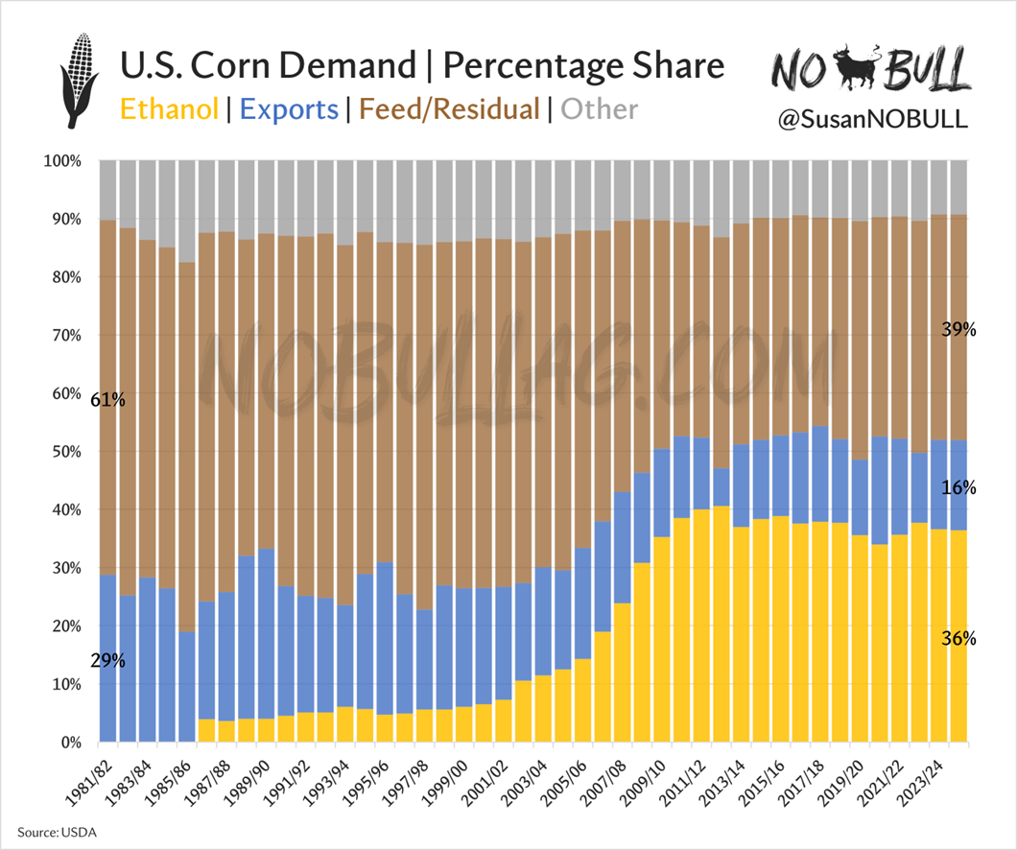
NOBULLAG.COM

Slide 5
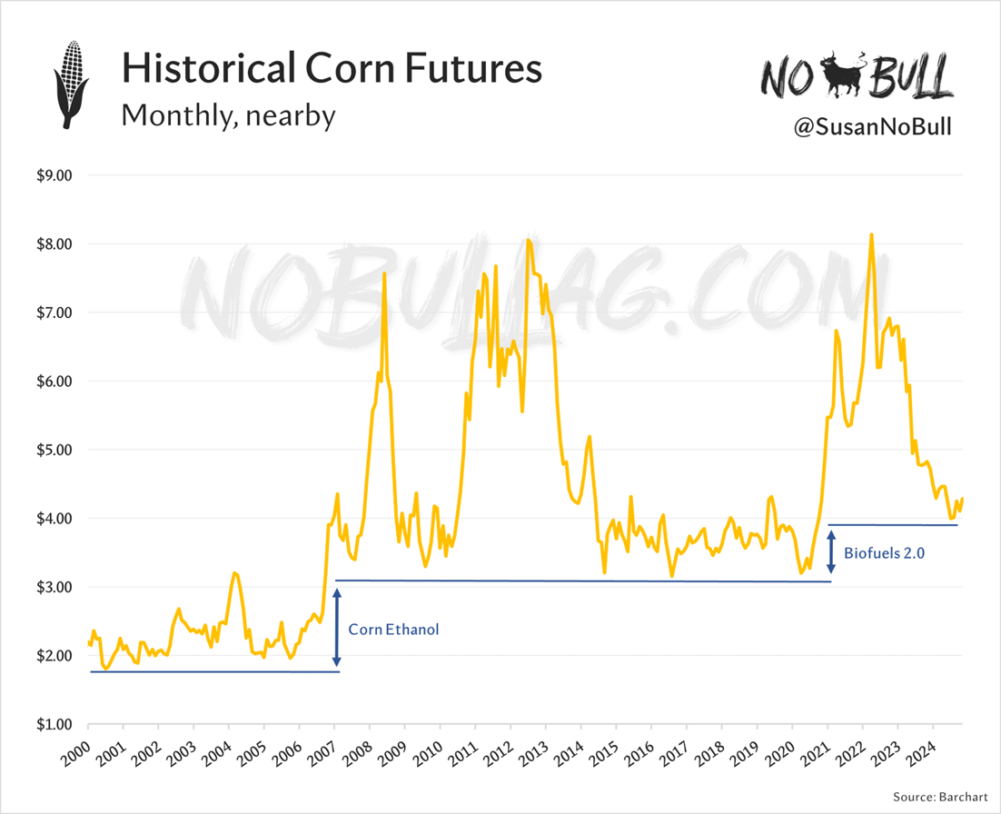
NOBULLAG.COM

Slide 6
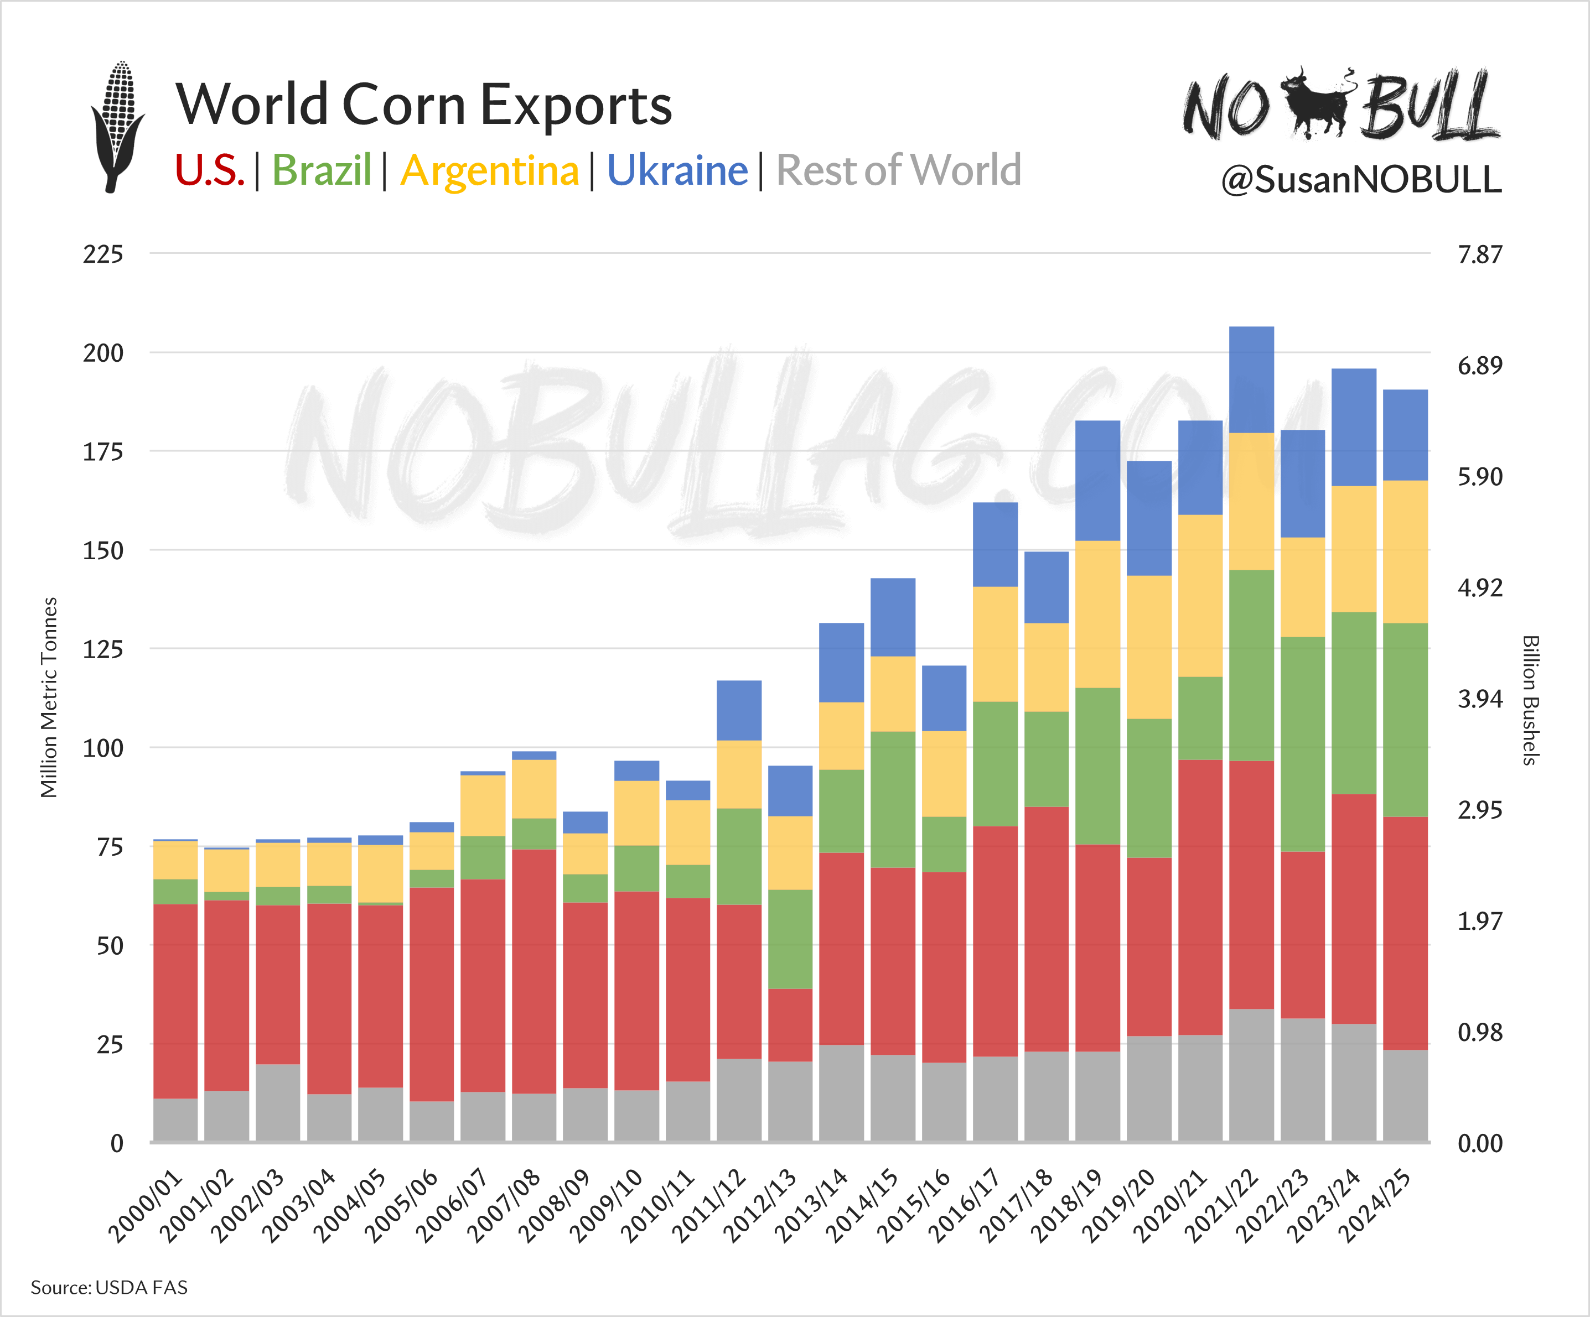
NOBULLAG.COM

Slide 7
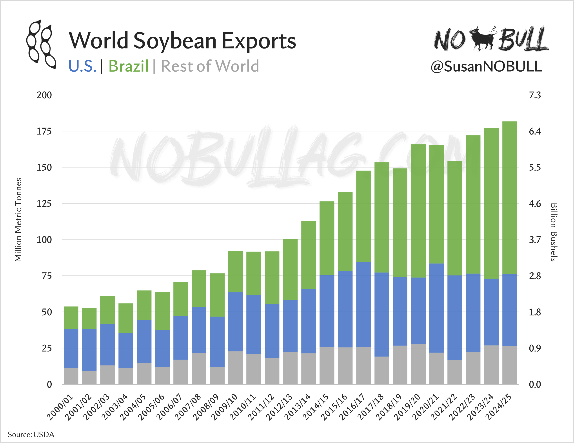
NOBULLAG.COM

Slide 8
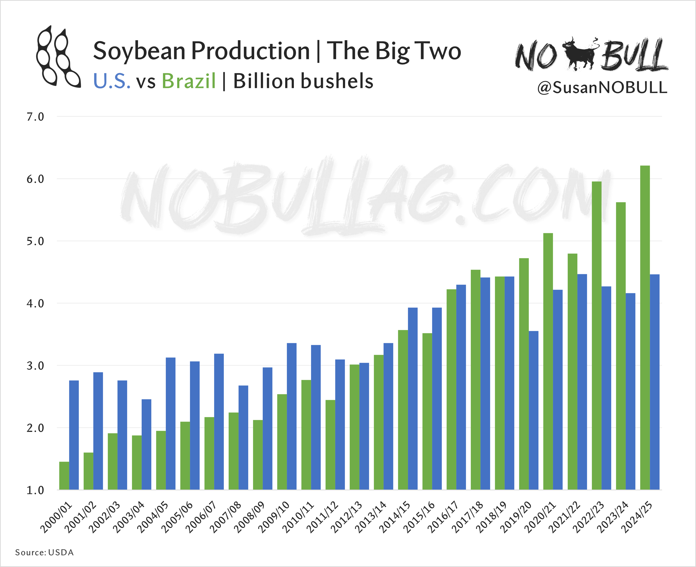
NOBULLAG.COM

Slide 9
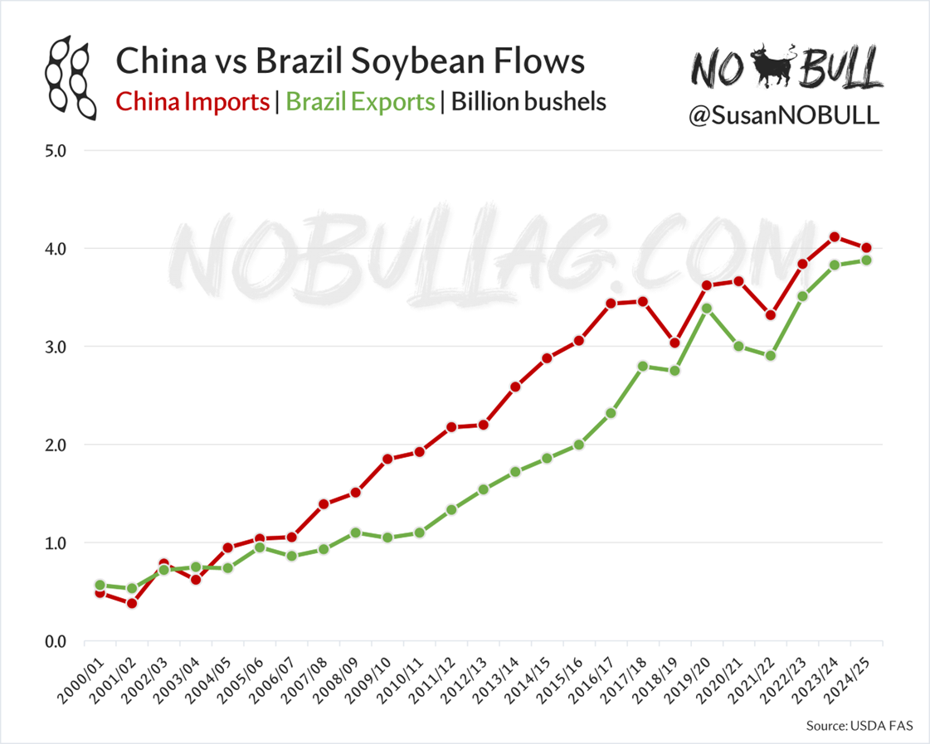
NOBULLAG.COM

Slide 10
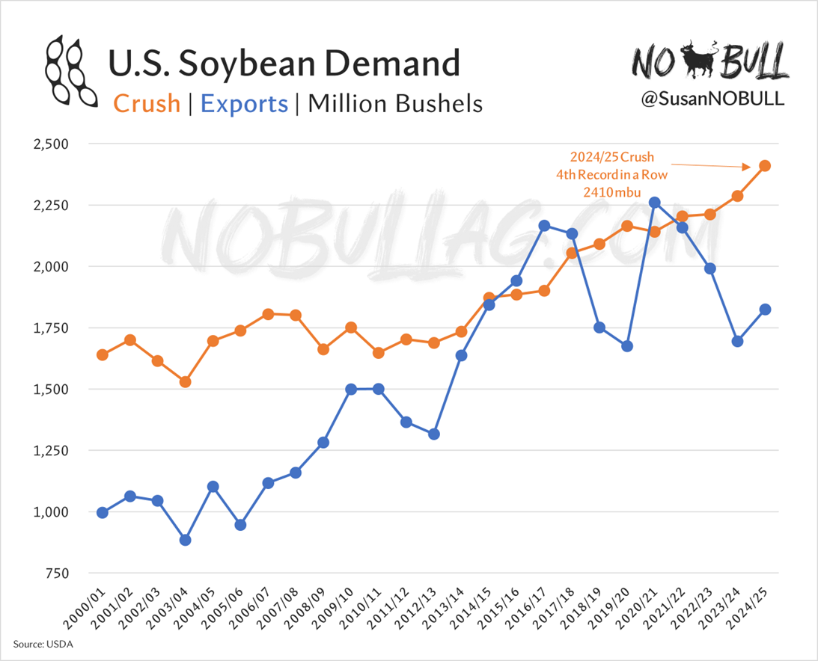
NOBULLAG.COM

Slide 11
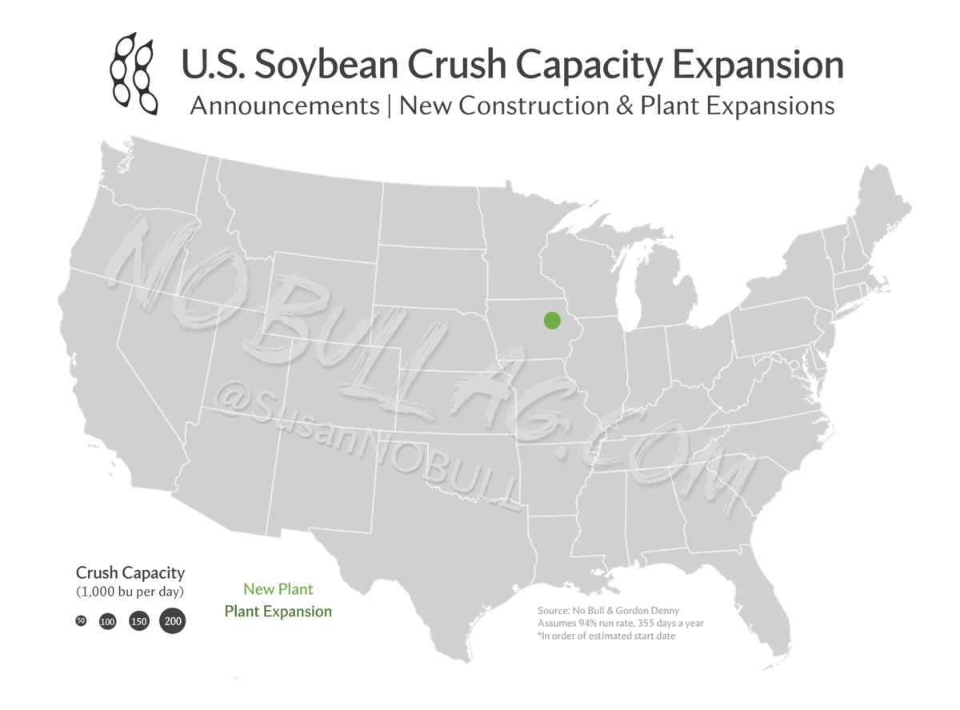
NOBULLAG.COM

Slide 12
Hasta la vista, Emissions
California’s Low Carbon Fuel Standard legislates a reduction in the carbon intensity of transportation fuels sold in or supplied to California
California = $4.1T economy
Spurred a revolution in biomass-based diesel production
Renewable Diesel
‘Drop-in’ fuel, one-for-one replacement
NOBULLAG.COM

Slide 13
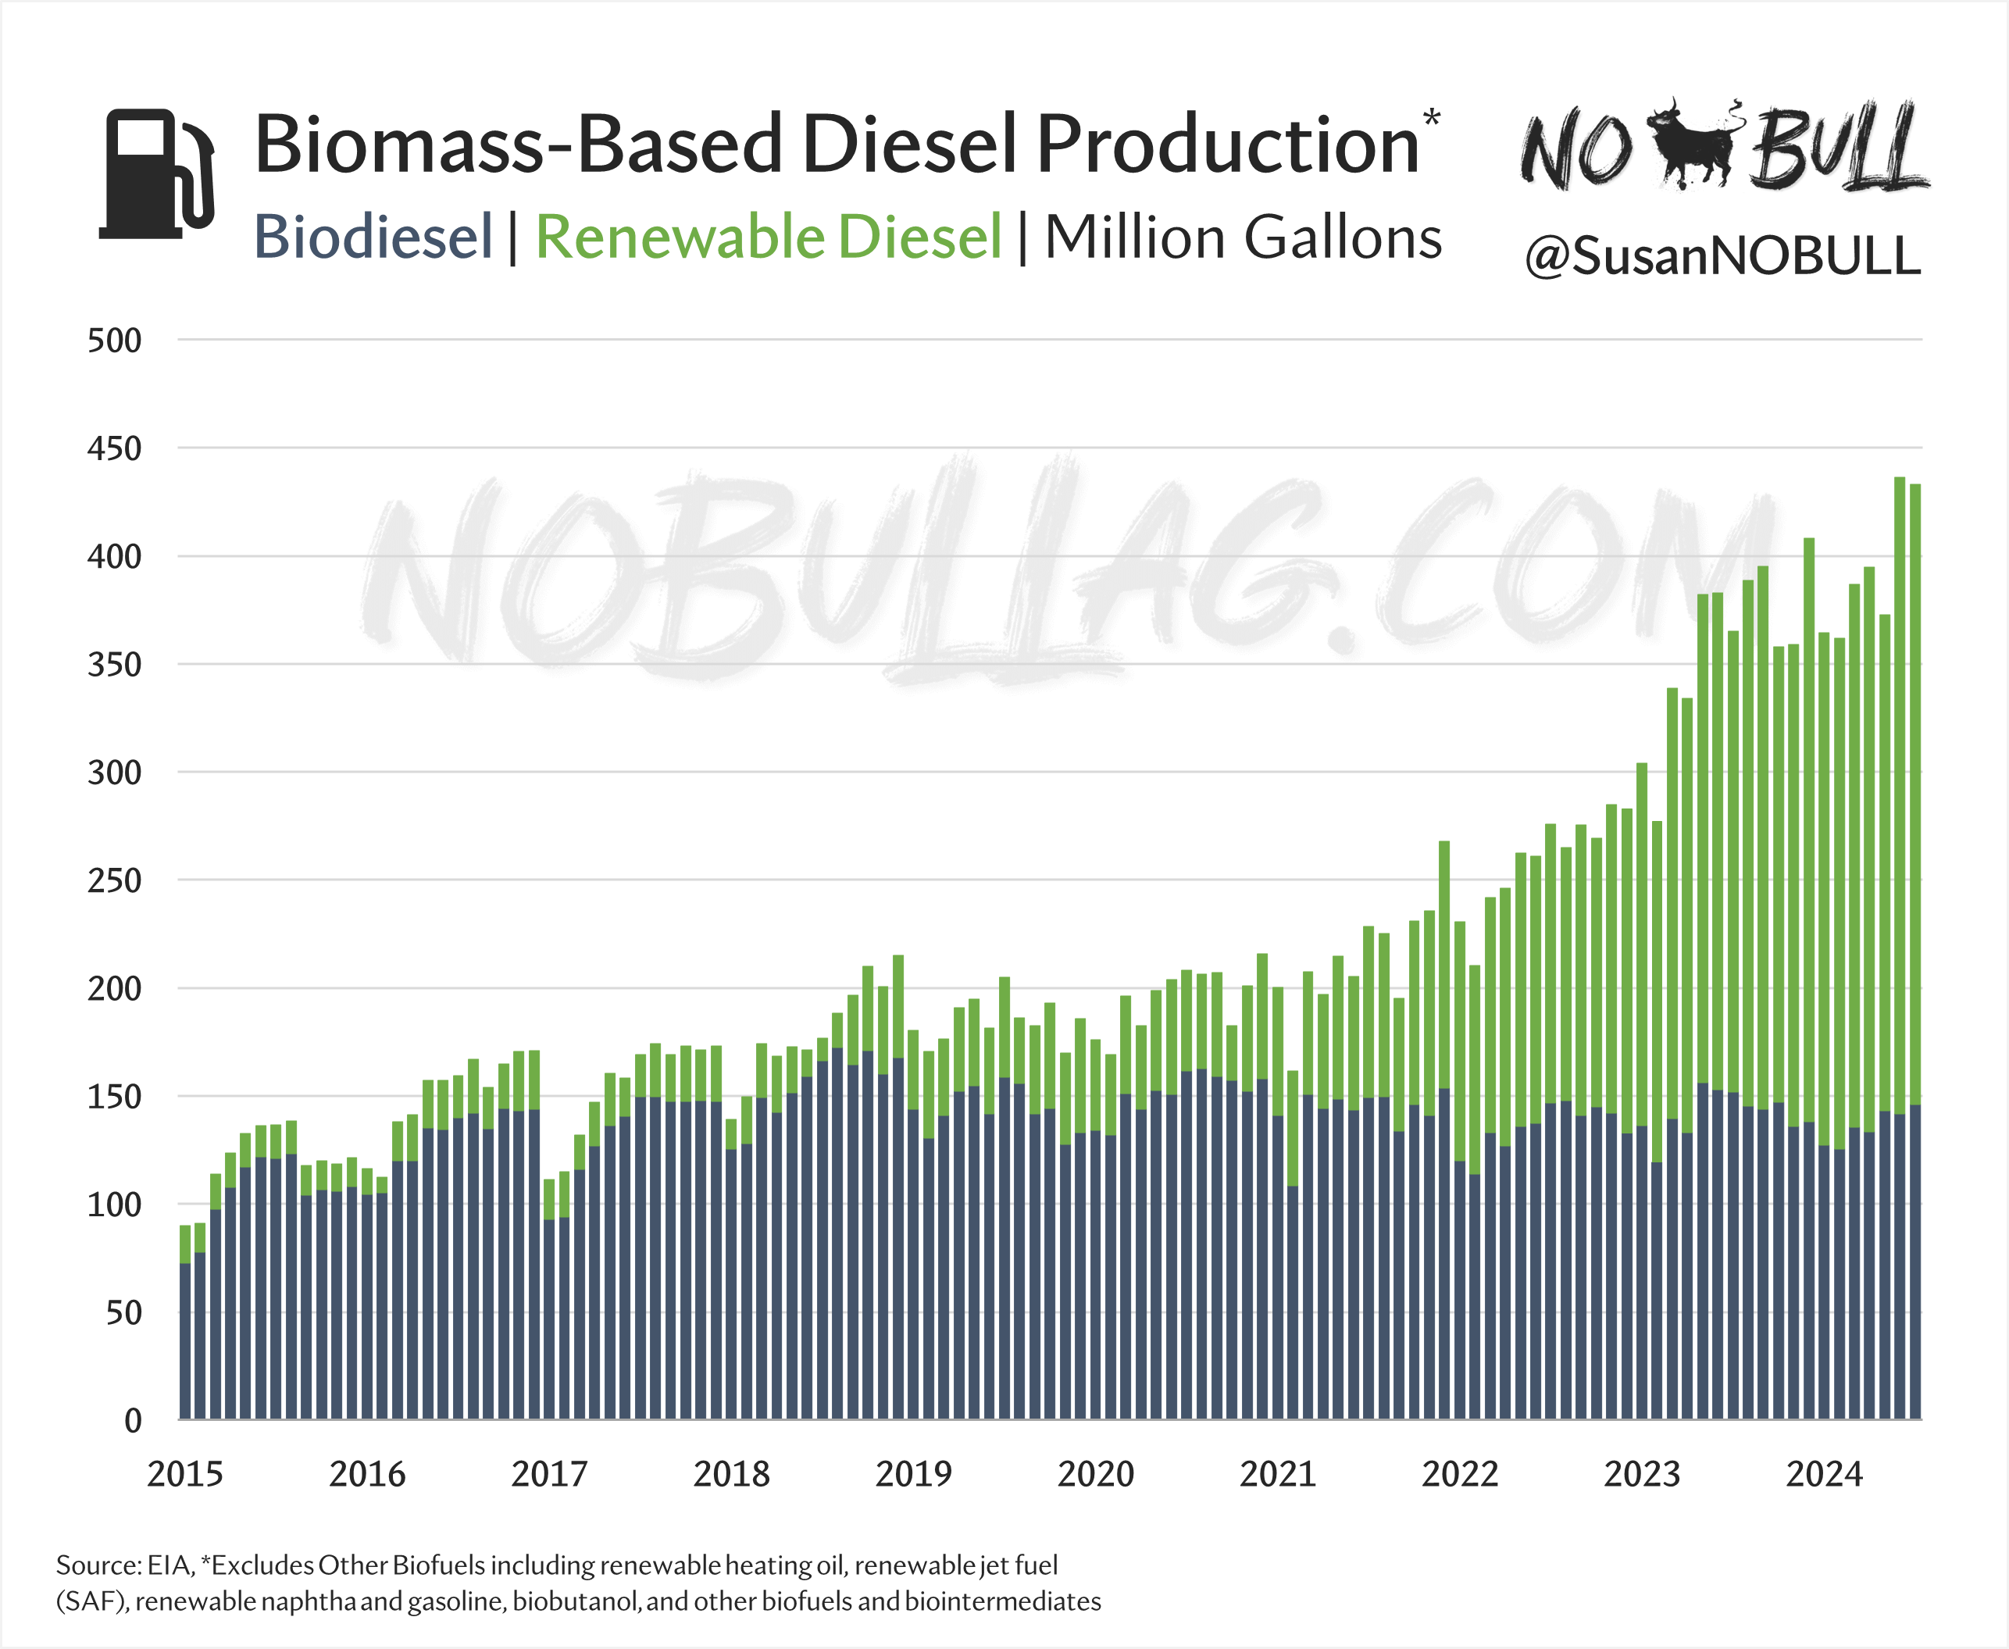
NOBULLAG.COM

Slide 14
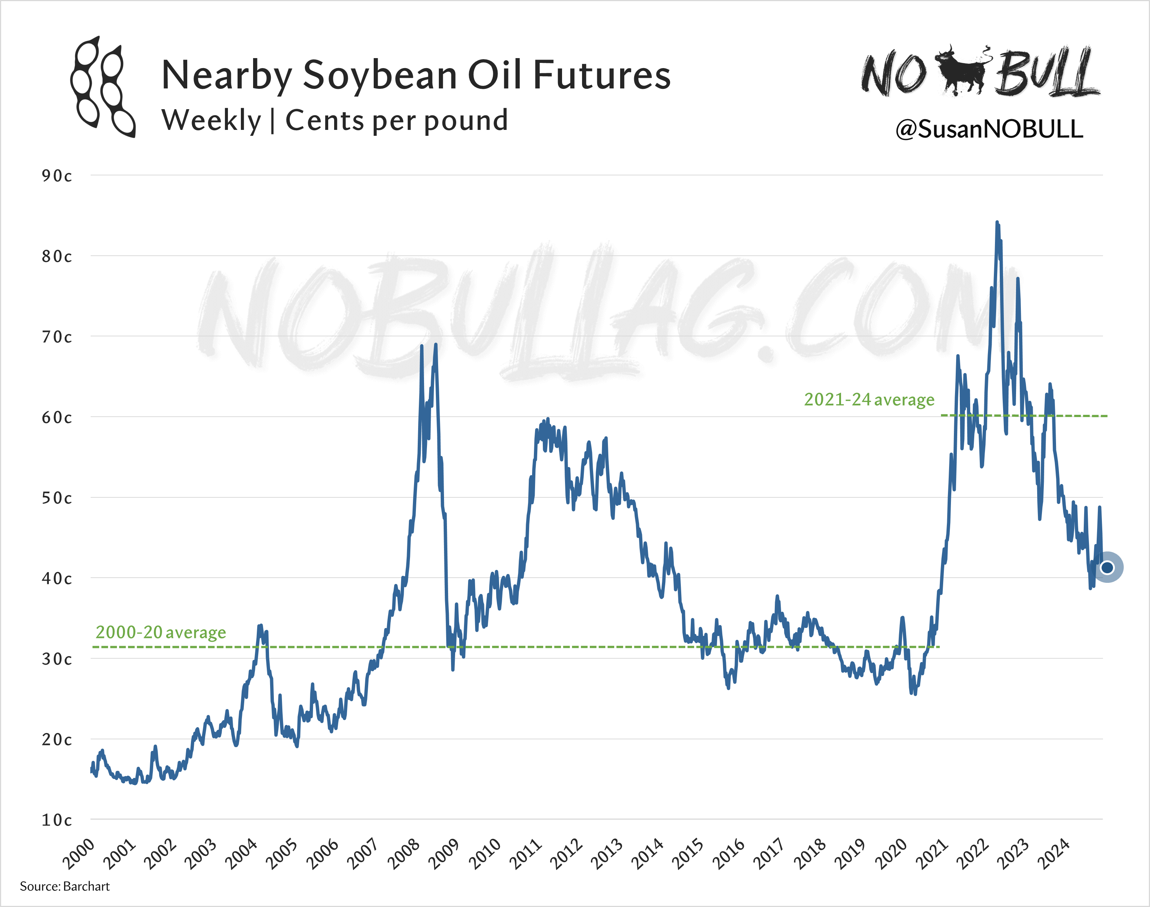
NOBULLAG.COM

Slide 15
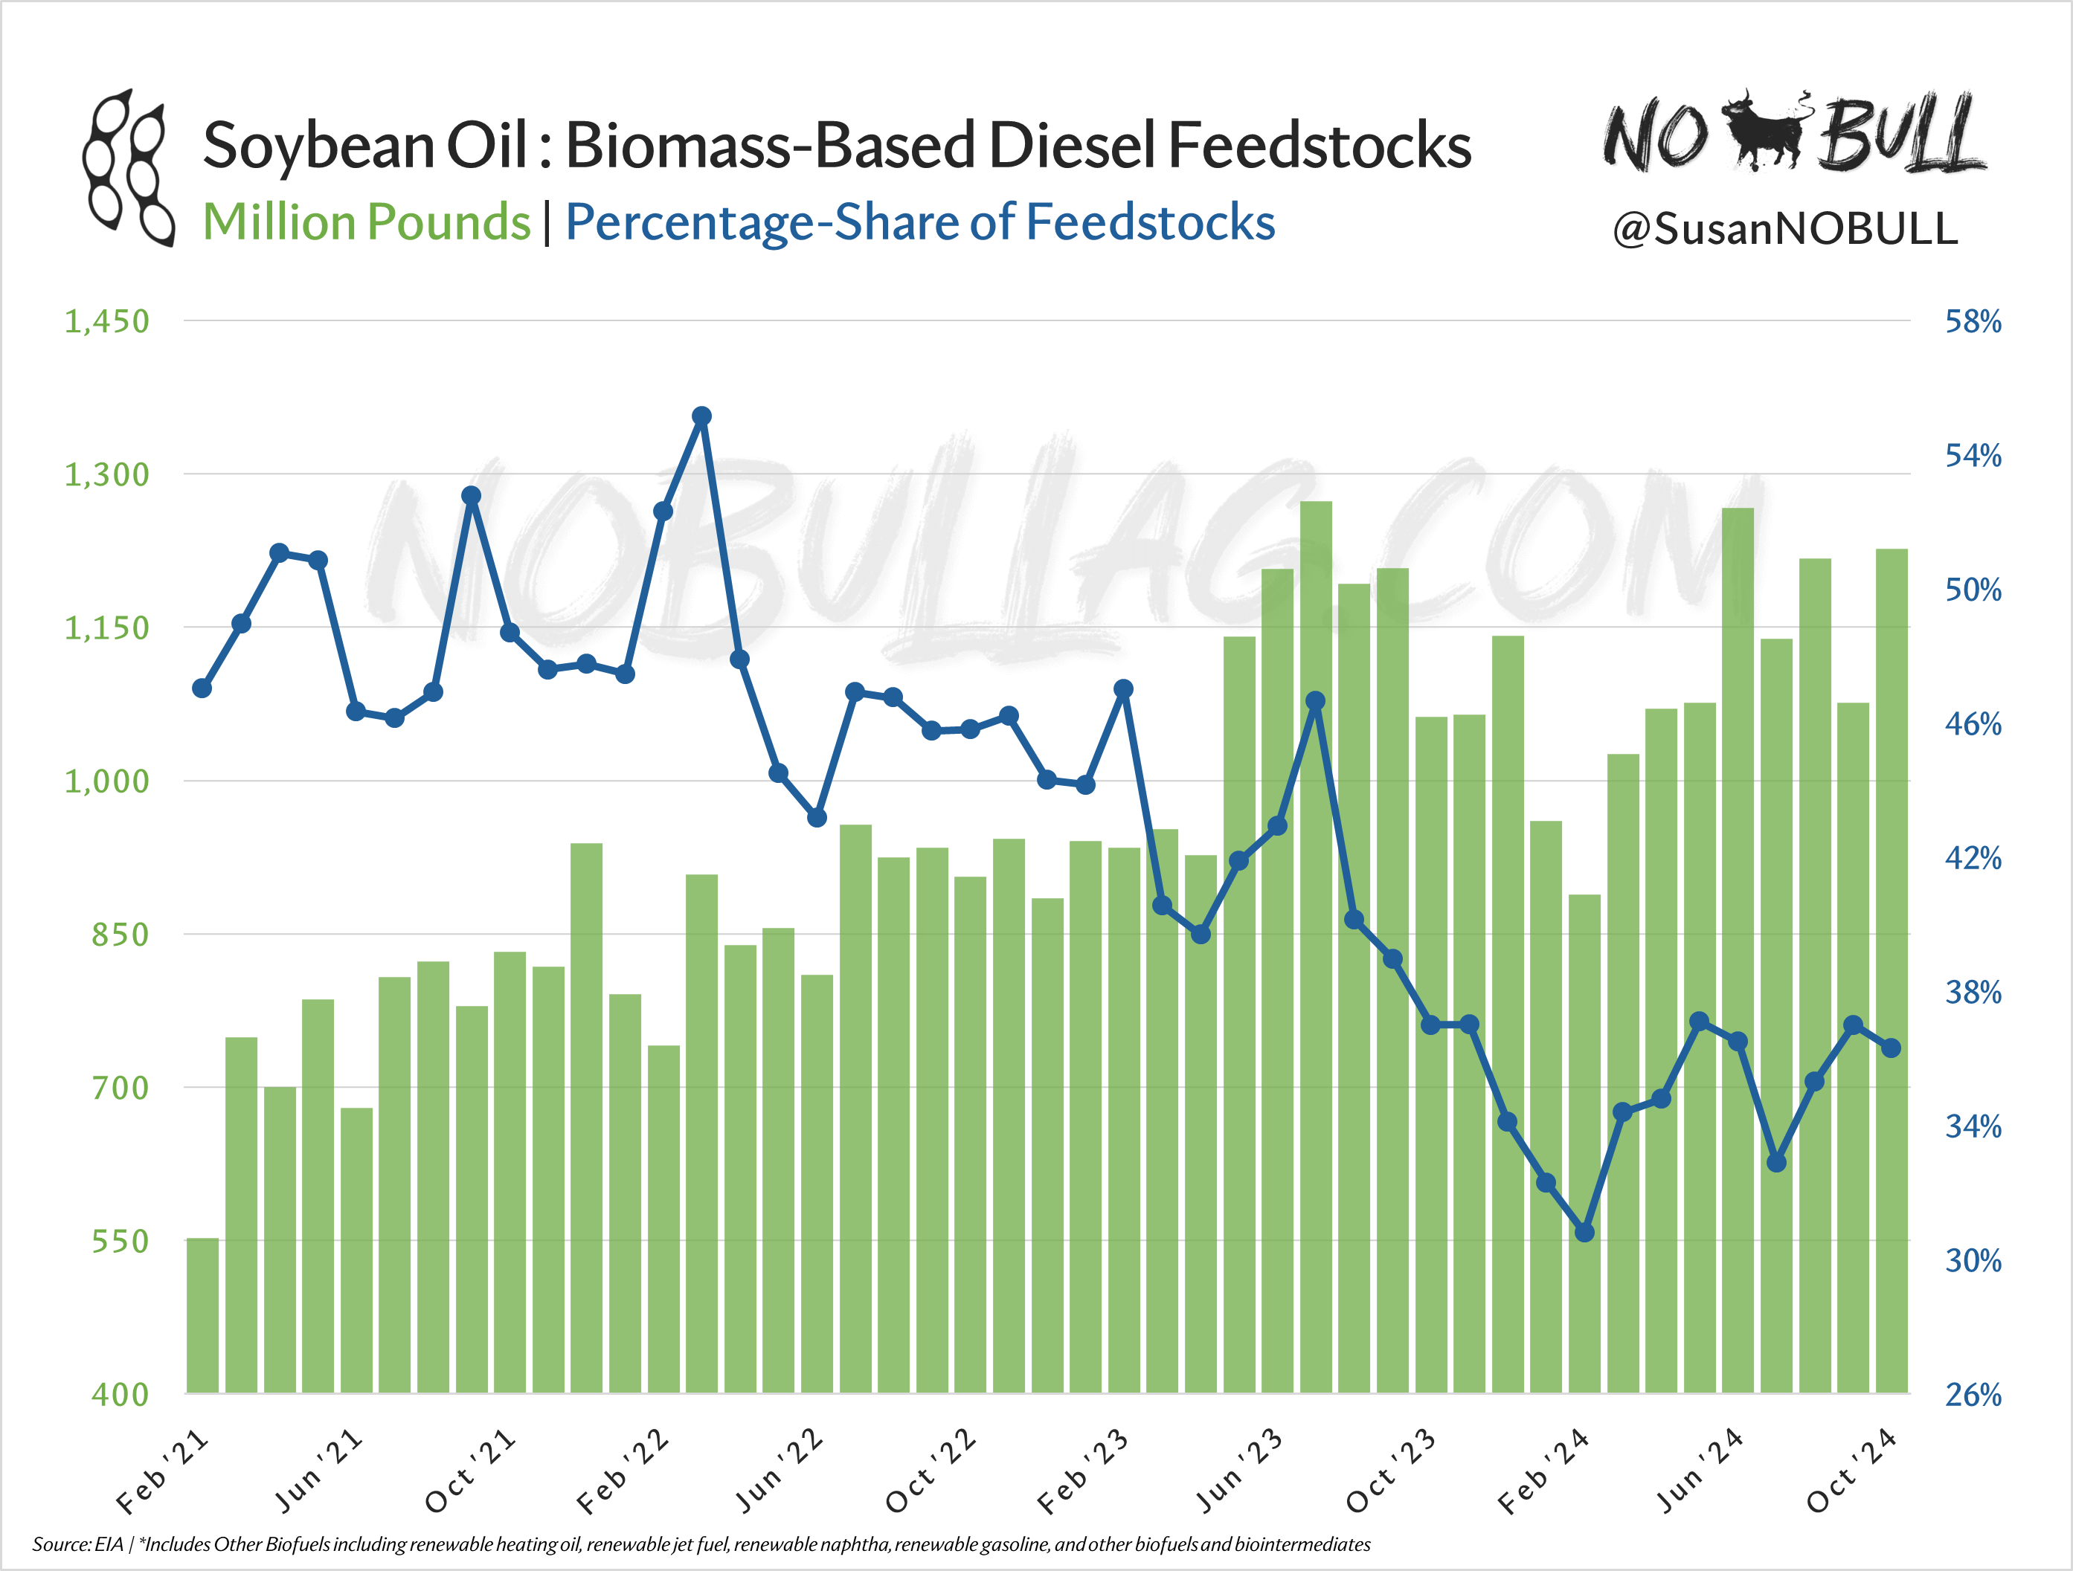
NOBULLAG.COM

Slide 16
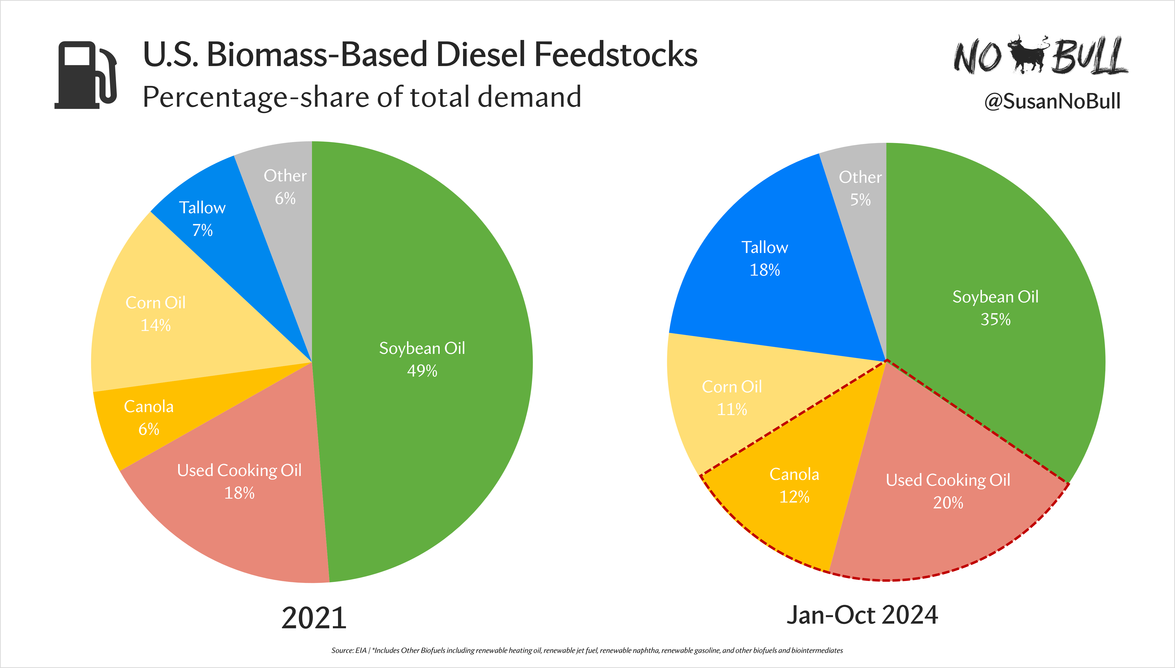
NOBULLAG.COM

Slide 17
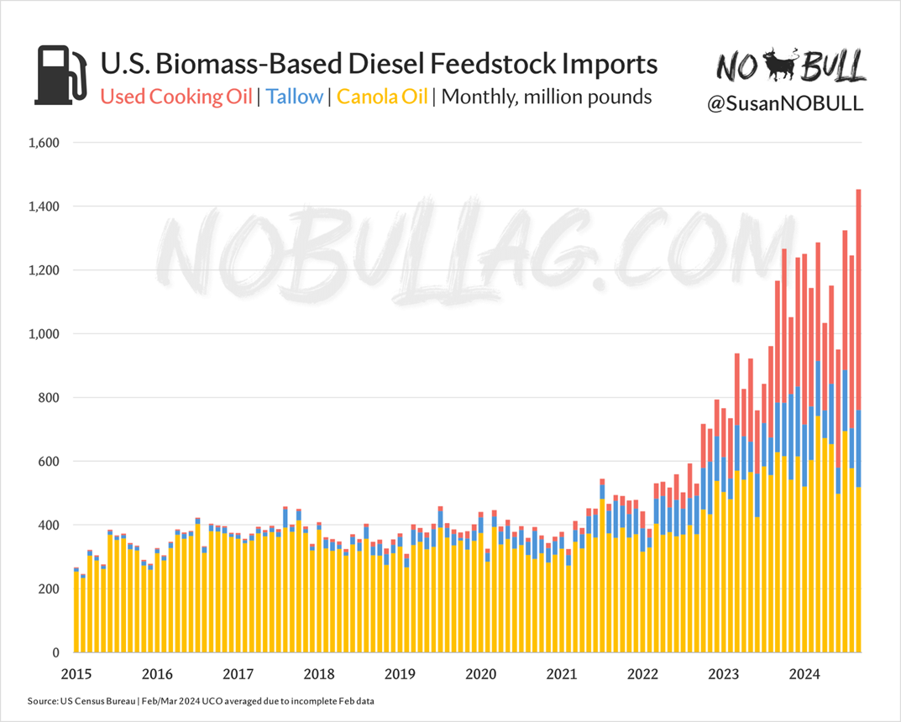
NOBULLAG.COM

Slide 18
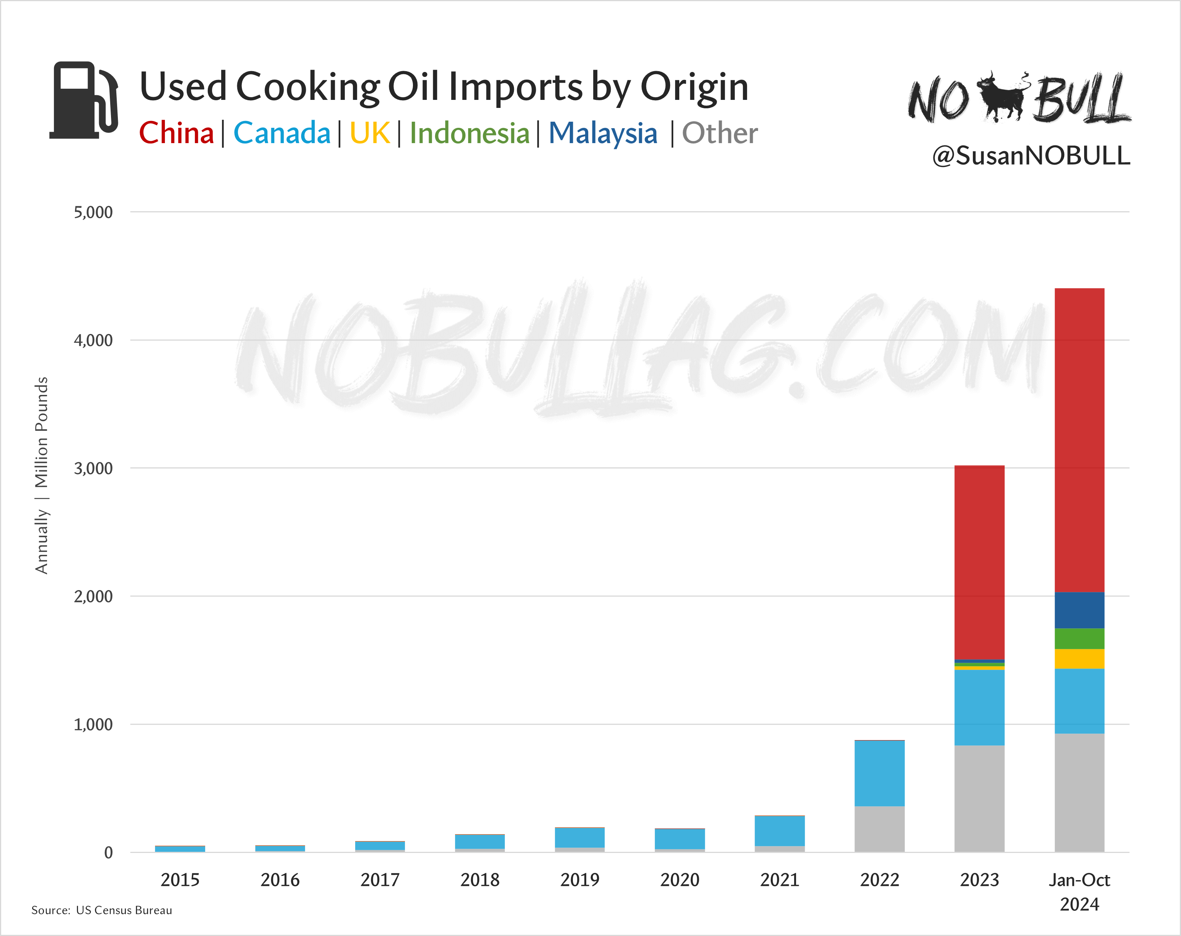
NOBULLAG.COM

Slide 19
Today and
Beyond
NOBULLAG.COM

Slide 20
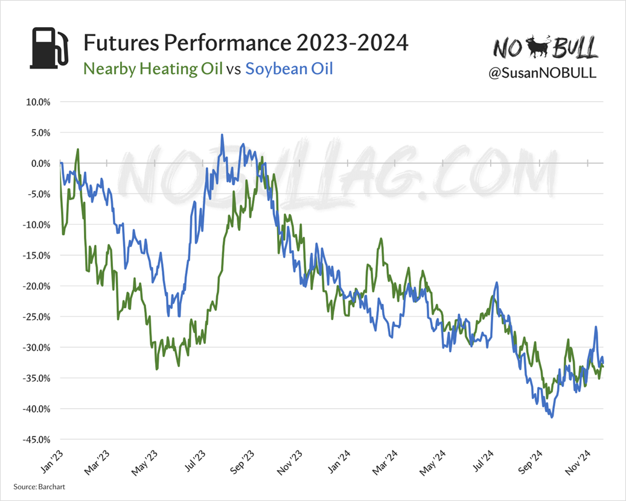
NOBULLAG.COM

Slide 21
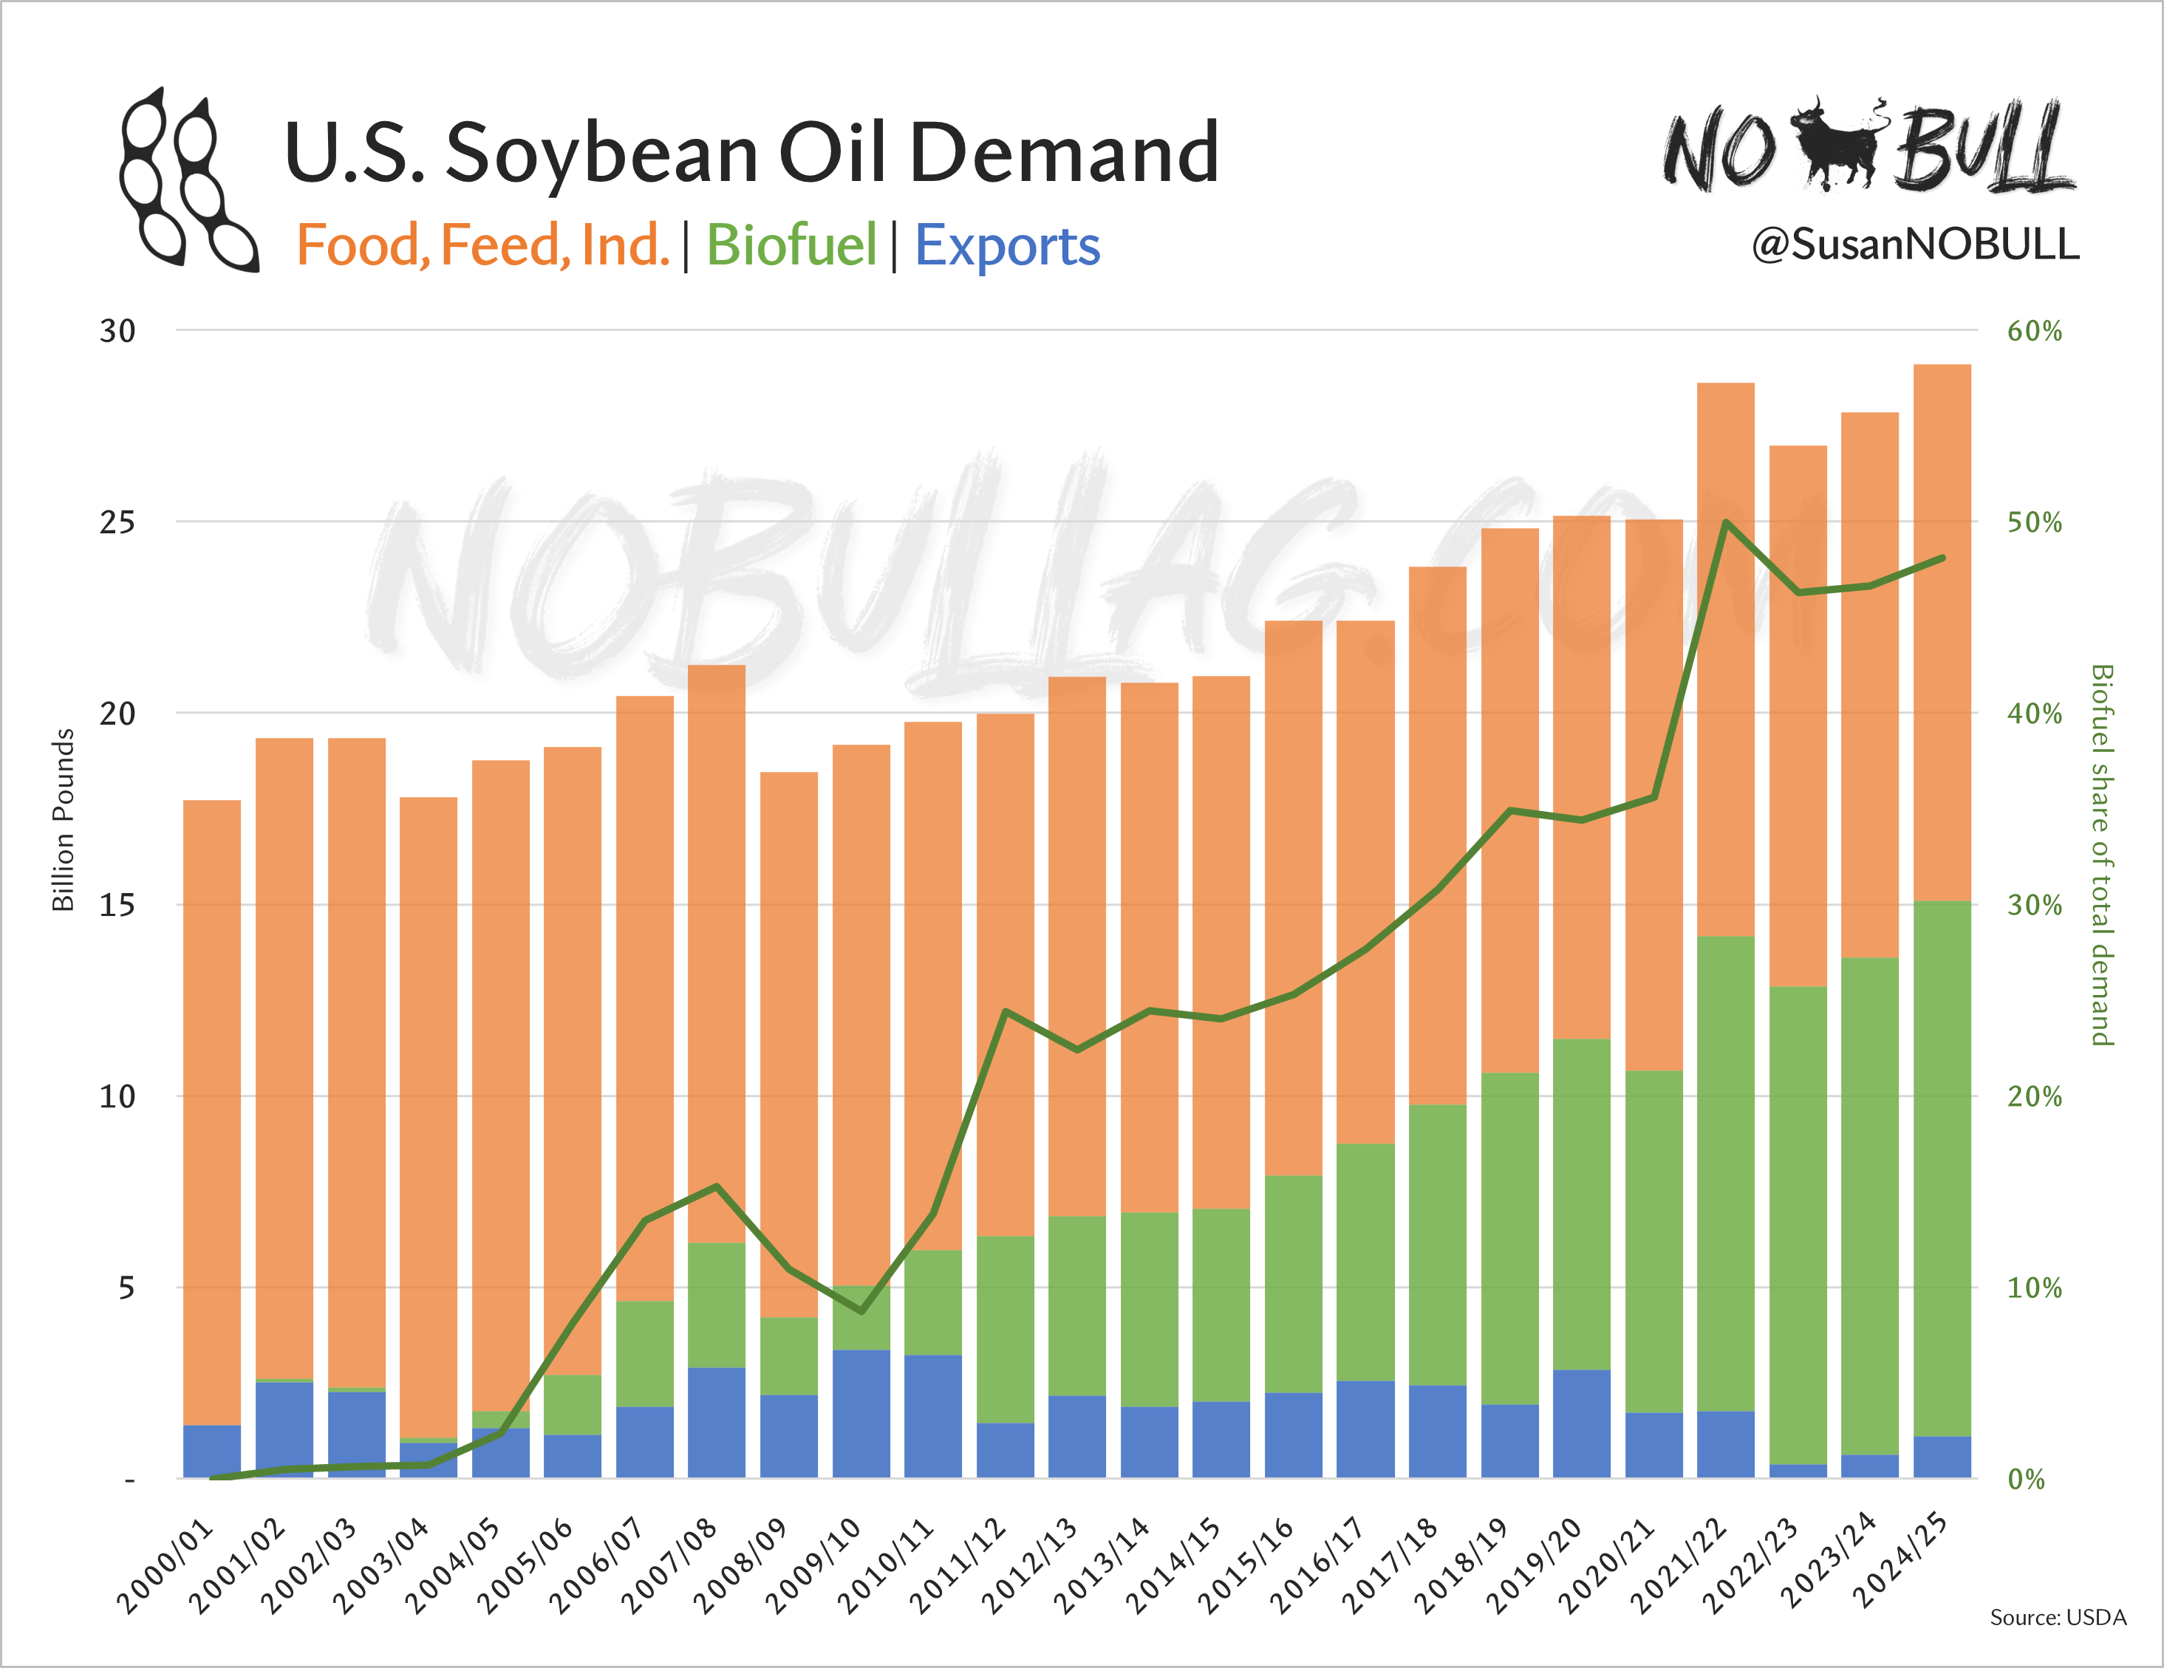
NOBULLAG.COM

Slide 22
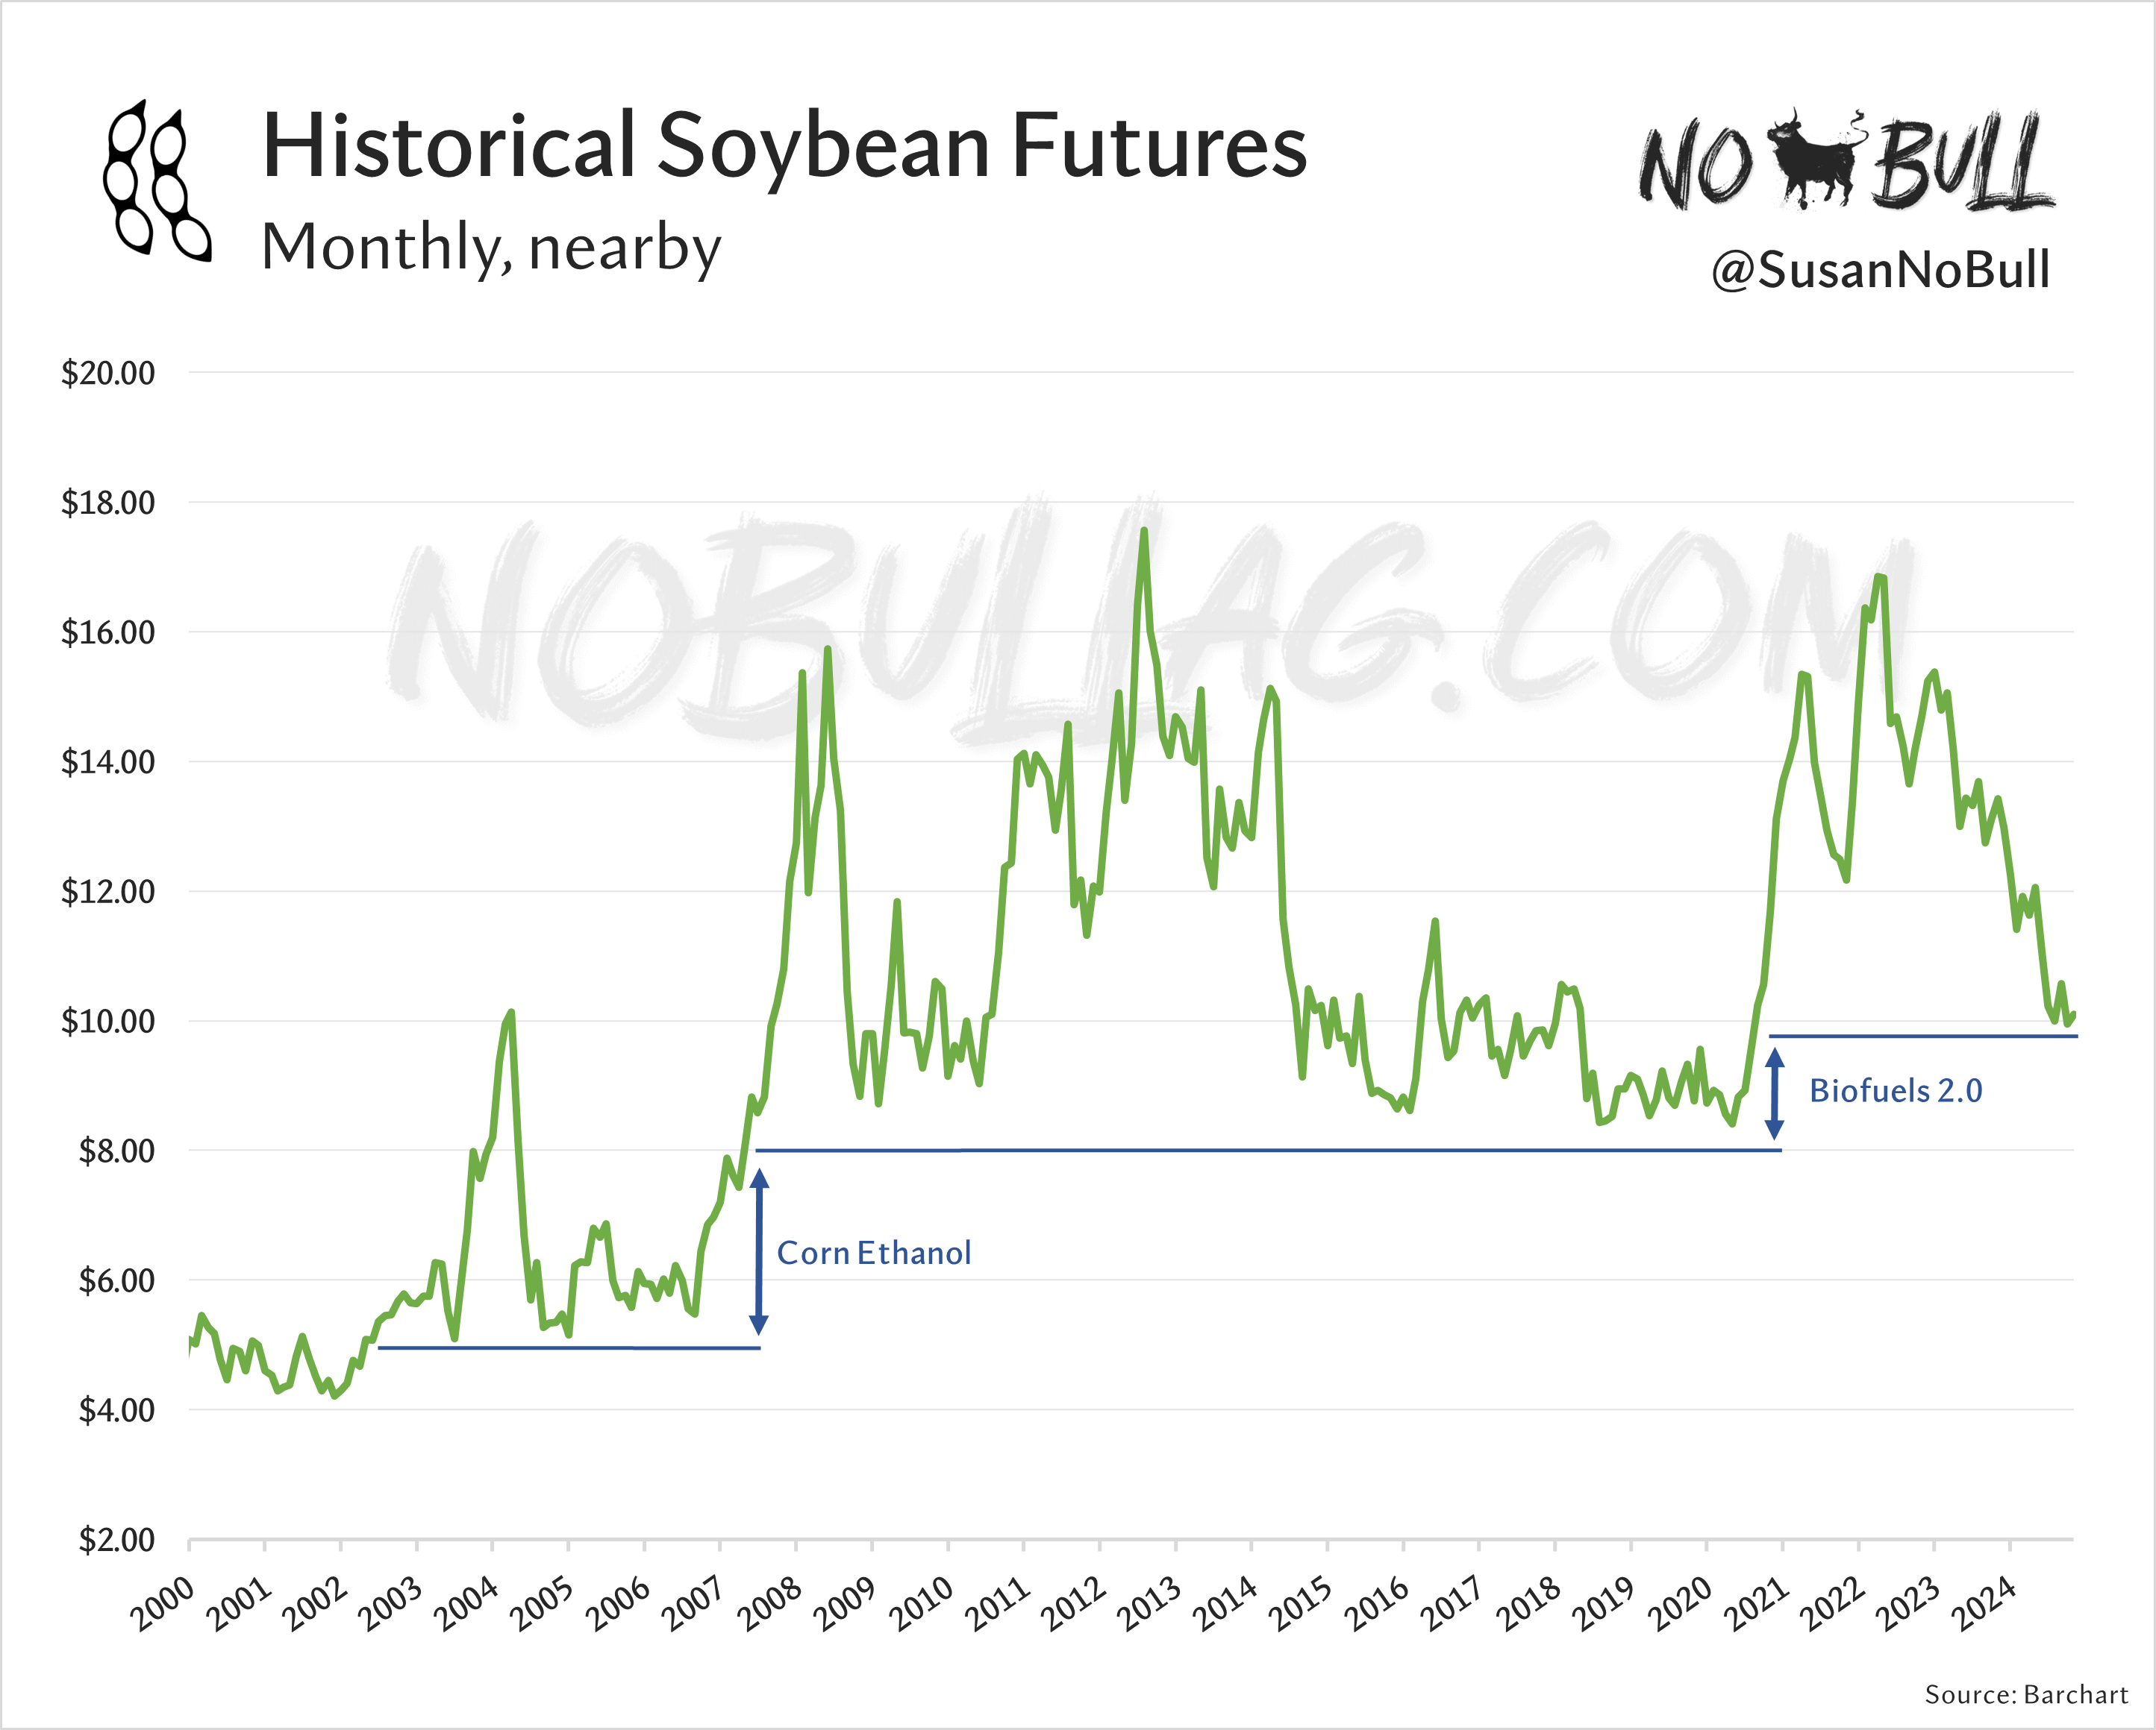
NOBULLAG.COM

Slide 23
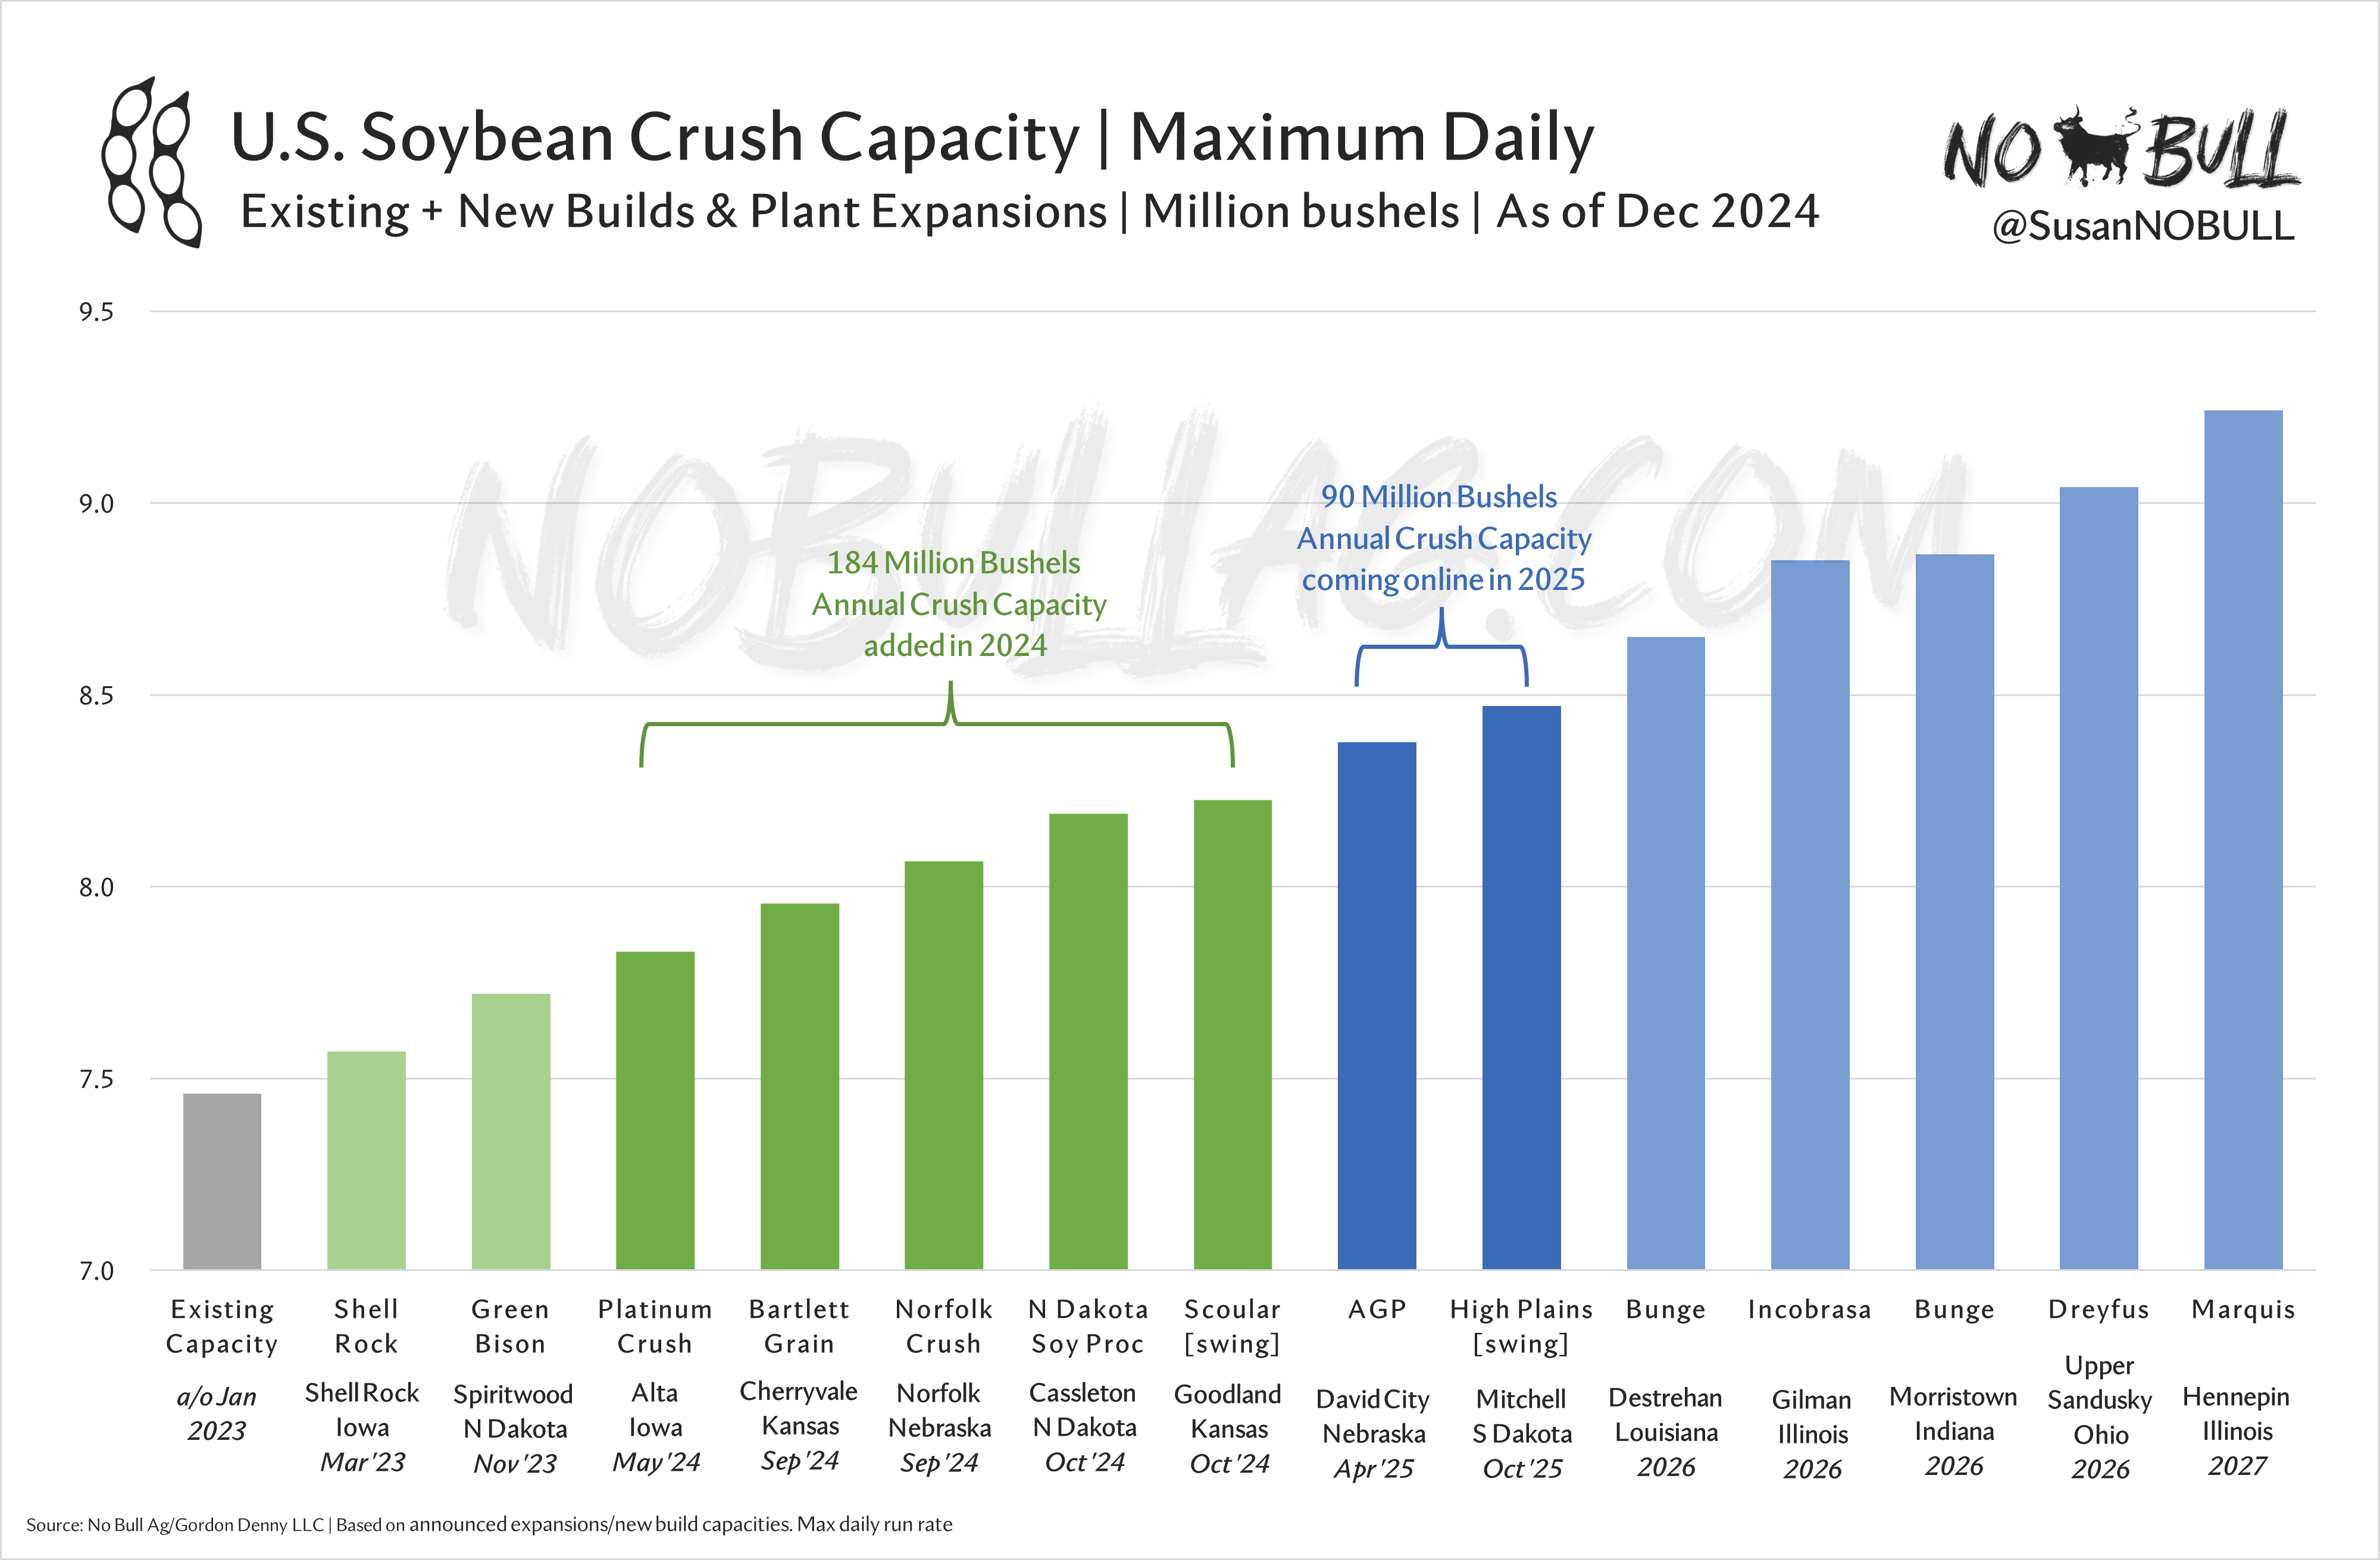
NOBULLAG.COM

Slide 24
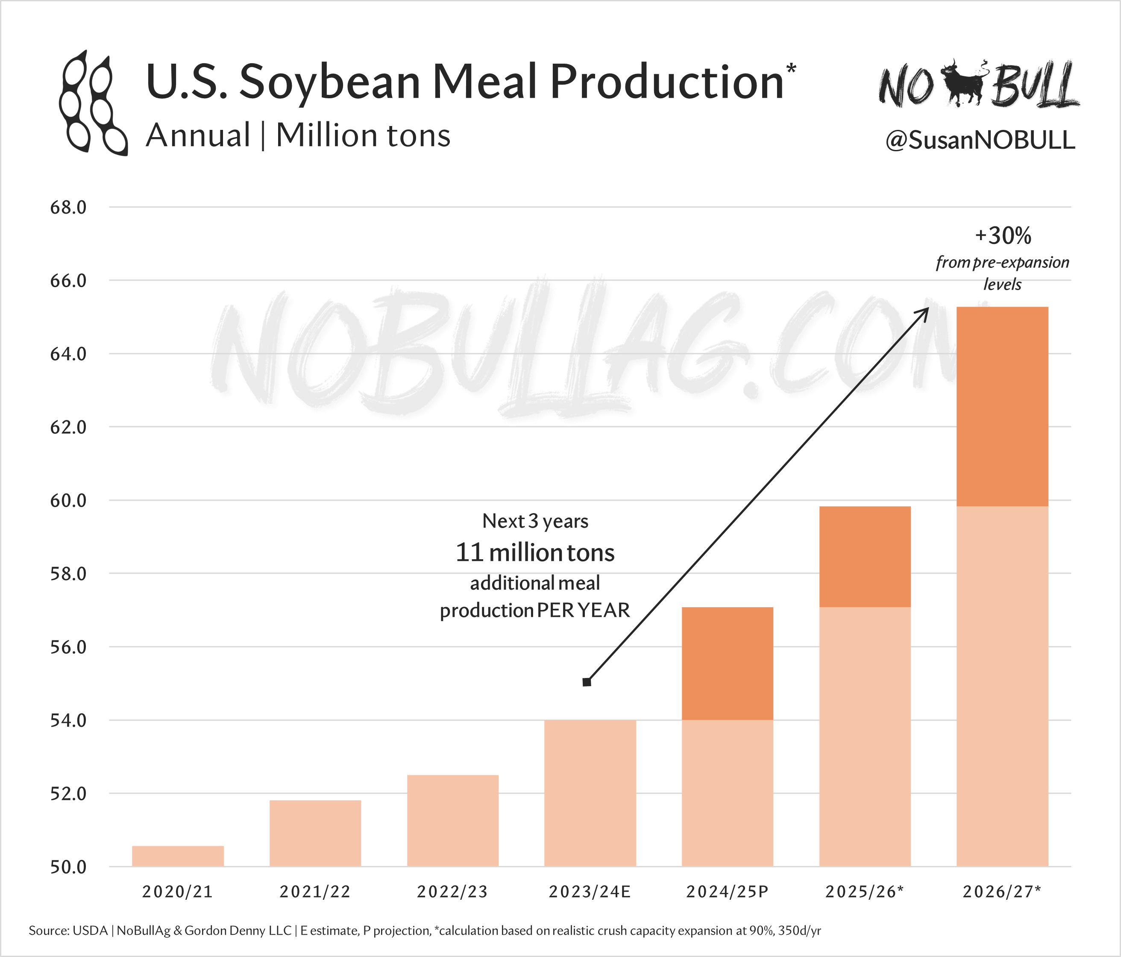
NOBULLAG.COM

Slide 25
NOBULLAG.COM

Slide 26
The government giveth…
…and the government taketh away.
NOBULLAG.COM

Slide 27
What is the 45Z Clean Fuel Production Credit?
Part of Inflation Reduction Act
Replaces long-standing 40A $1 blending tax credit
Credits awarded on a sliding scale based on the fuel’s carbon intensity reduction
Waste products like UCO and tallow = largest credits
Crop-based biofuels = smaller credits (higher CI)
Imported canola oil & UCO excluded
NOBULLAG.COM

Slide 28
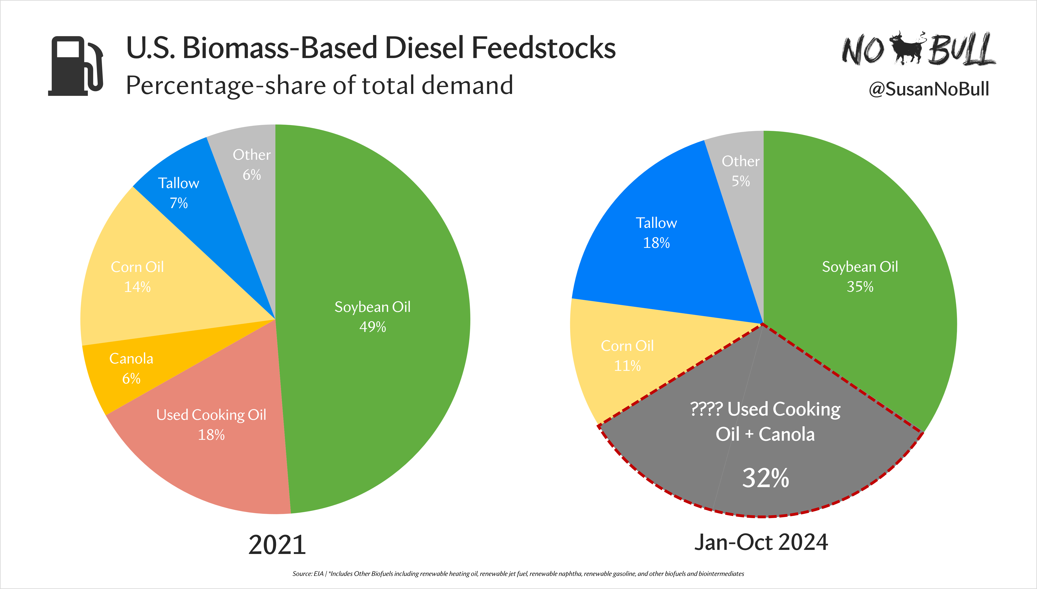
NOBULLAG.COM

Slide 29
45Z Implications
>12B lbs annual UCO & canola oil feedstock demand
Fuel imports likely plummet (18% of U.S. supplies)
Massive reshuffling/market adjustment
Soybean oil still commands smallest subsidy, but will win by default
NONE of this is final, only PROPOSED
NEW ADMINISTRATION IN OFFICE TODAY
NOBULLAG.COM

Slide 30
The
Trump
Factor
Tariffs…
Canola…
IRA in limbo?
Renewable Fuel Standard…
NOBULLAG.COM

Slide 31
NOBULLAG.COM

Slide 32
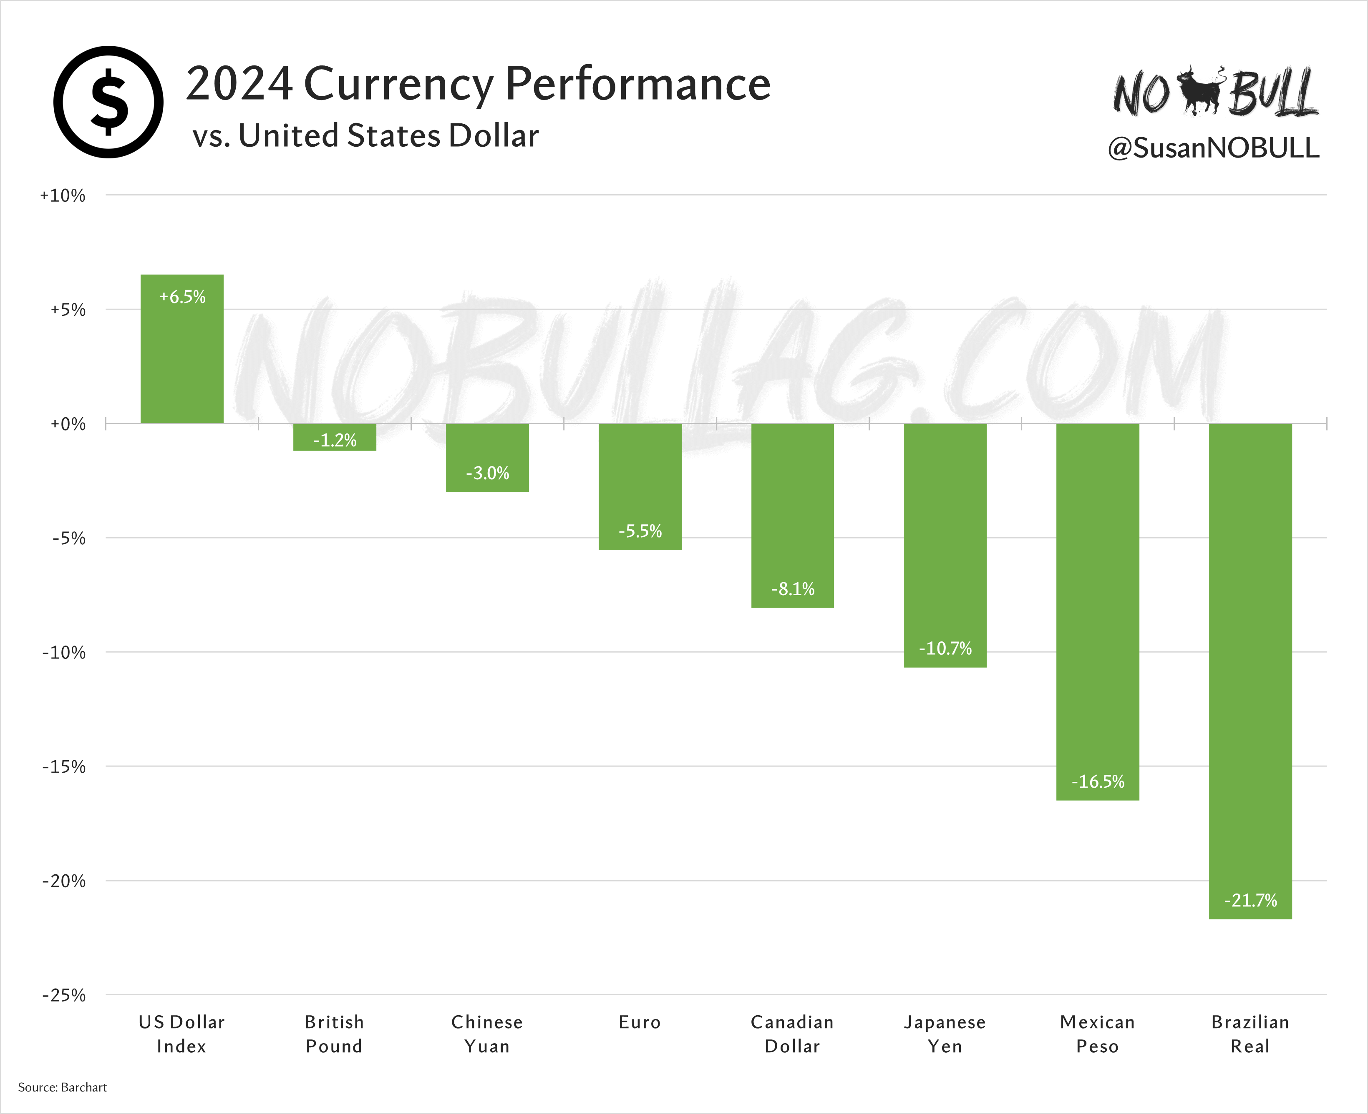
NOBULLAG.COM

Slide 33
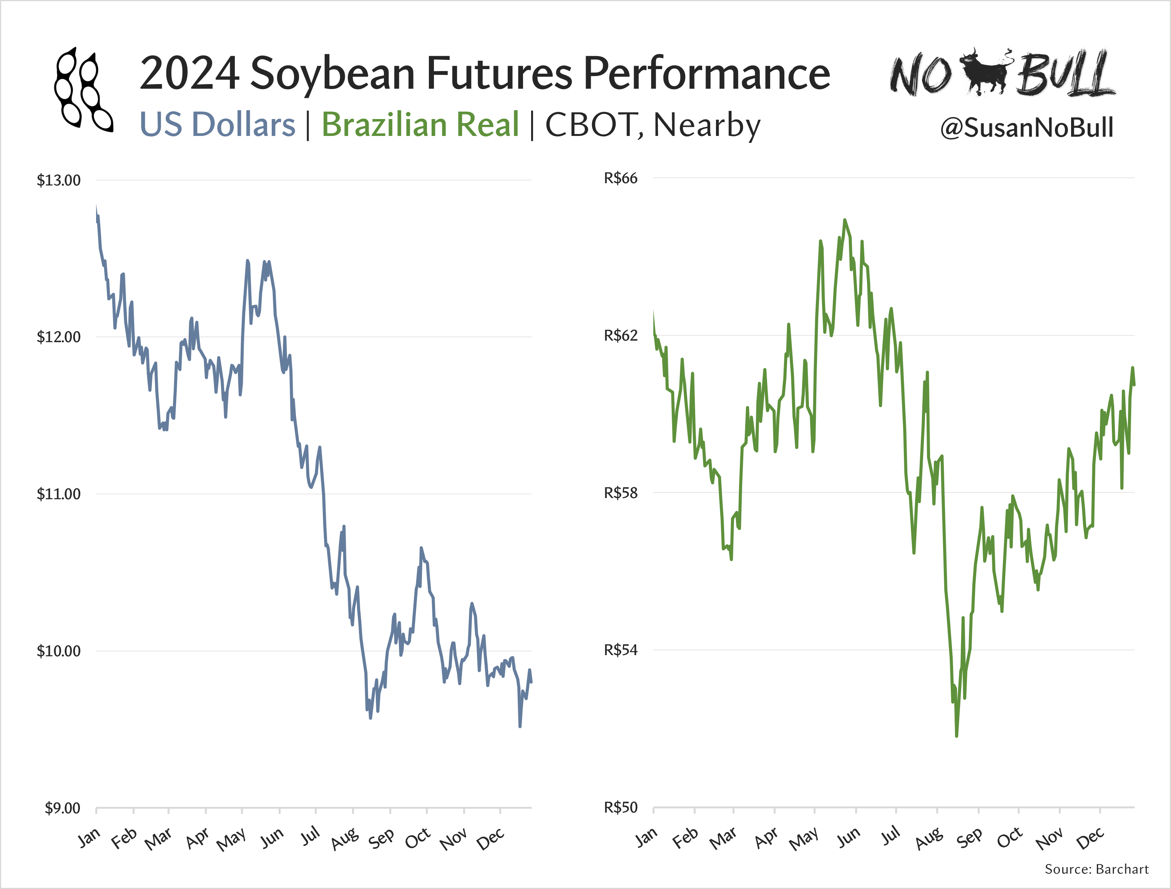
NOBULLAG.COM

Slide 34
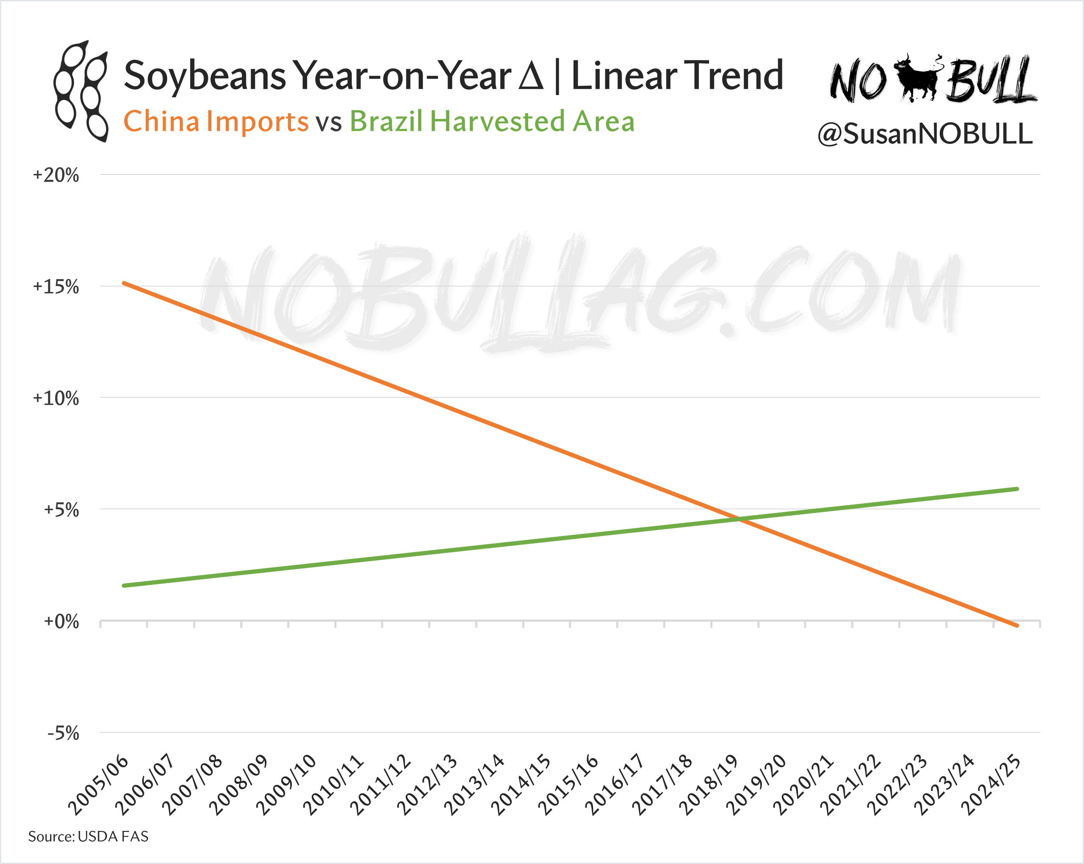
NOBULLAG.COM

Slide 35
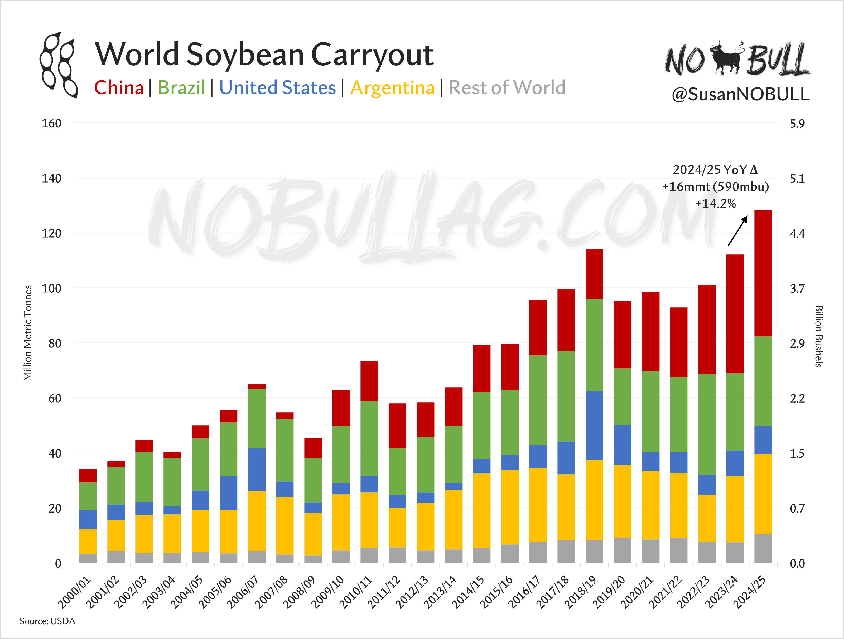
NOBULLAG.COM

Slide 36
Looking Ahead | Soybeans
We aren’t running out of beans
Brazil production growth outpacing Chinese demand growth
Longer term: world protein demand growth
Soybean oil will continue to be a market driver… (↑/↓)
Policy is more important than ever before
Growing global mandates = supportive to veg oils (with limits)
A new year… new rules & a new administration
Risk management is more important than ever
NOBULLAG.COM

Slide 37
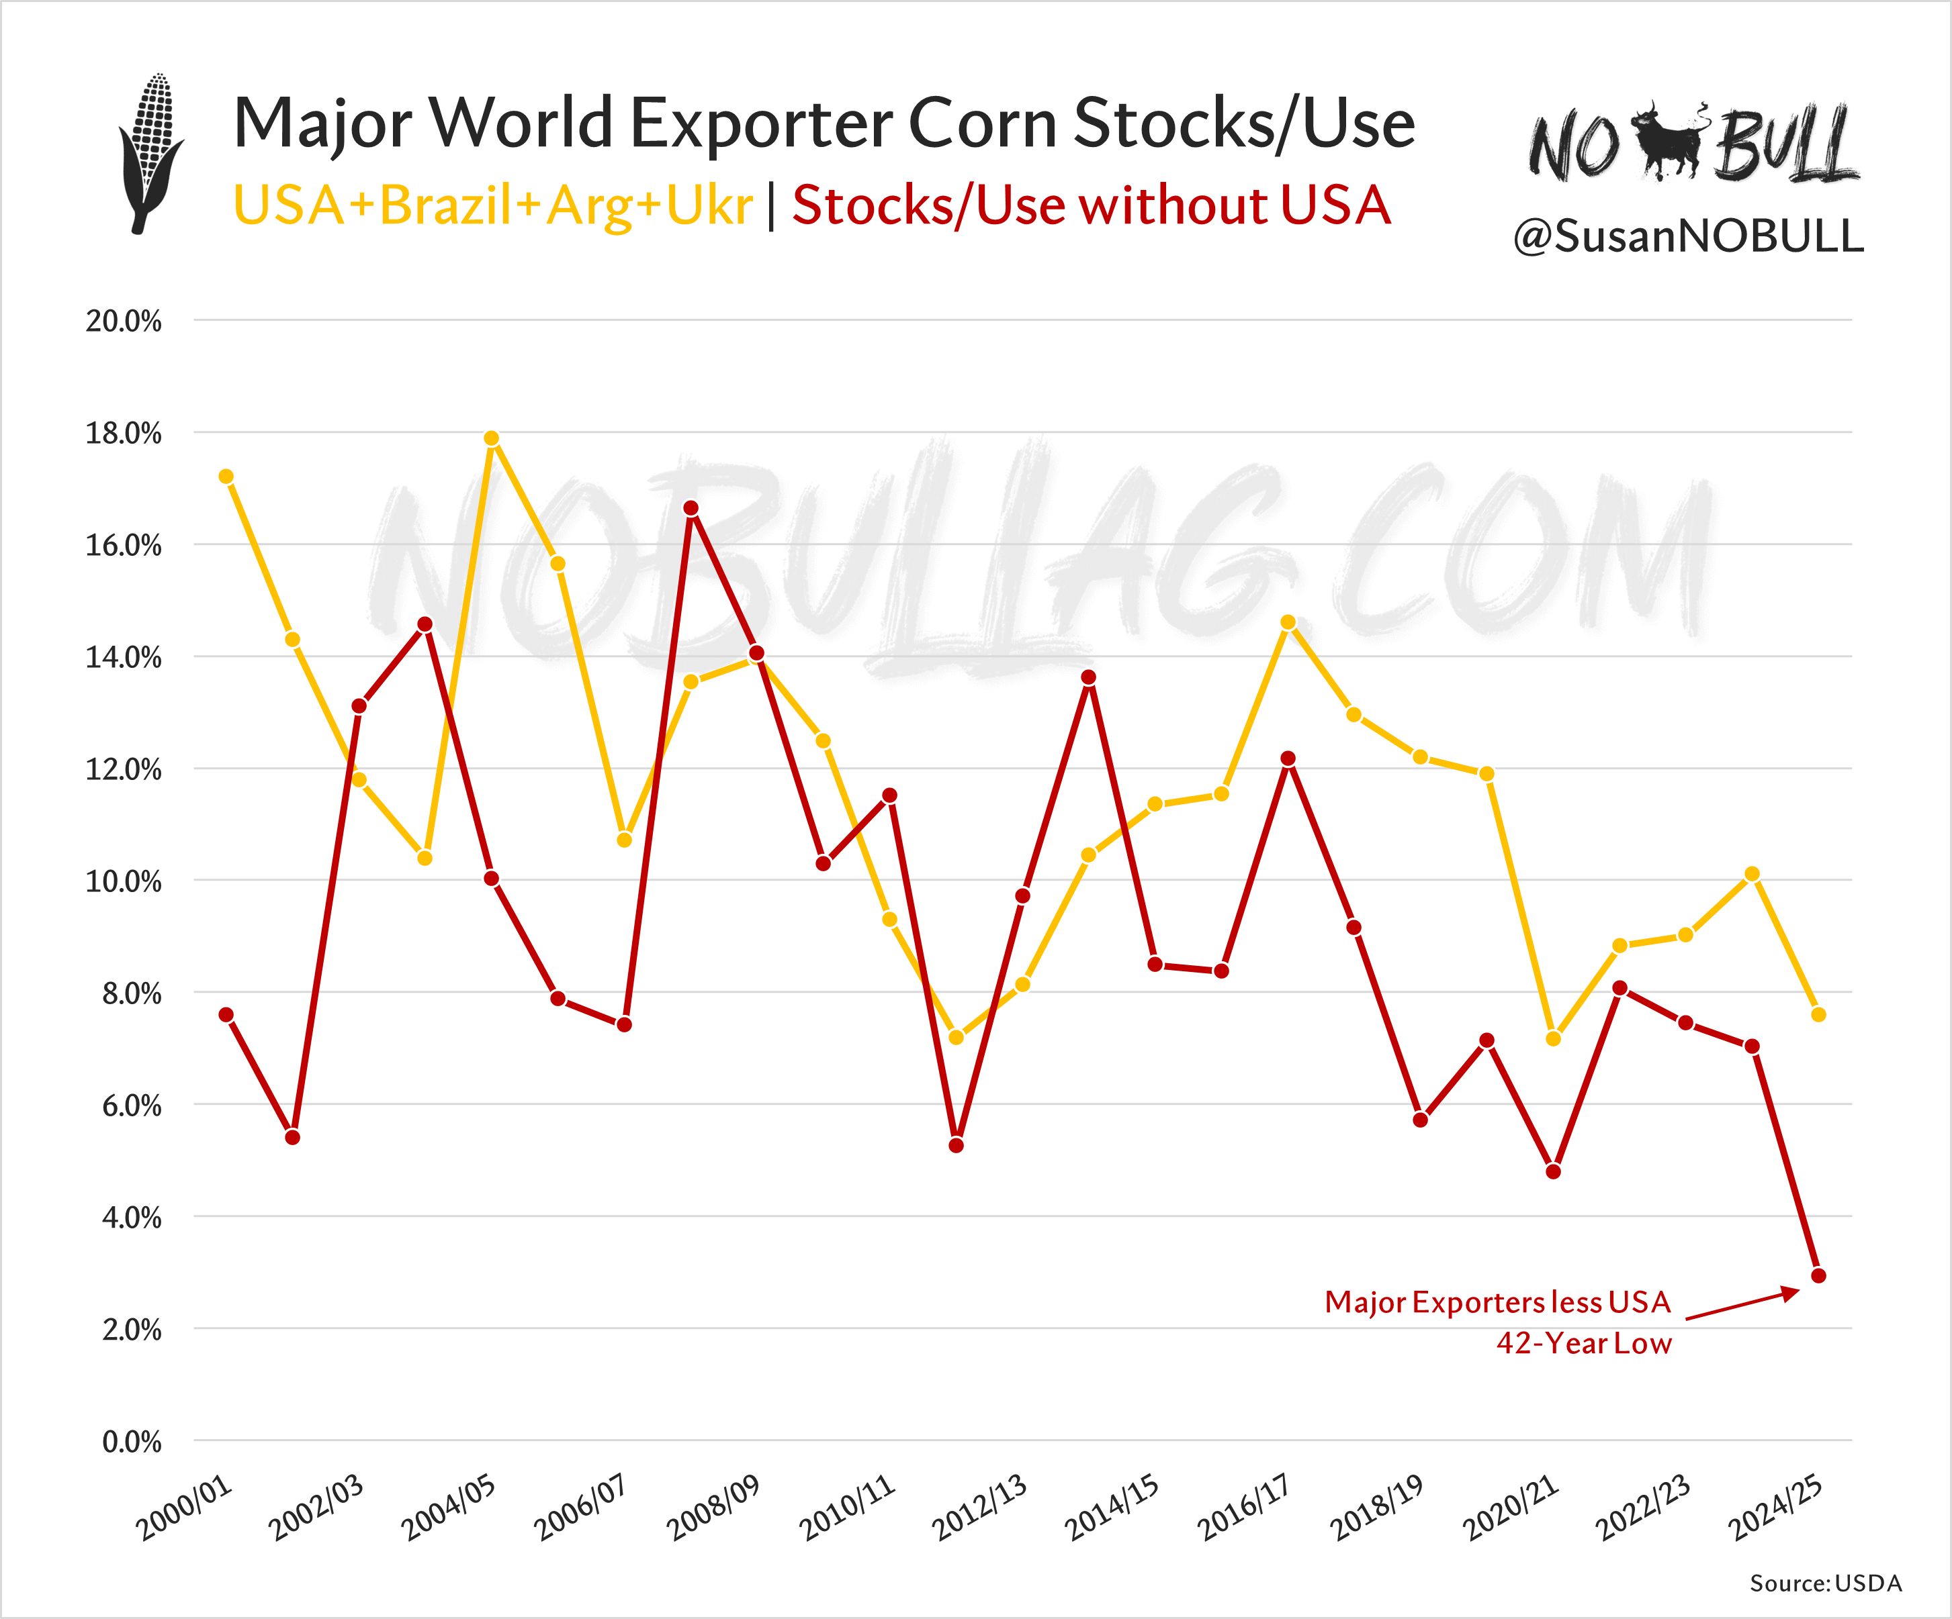
NOBULLAG.COM

Slide 38
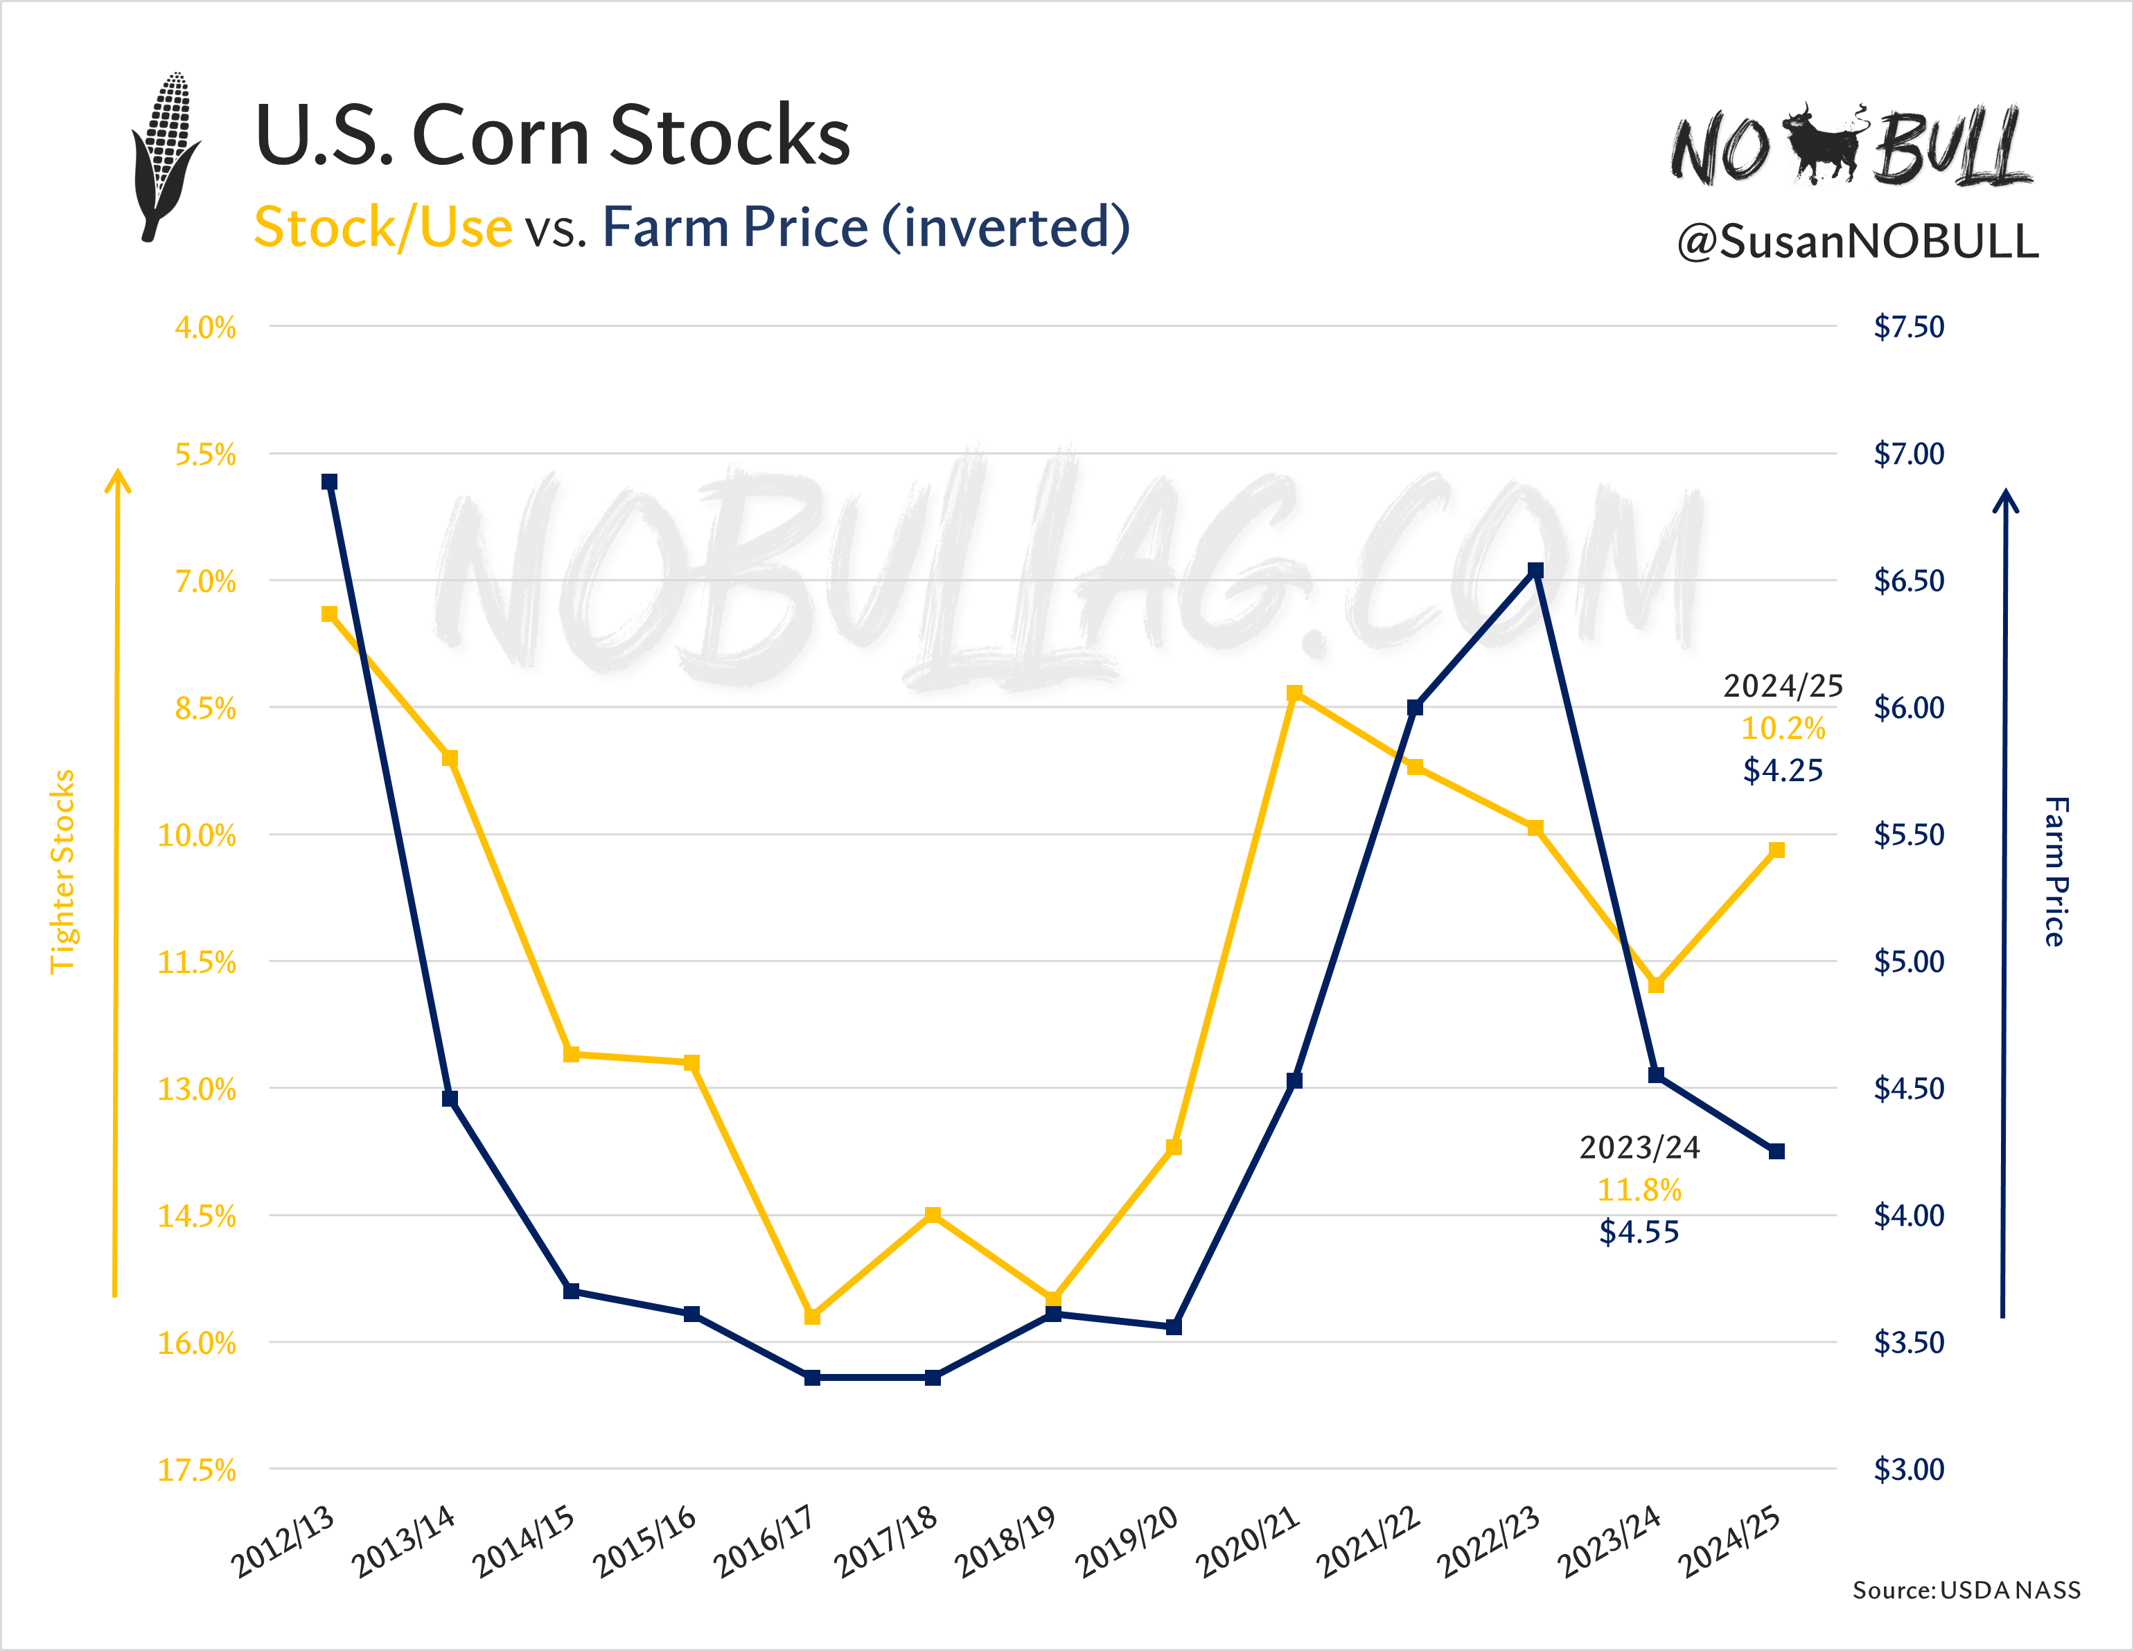
NOBULLAG.COM

Slide 39
Looking Ahead | Corn
The U.S. is currently winning by default
Strong demand, smaller US crop + Argentina weather supportive
We price things FAST
Policy is more important than ever before
Global biofuel expansion is supportive (i.e. India, Brazil, etc.)
U.S. Ethanol exports at risk
Opportunities with SAF but policy must be there first
Risk management is more important than ever
NOBULLAG.COM

Slide 40
NOBULLAG.COM

Slide 41
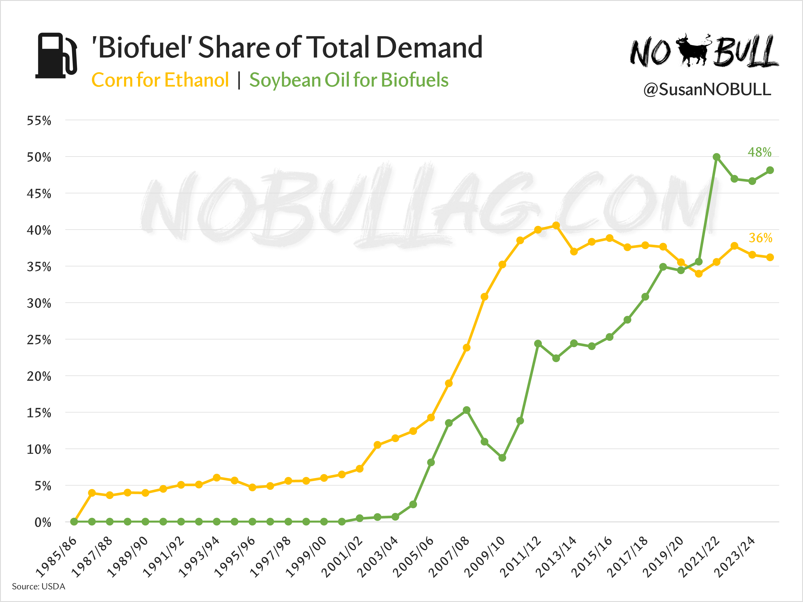
NOBULLAG.COM

Slide 42
“The greatest opportunities in business lie in recognizing the potential of change.”
Peter Drucker
NOBULLAG.COM

Slide 43
Thank You
NOBULLAG.COM
THIS IS A SOLICITATION. Reproduction or rebroadcast of any portion of this information is strictly prohibited without written permission. The information reflected herein is derived from sources believed to be reliable; however, this information is not guaranteed as to its accuracy or completeness. In an effort to combat misleading information, No Bull has performed its due diligence to ensure that all material information is provided within this report, though specific information related to your investment, hedging or speculative situation may not be included. Opinions expressed are subject to change without notice. This company and its officers, directors, employees and affiliates may take positions for their own accounts in contracts referred to herein. Trading futures involves risk of loss. Past performance is not indicative of future results.
NOBULLAG.COM

