Slide 1
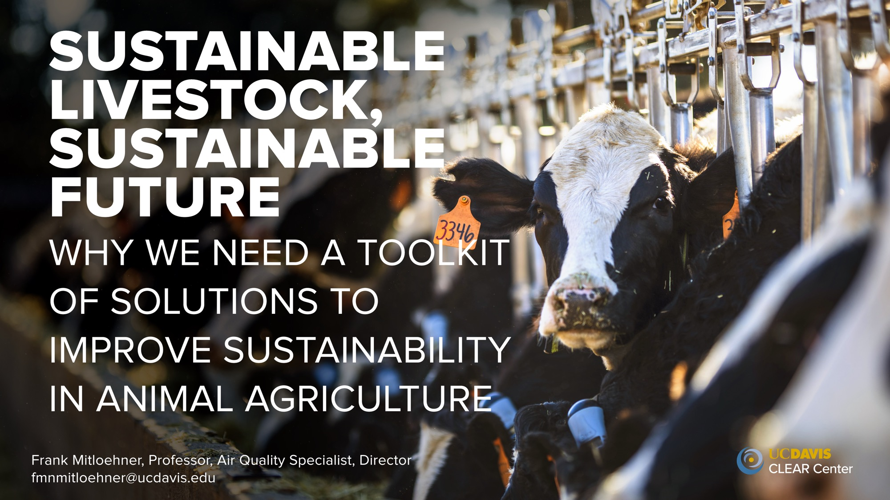

Slide 2
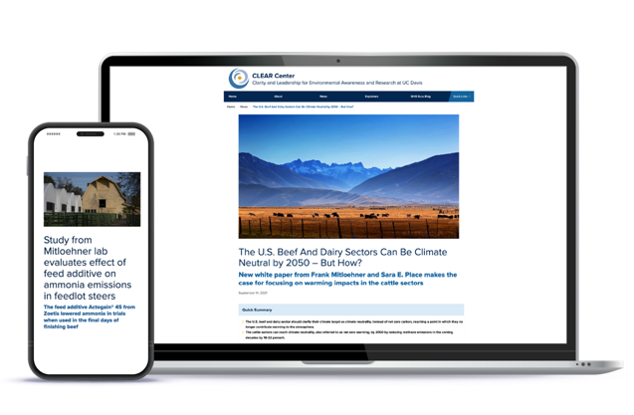
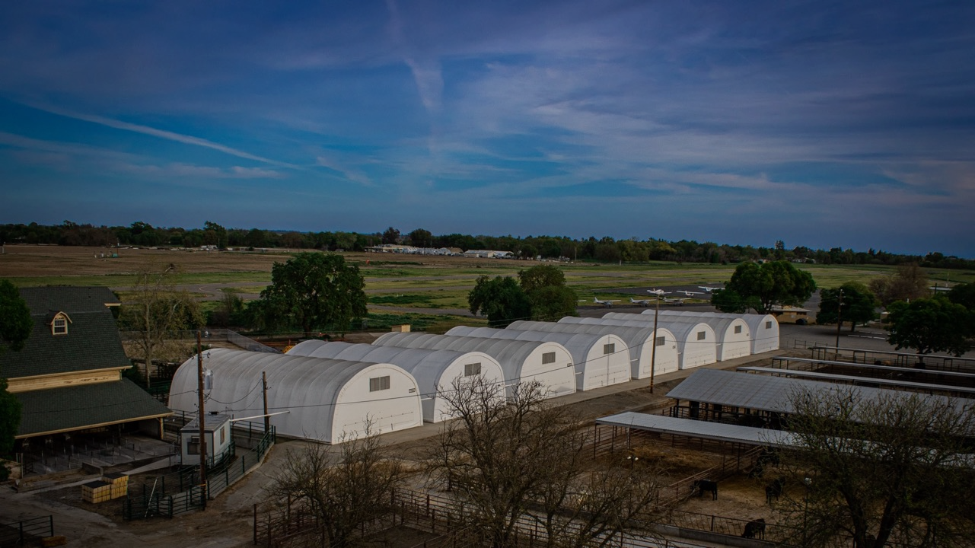
CLEAR Center at UC Davis
The Center leverages its two cores
– research and science communication – to help
animal agriculture become more sustainable.
Research
Outreach
Notes:
We are at the intersection of animal agriculture and the environment, focused on human and planetary health conducting research and communicating this information.
We are centered around two equal cores, research and communications, which sets us a part in this space.

Slide 3
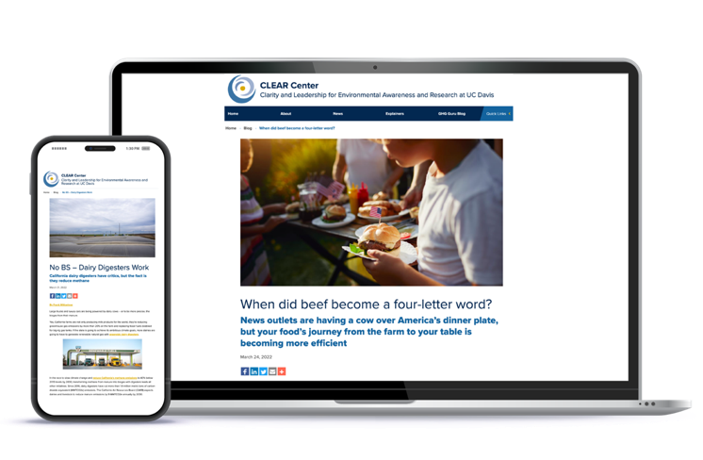
clear.ucdavis.edu – a resource for you on animal agriculture
and sustainability
Topical Explainers
Articles that explain a topic or concept. For example, “What is a dairy digester?”
Blogs
Like op-eds, our blog offers perspective and context to topics around animal agriculture.
News Stories
News-style articles that highlight research and CLEAR Center news.

Slide 4
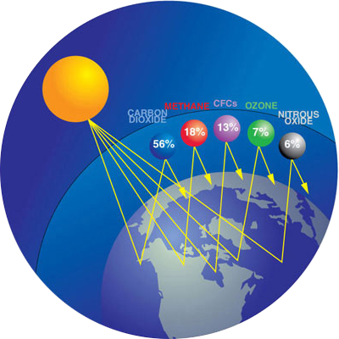

Slide 5
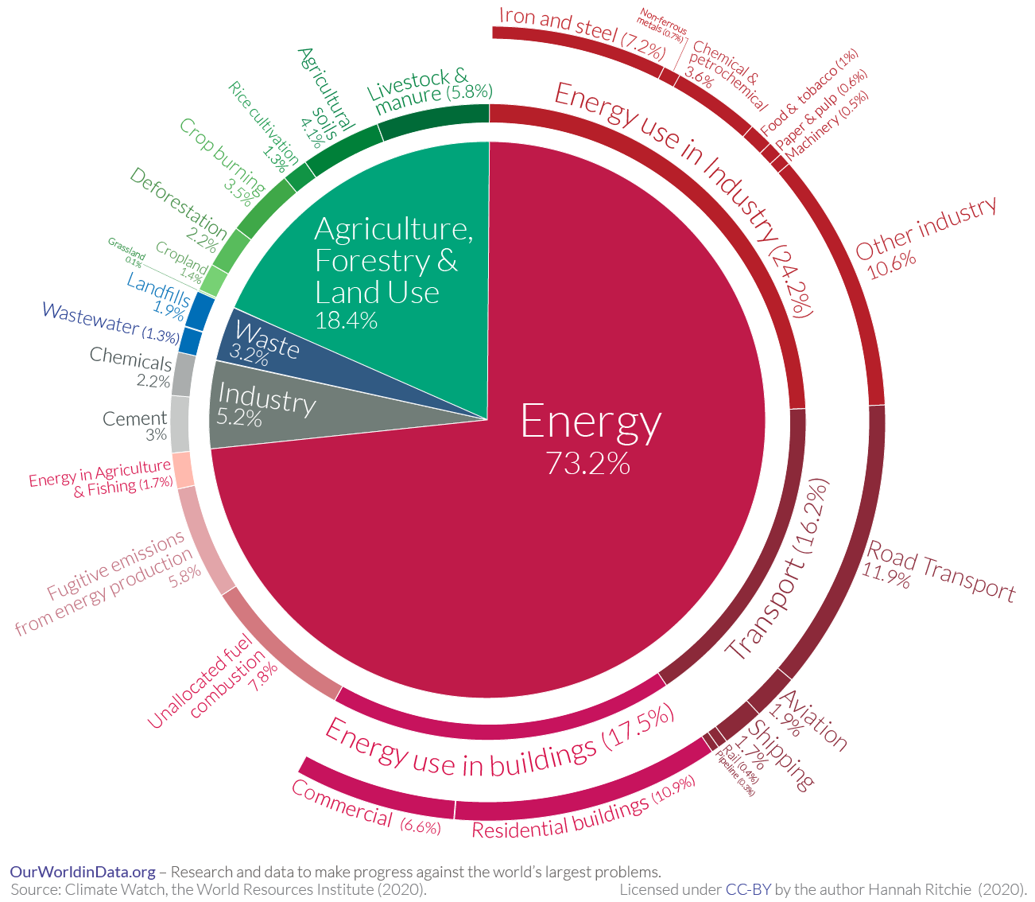
Global Greenhouse Gas Emissions by Sector
Emissions from 2016, when global greenhouse gas emissions totaled 49.4 GT (billion tons) CO₂eq.
Notes:
Global emissions, point to Ag and livestock at 6%

Slide 6
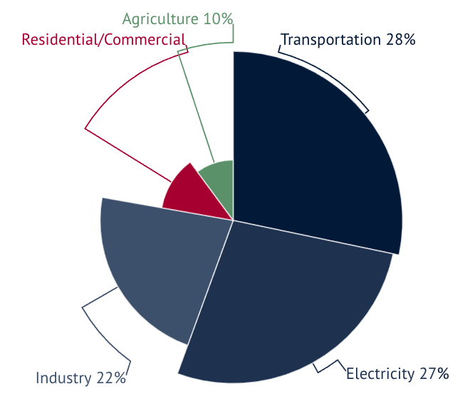
United States Greenhouse Gas Emissions by Sector
Total U,S, Emissions in 2018 = 6,677 Million Metric Tons of CO₂ equivalent. Source: https://www.epa.gov/ghgemissions/sources-greenhouse-gas-emissions

Slide 7
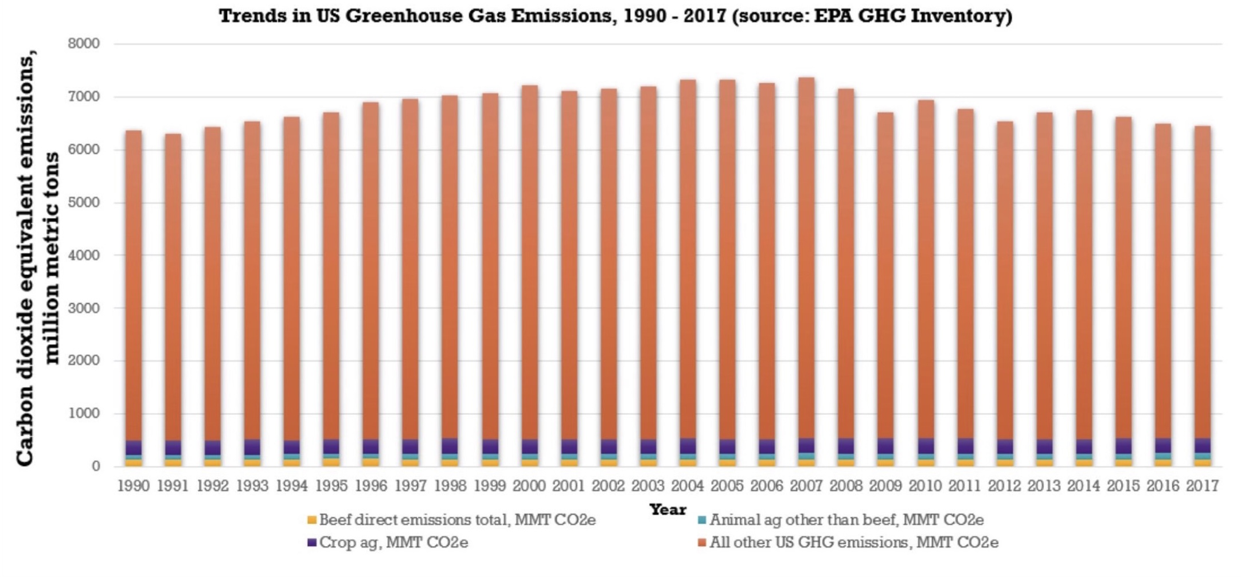

Slide 8
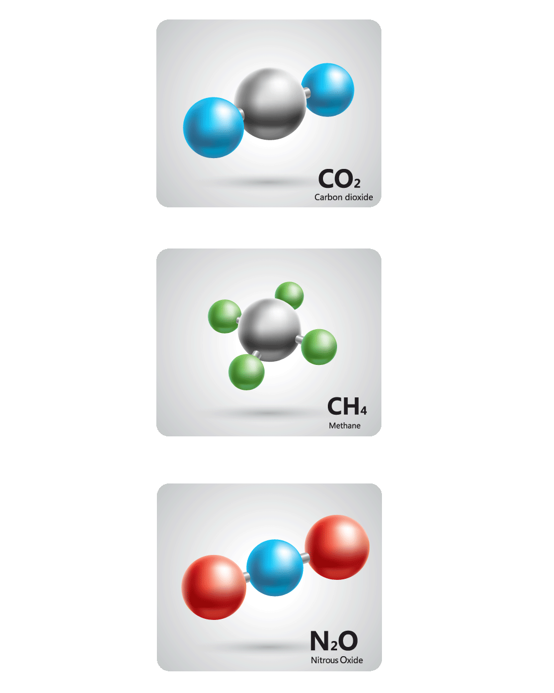
Global Warming Potential (GWP₁₀₀) of Main Greenhouse Gases
Carbon Dioxide (CO₂) 1
Methane (CH₄) 28
Nitrous Oxide (N₂O) 265
Notes:
These are the current standards by which we measure greenhouse gases, the GWP100. This was developed in 1990 as policy makers and governments needed a way to quantify impact of greenhouse gases. But it wasn’t without it’s caveats, and it isn’t painting a complete picture of how these gases warm the atmosphere.

Slide 9
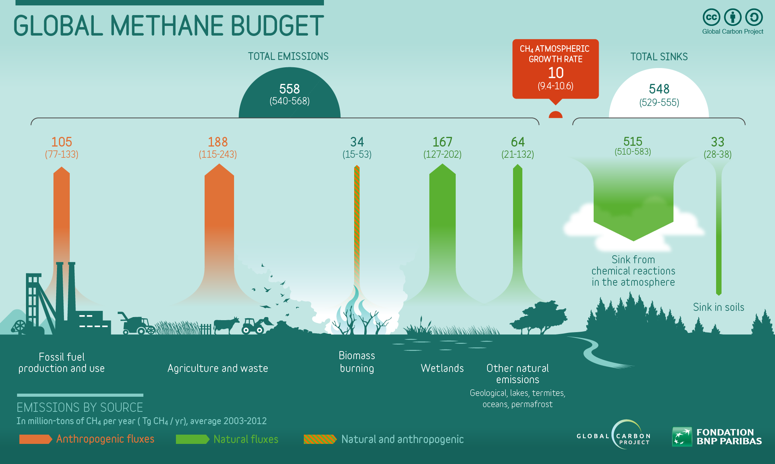
Notes:
Let’s take a look at Methane. This is the global methane budget, factoring sources from Fossil Fuels, Ag, Biomass, wetlands and other sources. And you can see how much is emitted, which is 558 million tons, but take a look at sinks. [click]

Slide 10
Half-Life of Main
Greenhouse Gases in Years
Carbon Dioxide (CO₂) 1,000
Methane (CH₄) 12
Nitrous Oxide (N₂O) 110
Notes:
Lifespan matters when measuring how a gas warms a planet. Up to this point we’ve been looking at the CO2 equivalent of each gas, not how it warms the planet. Methane isn’t going to significantly warm the planet for 1000 years. Only 10. And biogenic methane, that is methane from cattle, isn’t adding warming. [CLICK]

Slide 11
Notes:
And when we say it accumulates, it builds up in the atmosphere. So say you drove your car here today. You’re emissions from driving today are added to your emissions from driving yesterday and the day before and so on. This is a stock gas and all fossil fuels are a stock gas. Additional CO2 is added with every pulse, creating additional warming. [Click]
Biogenic methane is a flow gas. Remember the carbon cycle? For every pulse of methane, one is destroyed at the same rate. No additional methane is added and no additional warming is added.

Slide 12
CO2

Slide 13
CH4

Slide 14
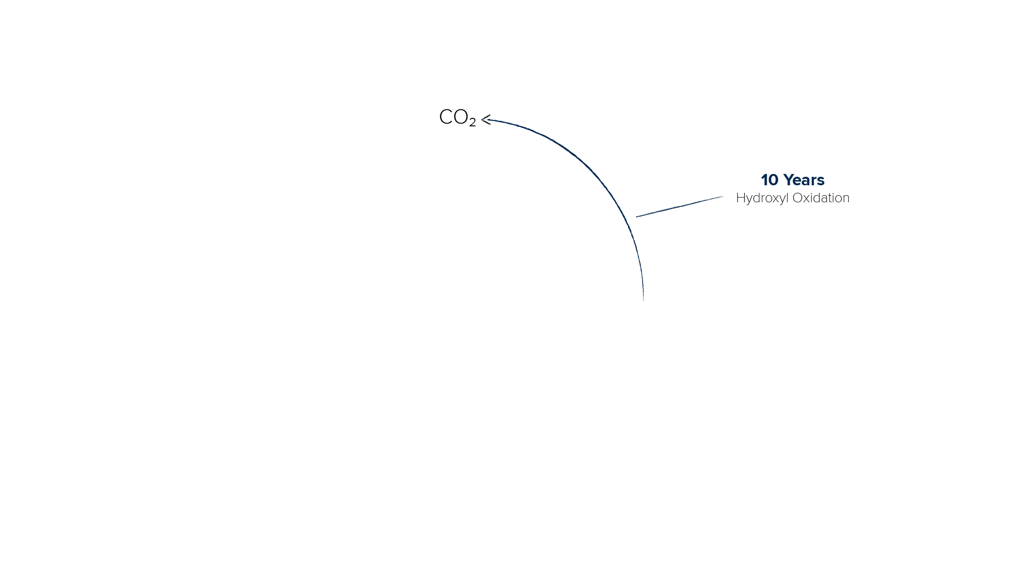
Notes:
What if I told you that methane from cattle in this state is not warming the planet? What if I told you it could be part of the climate change solution?
What do cattle eat? Plants. They eat cellulose, which is the most abundant biomass we have on this planet. We can’t eat it, but ruminants can.
Now let’s go back to your grade school days when you learned how plants grow. [CLICK]
First plants need a few things to grow. CO2, sunlight and water. [CLICK]
They absorb the CO2 and store it as cellulose. [CLICK]
A ruminant eats that plant containing cellulose and releases it as methane. [CLICK]
After 10 years that methane is converted into CO2 [CLICK]
And it is free to be absorbed by plants again. [CLICK]
And it’s important to note that this is recycled carbon.

Slide 15
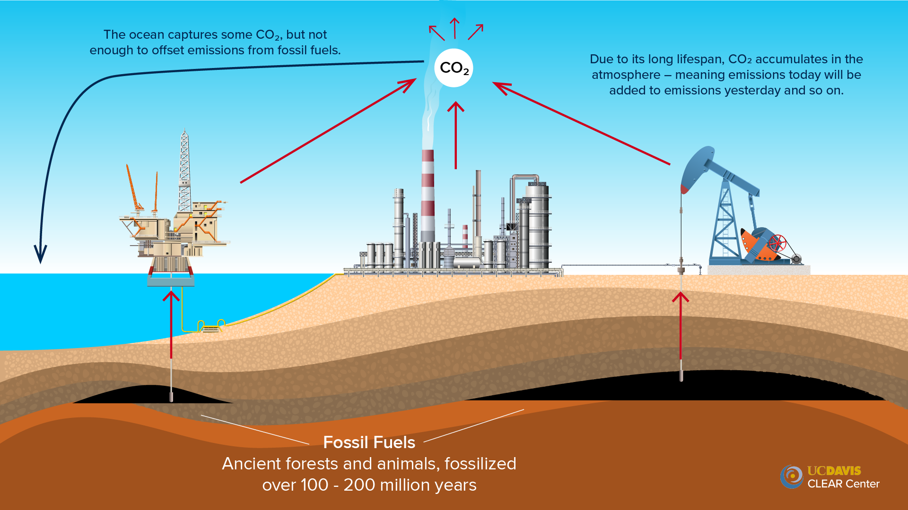
Notes:
Now let’s take a look at CO2 from fossil fuels. It is our ancient forests and dinosaurs sucked up out of the ground.

Slide 16
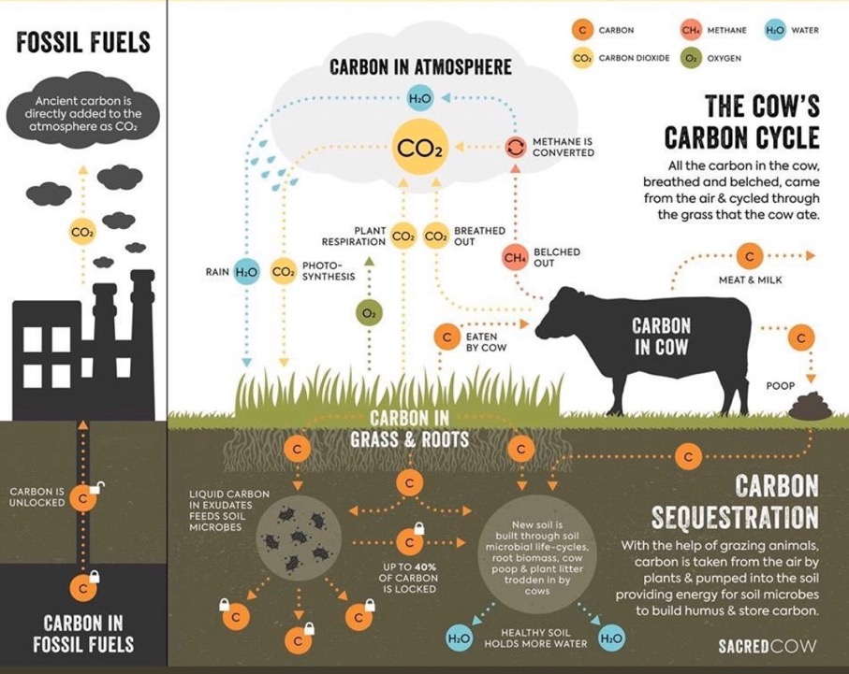
Fossil vs. Biogenic Carbon
Via:
@sustainabledish
sacredcow.info

Slide 17
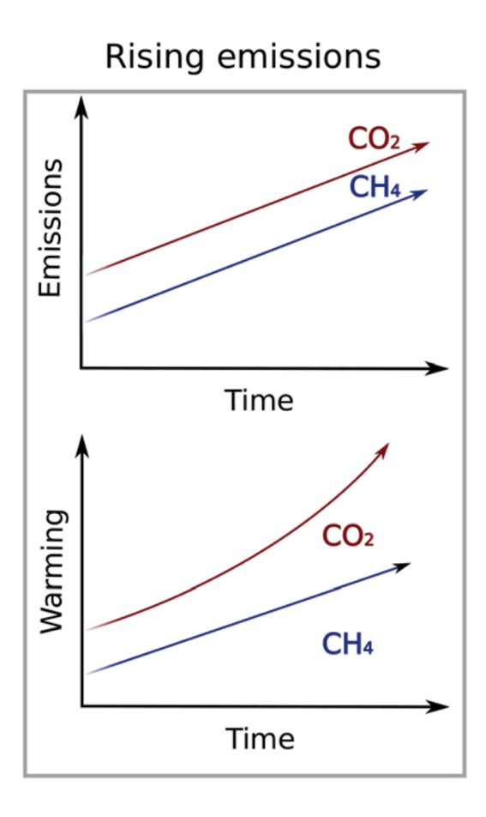
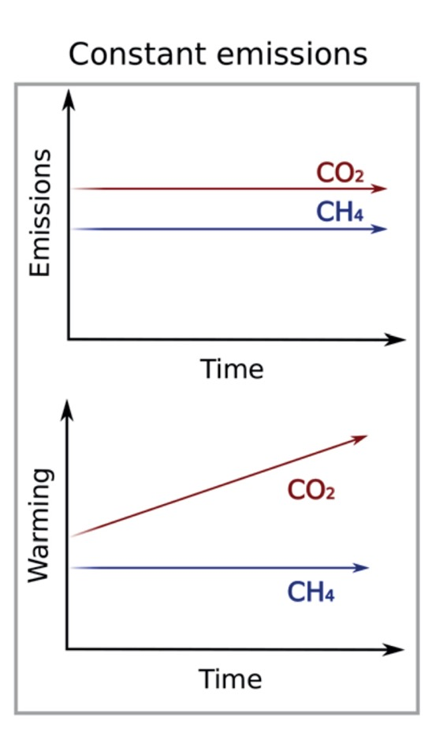
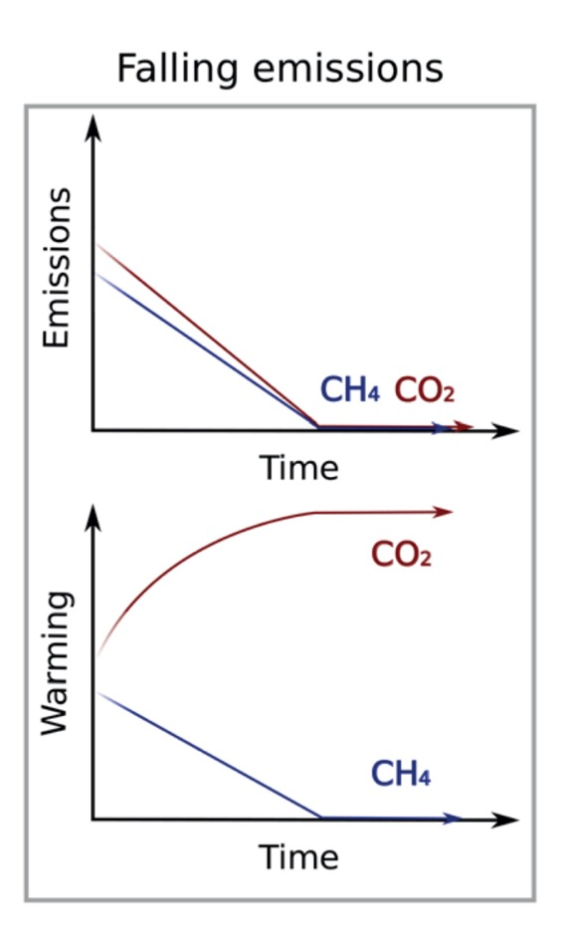
Oxford Martin, Climate Metrics for Ruminant Livestock, July 2018, https://www.oxfordmartin.ox.ac.uk/downloads/reports/Climate-metrics-for-ruminant-livestock.pdf%C2%A0
Notes:
So what does warming really look like in terms of emissions between CO2 and Methane? Looking at the first graph we see emissions for both pollutants going up and you can see that methane, CH4, goes up pretty much at the same rate. You’ll that CO2 climbs up at a steeper rate than it is emitted. This is because it is a stock gas, and for every pulse of CO2 emitted, we’re adding additional warming. It’s warming on top of warming already there. [CLICK]
What if kept emissions constant? Well, it’s not a dissimilar story. Methane stays constant. But CO2 continues to warm, because that gas is building up, where as methane is being destroyed as it is added to the atmosphere. [CLICK]
And what if we decrease emissions? Let’s look at CO2 first this time. You’ll see that warming will continue to rise, though more gradually, before plateauing. Again with CO2 being a stock gas, as CO2 is reduced it’s still adding warming to the atmosphere just in smaller amounts, before it evens out after no additional CO2 is added.
But take a look at Methane. That is what a solution looks like. If we can reduce methane, which we have, we can induce cooling and eat into that gap that separates CO2 and Methane.

Slide 18
Historical and projected demand for animal products. Source: Based on FAOSTAT food balance sheets and the projected demand from FAO. 2018b. The future of food and agriculture: Alternative pathways to 2050. Rome. https://www.fao.org/global-perspectivesstudies/resources/detail/en/c/1157074/. Pathways towards lower emissions – A global assessment of the greenhouse gas emissions and mitigation options from livestock agrifood systems.

Slide 19
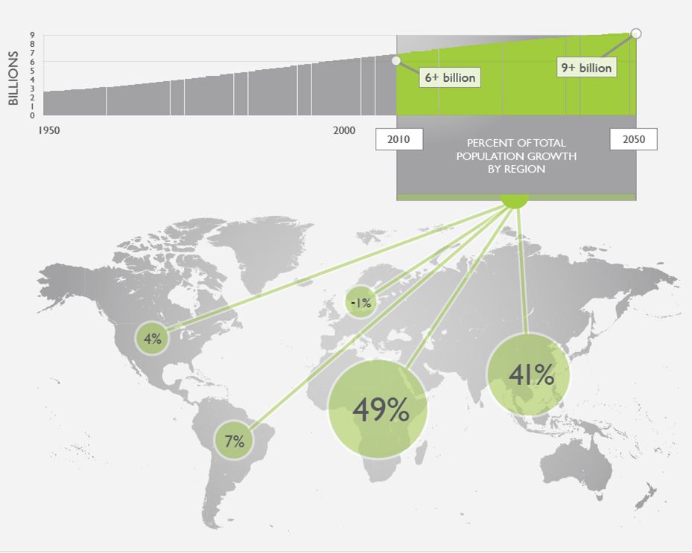

Slide 20
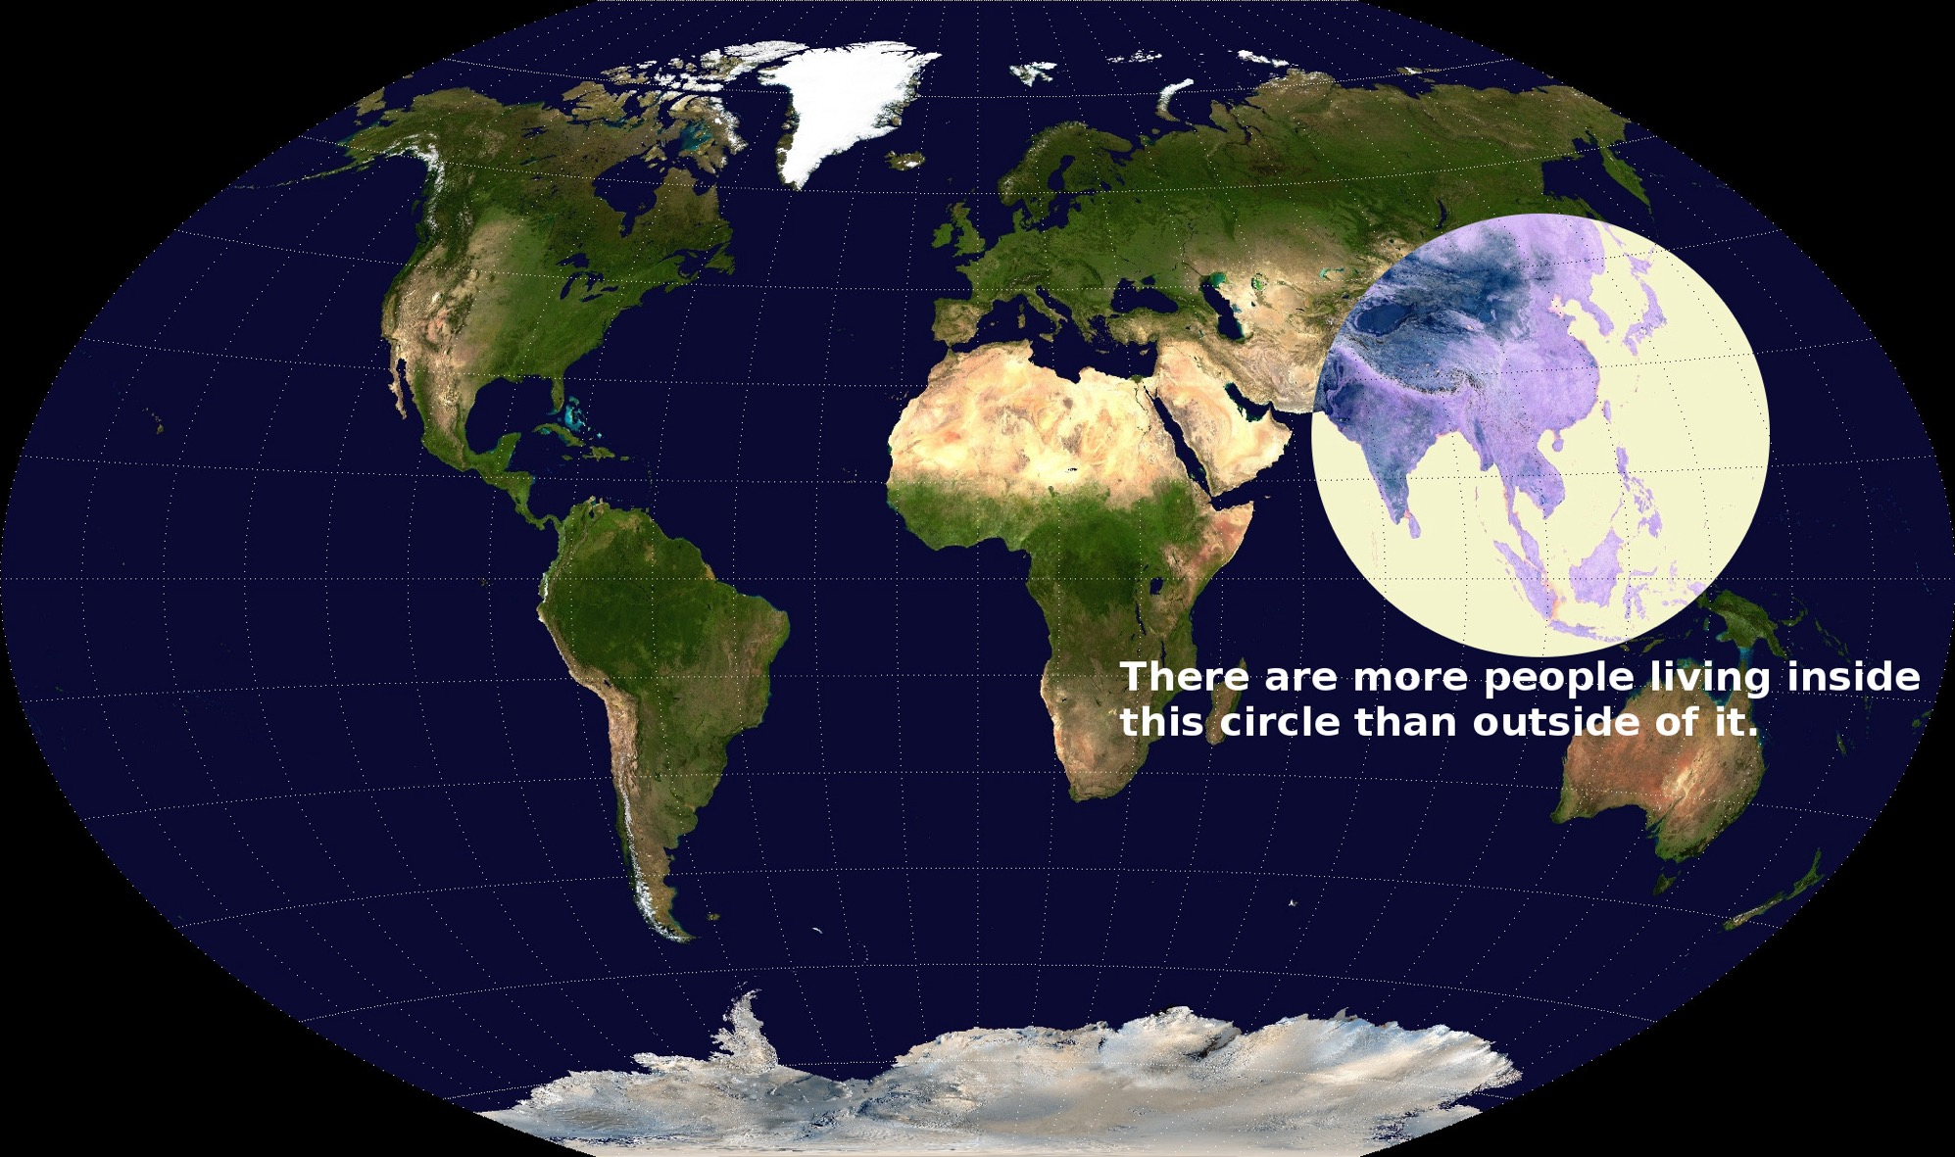

Slide 21
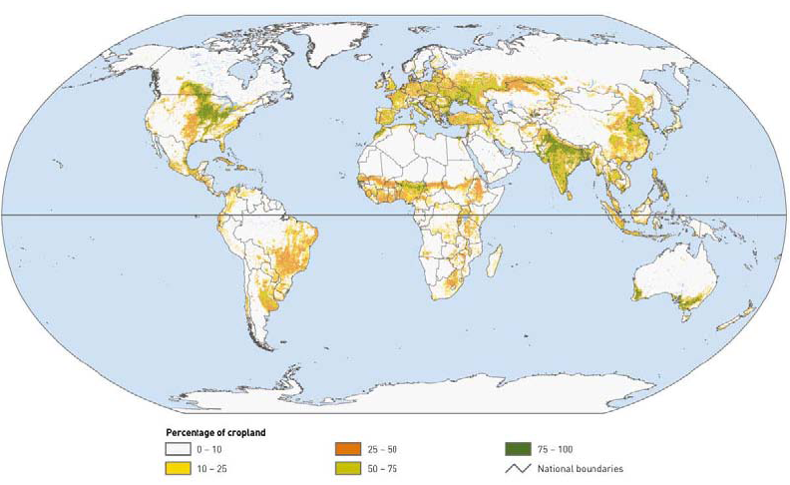
Distribution of cropland
FAO (2006)

Slide 22
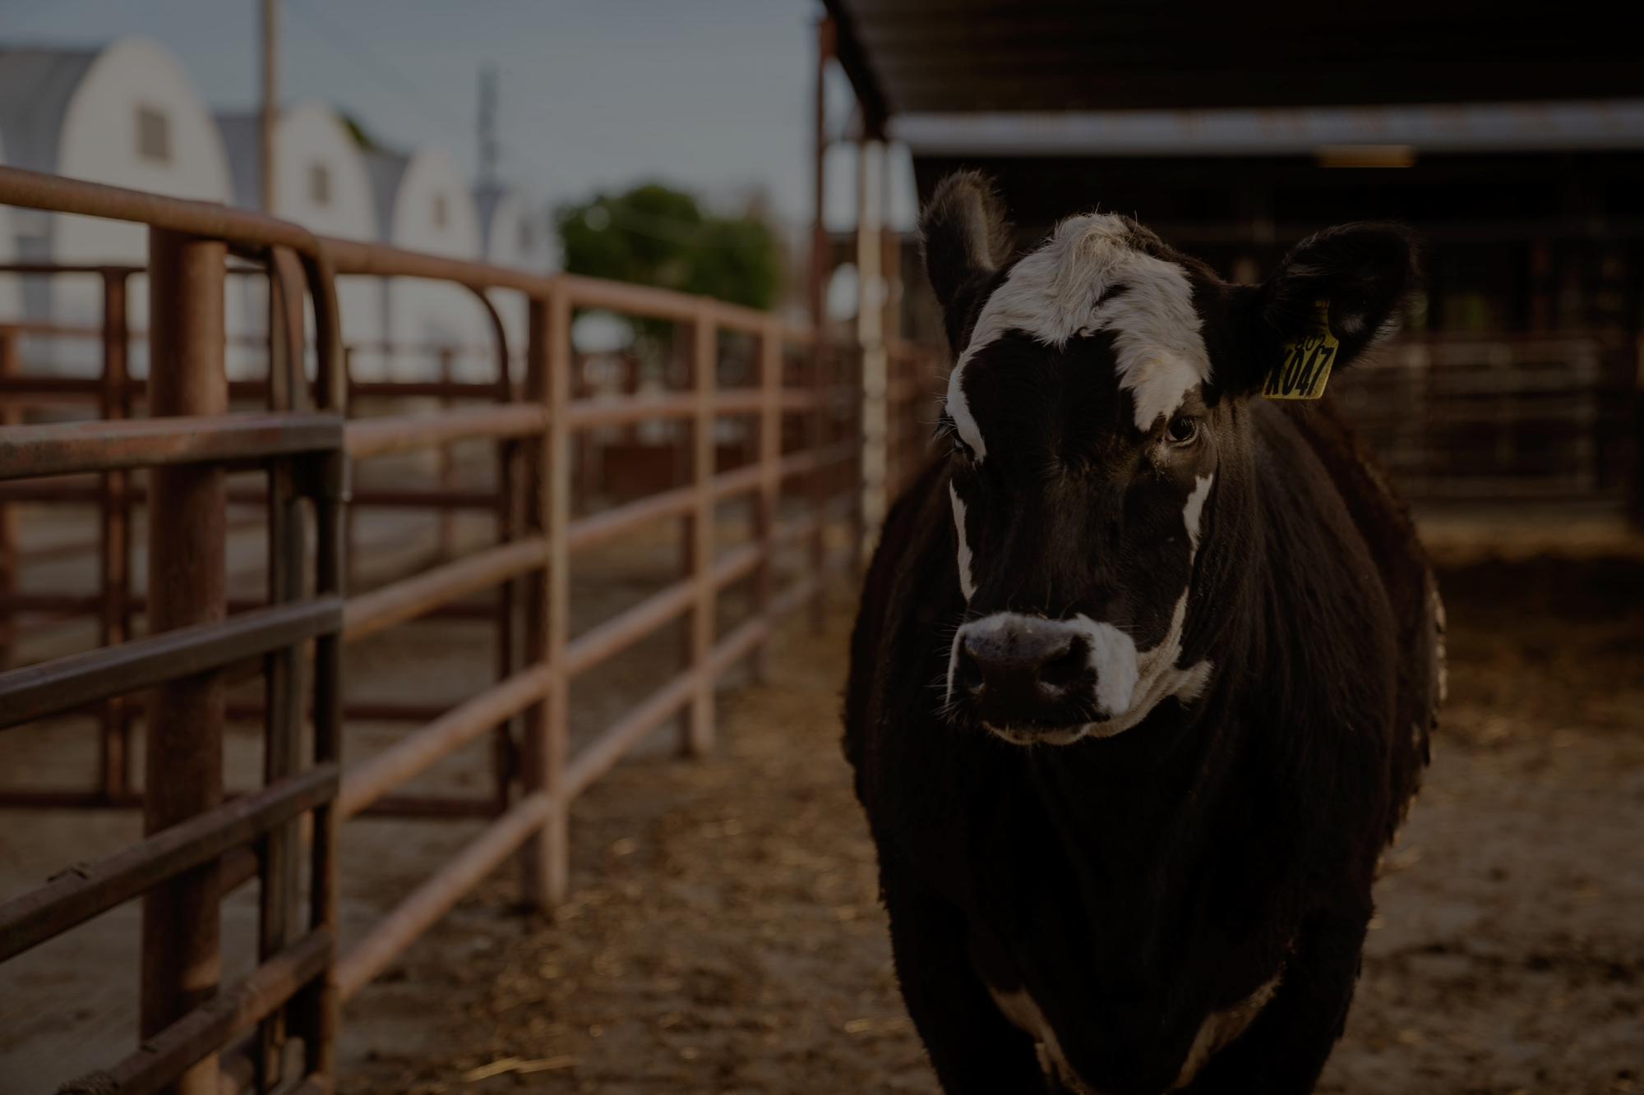
What are our pathways to reduce emissions in animal agriculture?
Notes:
We need a toolkit of solutions.

Slide 23
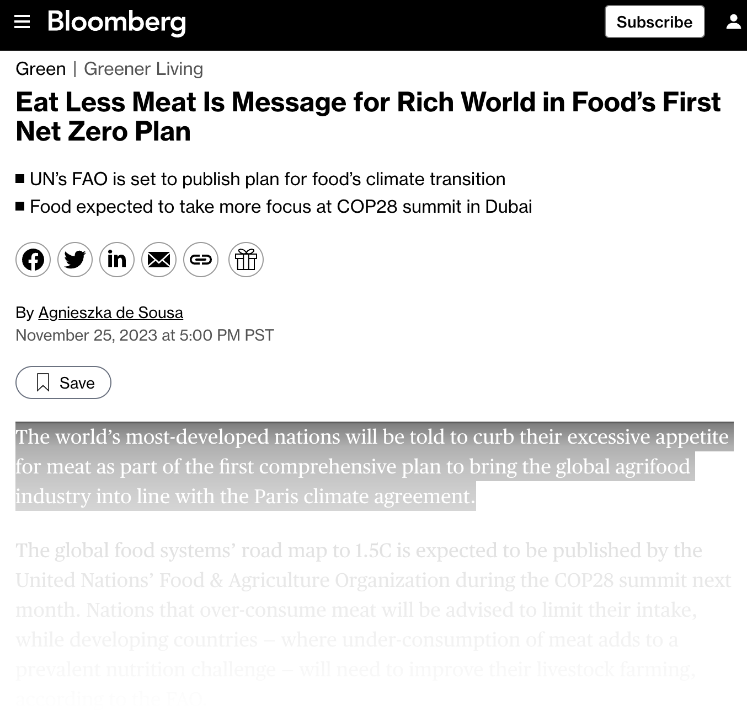

Slide 24
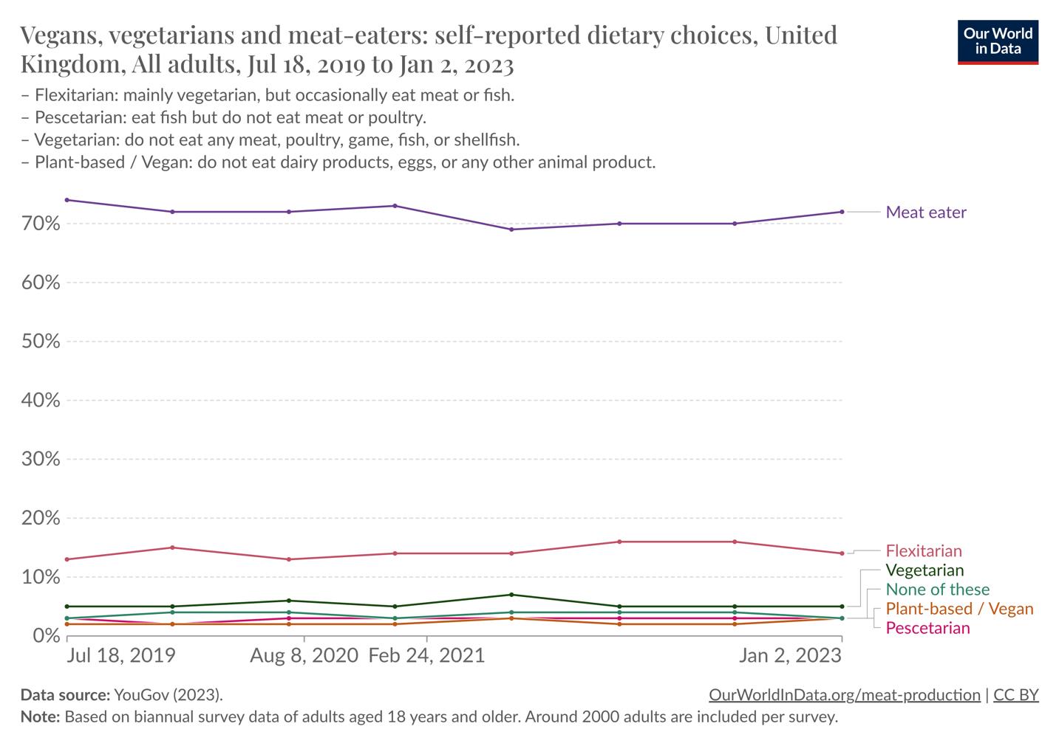
Diet choices in the UK
Edouard Mathieu and Hannah Ritchie (2022) - “What share of people say they are vegetarian, vegan, or flexitarian?” Published online at OurWorldInData.org. Retrieved from: 'https://ourworldindata.org/vegetarian-vegan' [Online Resource]
Notes:
An example of a developed counties consumption habits.

Slide 25
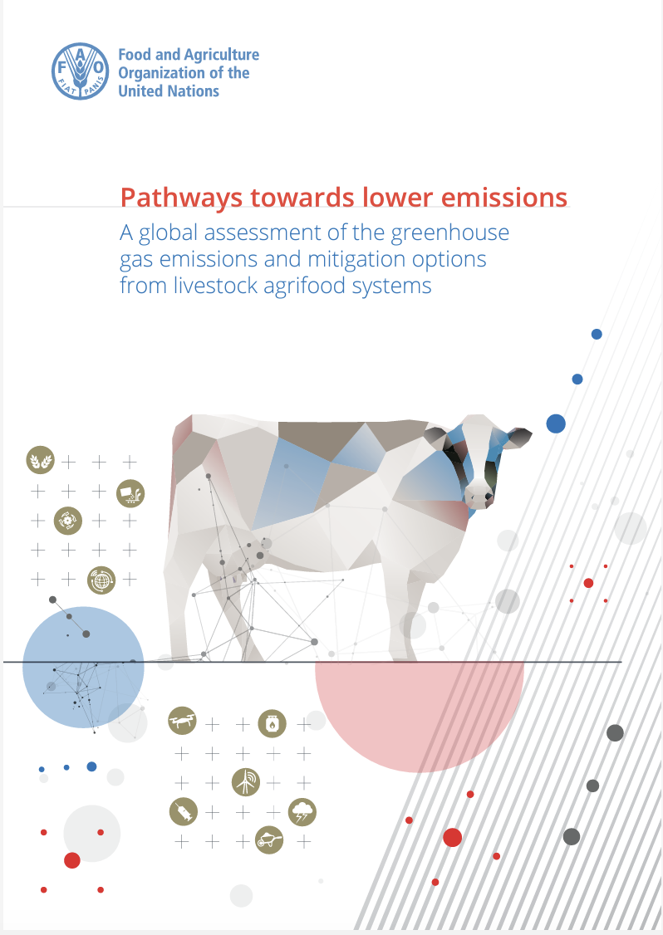
ucdavisclear.co/faopathways

Slide 26
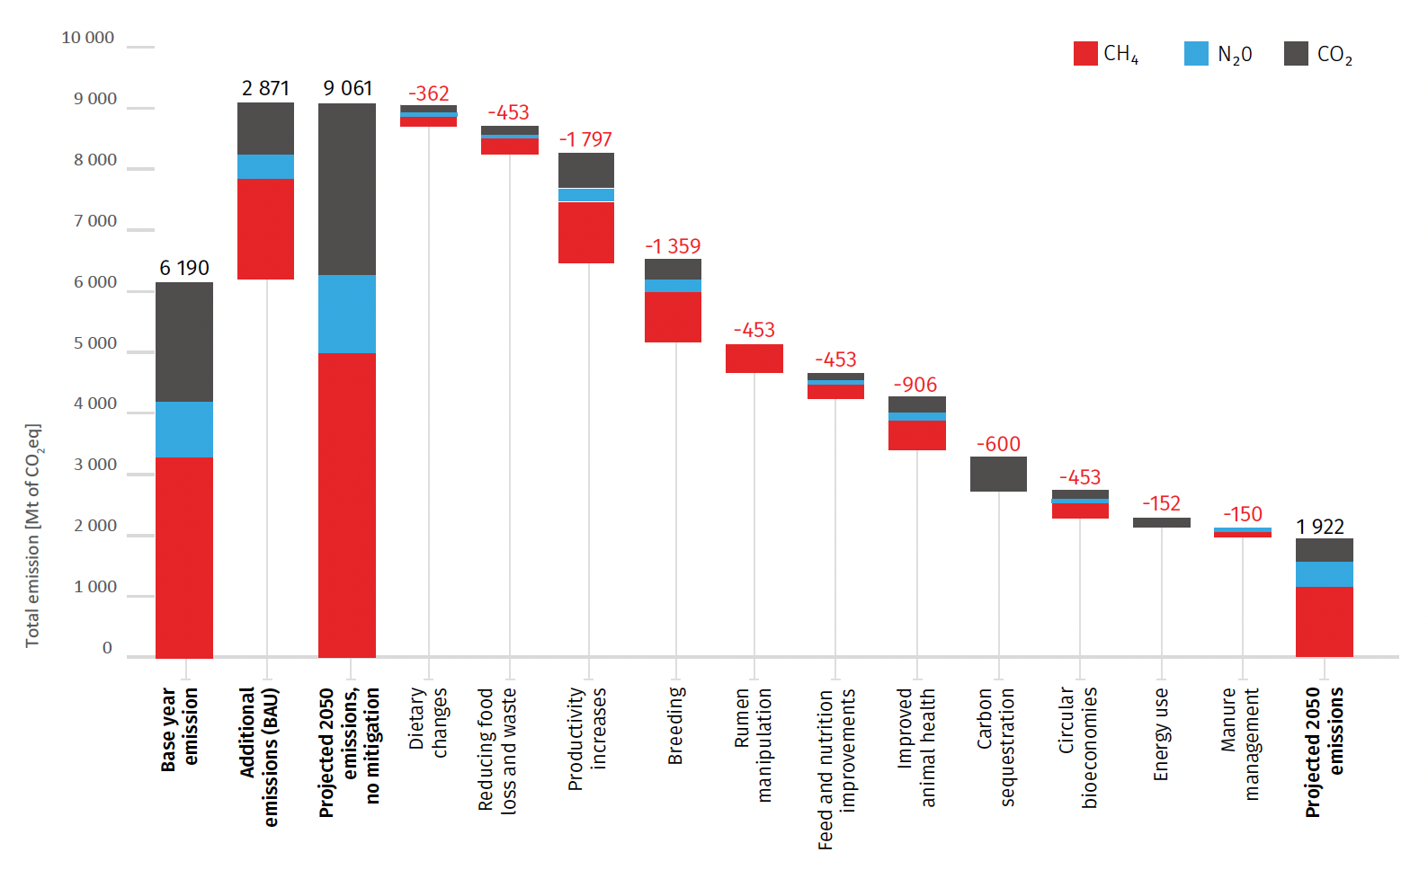
Base year and projected emissions from livestock systems shown as a waterfall chart with a range of mitigation measures applied to 2050 with their technical potential. From: Pathways towards lower emissions – A global assessment of the greenhouse gas emissions and mitigation options from livestock agrifood systems.

Slide 27
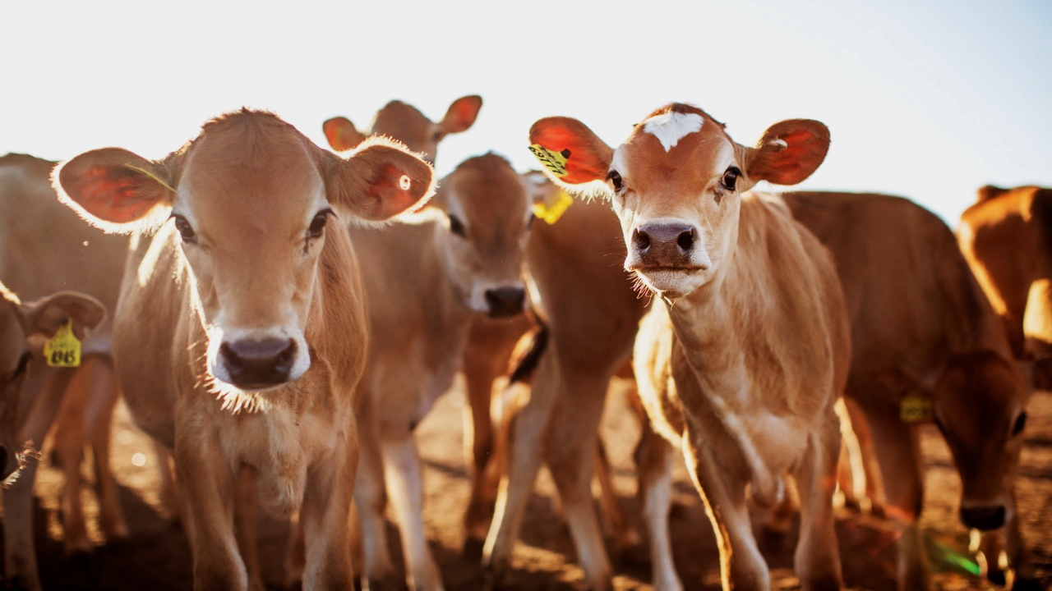
California
Case Study
https://bit.ly/pathwayclear

Slide 28
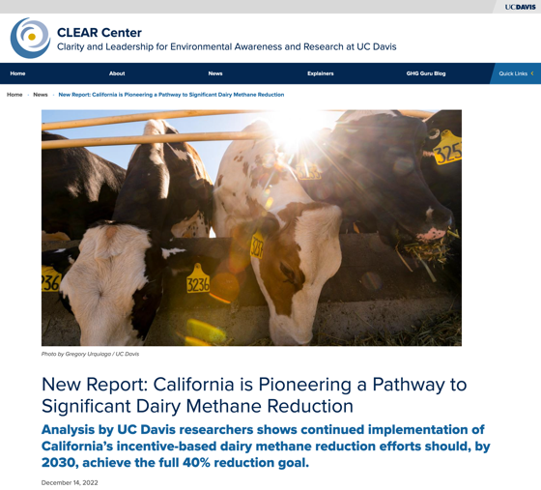
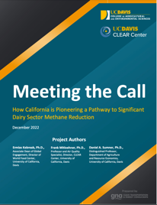
Whitepaper highlighting benefits of incentive-based policies in GHG reductions
Use your cellphone camera to scan the QR code and take you to the article.
https://bit.ly/pathwayclear

Slide 29
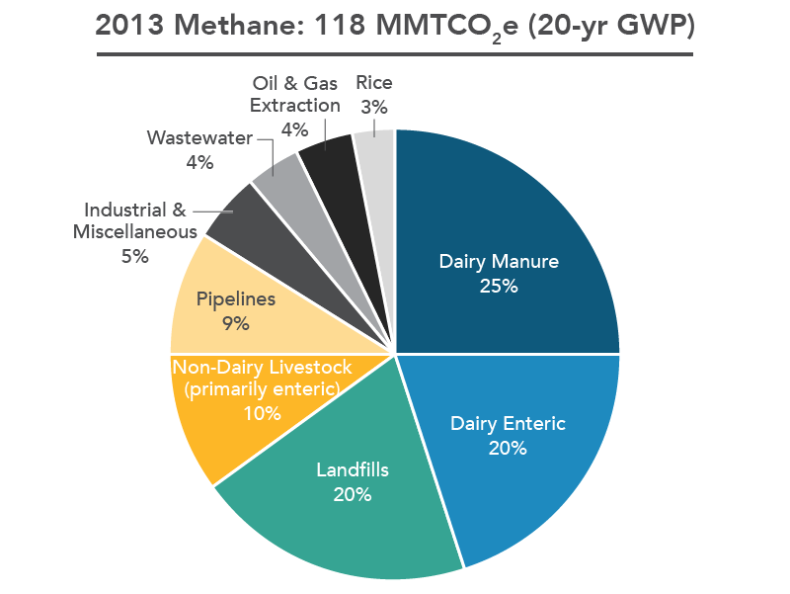
Ambitious Goals in California
California had set aggressive targets for reducing methane 40% below 2013 levels by 2030
Dairy to reduce 7.2 MMTCO2e
1.8 MMTCO2e reductions coming from mostly beef cattle.
Notes:
For example in California we have aggressive reduction goals and will look at various solutions to get there.

Slide 30
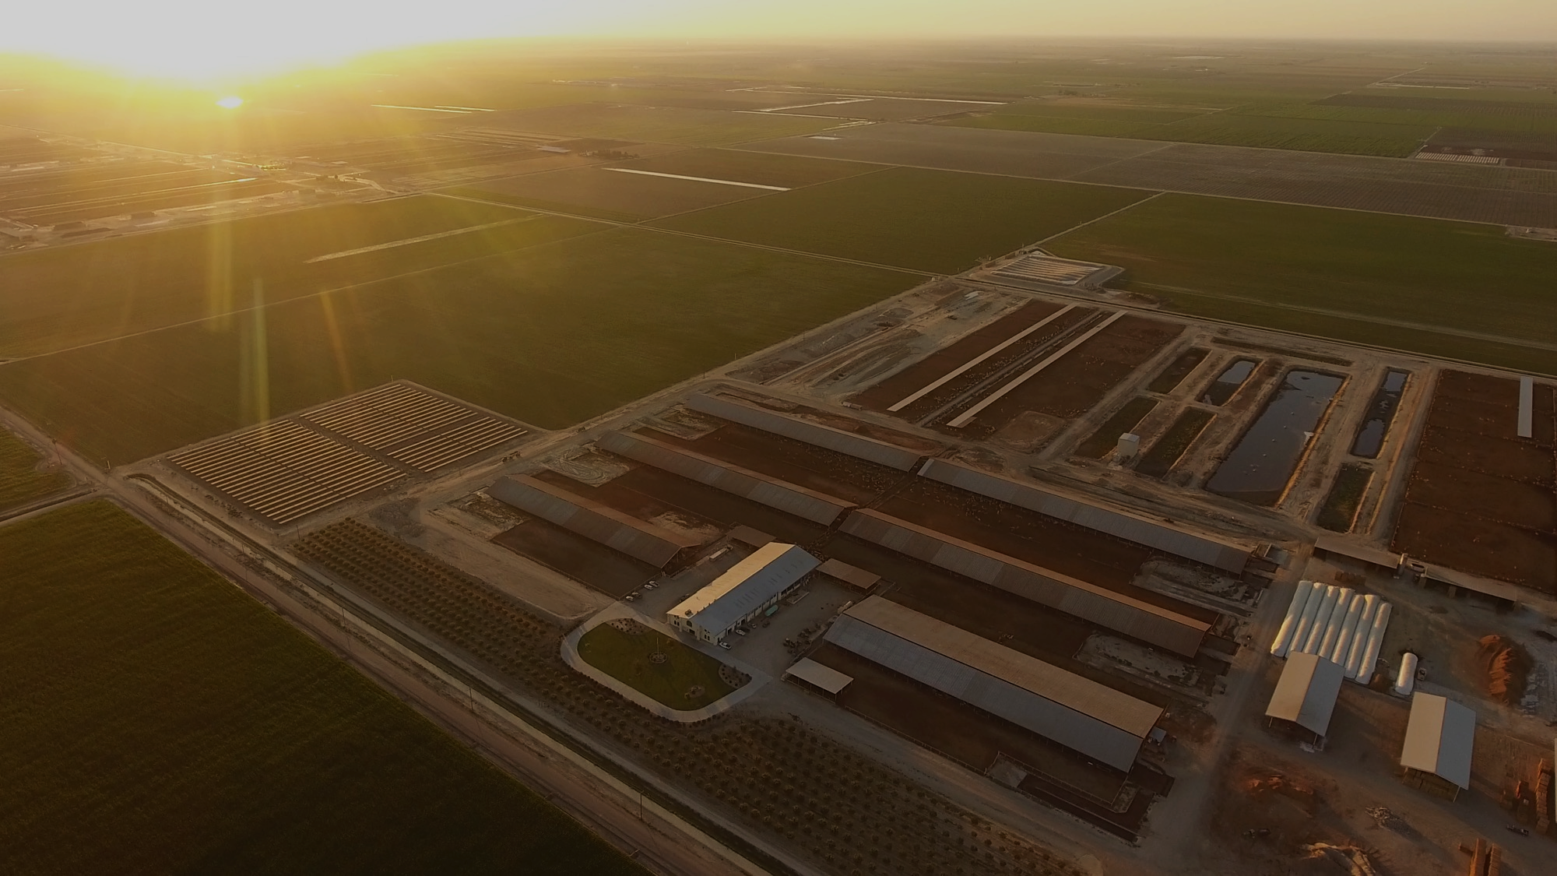
California dairy should exceed the full 40 percent reduction by 2030 = 7.61 – 10.59 MMT
Attrition - 2.6 to 3.3 MMTCO2e/yr
Alternative manure management - 0.6 and 1.1 MMTCO2e/yr
Dairy Digesters - 4 MMTCO2e/yr
Feed additives - 250,000 MTCO2e - 2 MMTCO2e/yr

Slide 31
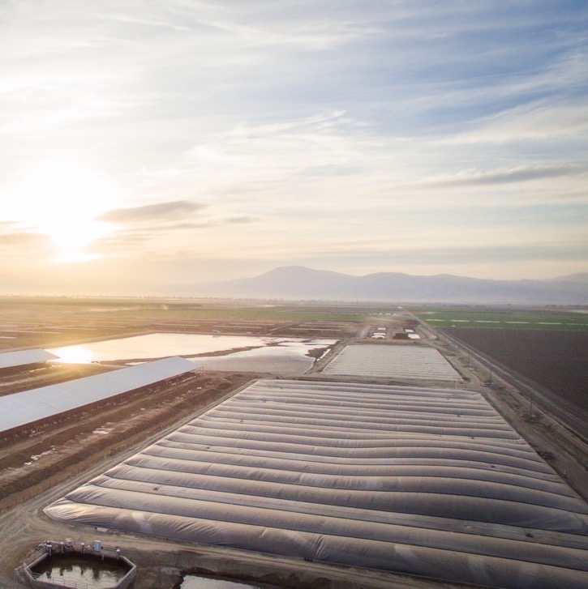
California dairies have reduced greenhouse gases by 4.4 MMTCO2e – more than half of the sector’s methane reduction goal.

Slide 32
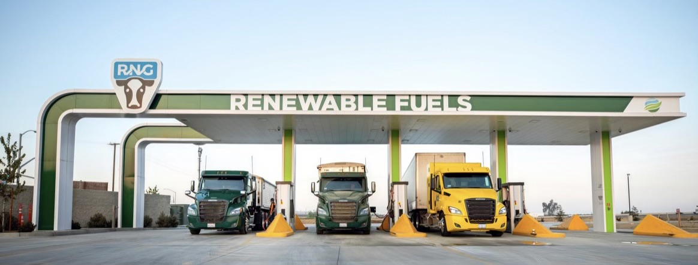

Slide 33
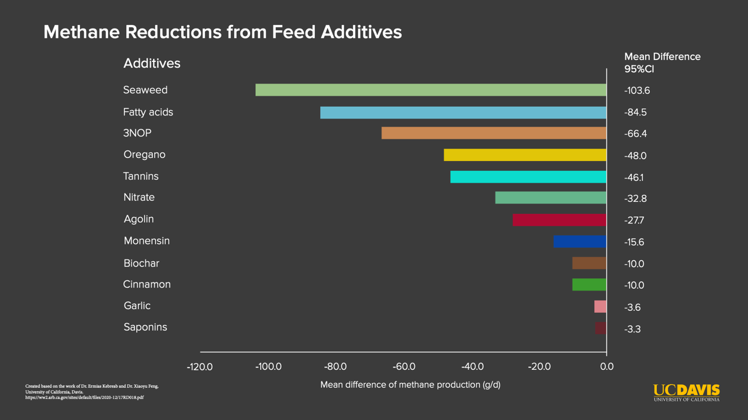
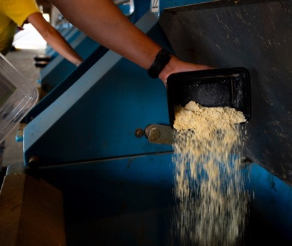
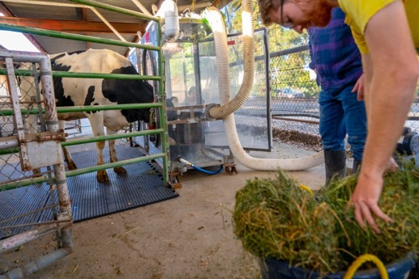
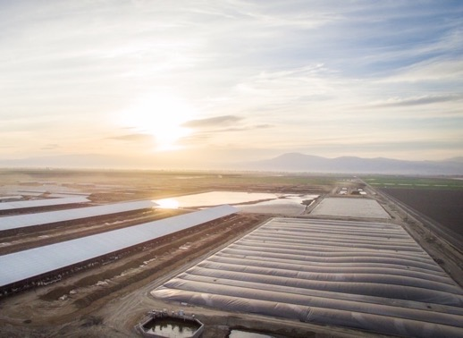
Reducing methane with feed additives
Dairy digesters are a cost-effective way of reducing methane from manure.
Dairy digesters have reduced 30% of the greenhouse gasses mitigated in the California Climate Investment Initiative with less than 2% of state funding.

Slide 34
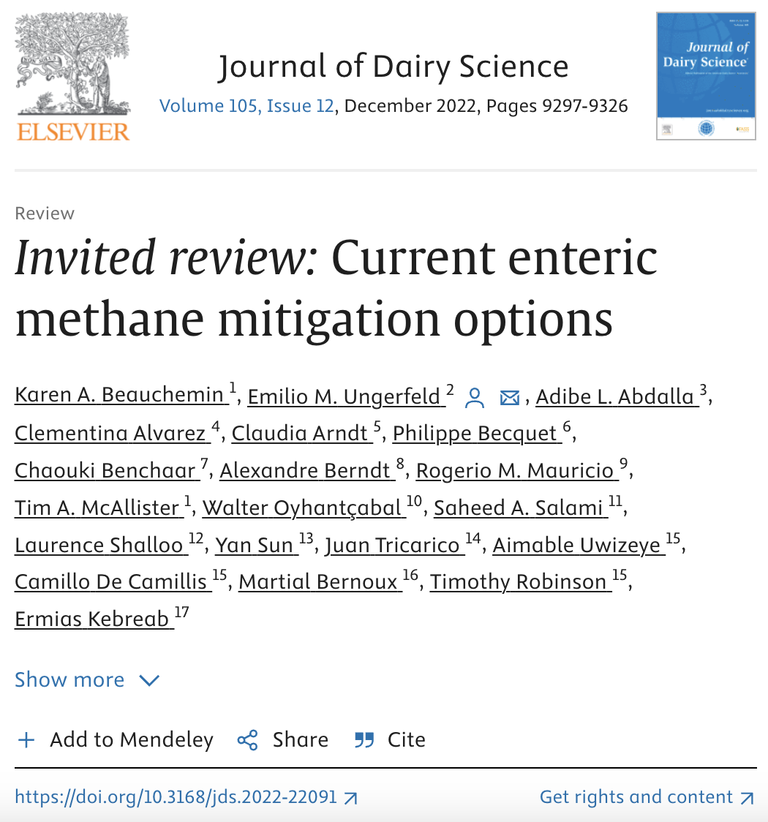
Increased Animal Productivity
Selection of Low-Methane Animals
Diet Reformulation
Forages
Action on Rumen Fermentation
Early State Mitigation Strategies
Notes:
For the sake of time, an opportunity to expand on the various solutions available. I am not sure if you want to animate each bullet or not. You’d have to speak on each bullet, which may limit time.

Slide 35
Oxford Martin, Climate Metrics for Ruminant Livestock, July 2018, https://www.oxfordmartin.ox.ac.uk/downloads/reports/Climate-metrics-for-ruminant-livestock.pdf%C2%A0
Notes:
So what does warming really look like in terms of emissions between CO2 and Methane? Looking at the first graph we see emissions for both pollutants going up and you can see that methane, CH4, goes up pretty much at the same rate. You’ll that CO2 climbs up at a steeper rate than it is emitted. This is because it is a stock gas, and for every pulse of CO2 emitted, we’re adding additional warming. It’s warming on top of warming already there. [CLICK]
What if kept emissions constant? Well, it’s not a dissimilar story. Methane stays constant. But CO2 continues to warm, because that gas is building up, where as methane is being destroyed as it is added to the atmosphere. [CLICK]
And what if we decrease emissions? Let’s look at CO2 first this time. You’ll see that warming will continue to rise, though more gradually, before plateauing. Again with CO2 being a stock gas, as CO2 is reduced it’s still adding warming to the atmosphere just in smaller amounts, before it evens out after no additional CO2 is added.
But take a look at Methane. That is what a solution looks like. If we can reduce methane, which we have, we can induce cooling and eat into that gap that separates CO2 and Methane.

