Slide 1

Supporting and measuring healthy life for dairy cows
Stephen LeBlanc

Slide 2
Is greater longevity an inherently good goal for dairy cows?

Slide 3

Reproduction and its impact on cow survival and replacement
Stephen LeBlanc
ADSA Discover conference
October 4, 2004
Nashville, IN

Slide 4
GET PREGNANT OR
DIE

Slide 5
The major reproductive disease of dairy cattle is semen deficiency

Slide 6
Disease kills.

Slide 7
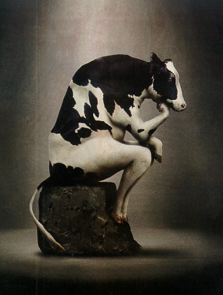
Disease kills
(sometimes).
It depends…
on milk and pregnancy

Slide 8
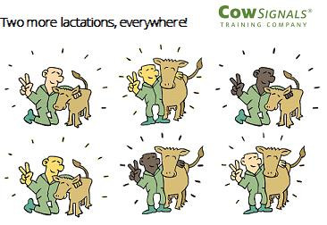

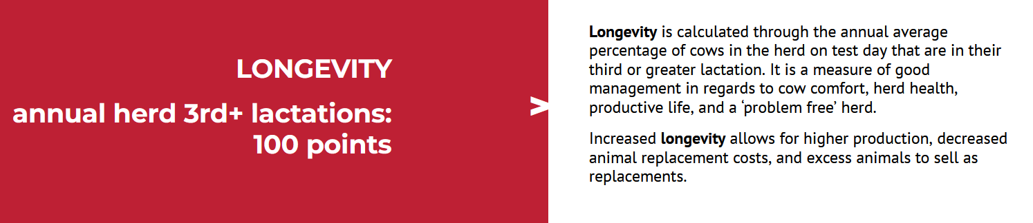
Is this the goal?

Slide 9
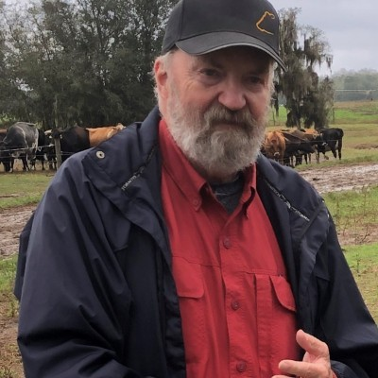
What is the goal?
“Milk is the absence of stress”
“Breaking” cows is bad because
  Welfare
  Social license
  It prevents realizing economic potential
Quality vs quantity of life
Environmental impact/GHG footprint
    Per cow
    Per acre
    Per calorie
    Per kg of protein or essential AA

Slide 10
Career enders
Non-pregnancy
Low milk
Chronic mastitis/high SCC
Chronic lameness

Slide 11
Premises
Culling is an economic decision*. Sell a cow when her net present value is < an available replacement animal
  * Or a decision to override economic rationale
Poor health will reduce productive lifespan, but longevity is a poor measure of health or welfare
Ethics and social license require quality of life for cows, not quantity
‘Metabolic athletes’ live demanding, not distressed lives

Slide 12
Do you have ≥90 lb tank average?

Slide 13
Do you have ≥90 lb tank average and consistently < 20% annual culling?

Slide 14
Do you have ≥ 90 lb tank average and consistently 20% annual culling?
If not, is it because
  high production is the result of “pushing” cows with the collateral damage of “breaking” cows

Slide 15
Do you have ≥ 90 lb tank average and consistently 20% annual culling?
If not, is it because
  high production is the result of “pushing” cows with the collateral damage of “breaking” cows
  A supply of (on average) genetically superior heifers increases selection pressure for production and health

Slide 16
Classical associations

Slide 17
The relationship of health with survival is complex
Disease
Death
Disease
↓ Milk yield
Culling
Disease
Non-pregnancy
Culling
Non-pregnancy
Disease
Culling
↓ Milk yield

Slide 18
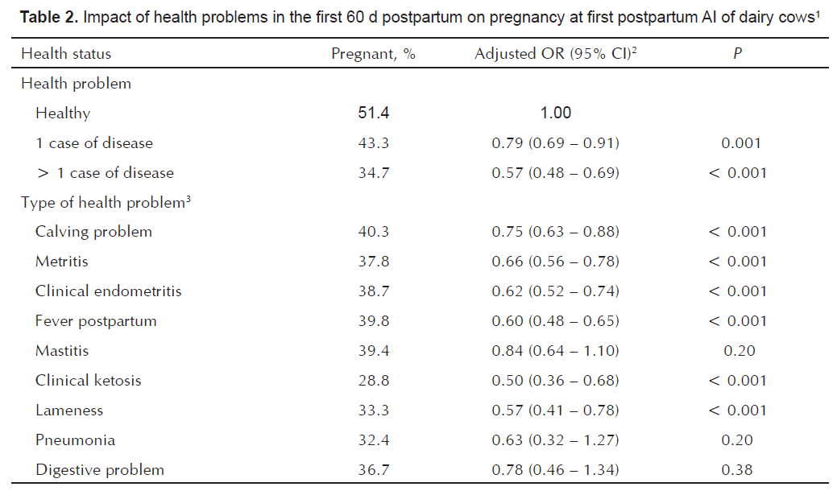
Transition health problems are common
But healthy cows have good fertility
Prevalence
56
27
17
15
16
20
21
12
10
7
3
2
5719 cows in 7 US herds
Santos et al RepDomRum 2010

Slide 19
Transition health problems are common
But healthy cows have good fertility
Prevalence
56
27
17
15
16
20
21
12
10
7
3
2
Santos et al RepDomRum 2010

Slide 20
Beaudeau et al AnnZootech 2000

Slide 21
Consequences, in terms of estimated effect of health disorders, of methodological choices (e.g. whether or not including in the models descriptors for milk yield and/or reproductive performance) are [important]. Metabolic and reproductive disorders may act indirectly through a subsequent decrease in milk yield and reproductive performance.
The impact of health disorders on longevity is on average weak, compared to the impact of low milk yield potential and poor reproductive performance. Herd characteristics (availability of heifers, quota, farmer’s attitude towards risk and uncertainty...) modify the risk for a cow to be culled for a given health disorder.
Beaudeau et al AnnZootech 2000

Slide 22

1-year cohort of data from 1946 cows in a transition facility in Germany
Metabolic disease = MF, RP, METR, KET, TWIN or MAST
Disease effects on culling vary by parity
Either primiparous cows are more resilient to a single disease, or producers (rightly?) weigh that event less heavily
Comprehensive disease data
No milk data
Prado et al JDS 2018

Slide 23
Same study
Machine learning algorithm
Conditional inference tree
Implies that clinical disease events were more influential than age in culling
Prado et al JDS 2018

Slide 24
Simple associations of health with culling
2070 cows from 6 herds in NY and Ontario
Clinical and metabolic data actively collected
No lameness data
*
*
*
*
*
*
*
*
*
*
*
*
*
Data from Dubuc et al JDS 2011

Slide 25
…controlling for other variables
Multivariable model Culled by 63 DIM
Multivariable model Culled by 300 DIM
Variable | OR | LSM Risk |  | P
 |  | No | Yes
DA |  | 3% | 8% | 0.02
Ketosis wk2 |  | 4% | 7% | 0.06
Milk TD1 | -7% lower odds per 1 kg > mean (37 kg) | -7% lower odds per 1 kg > mean (37 kg) |  | <0.01
SCC TD1 | -1% lower odds per 100 > mean (281) |  |  | <0.01
Variable | OR | LSM risk |  | P
 |  | No | Yes
DA |  | 10% | 40% | <0.01
Mastitis |  | 14% | 31% | <0.01
305 projected milk TD 3 | -36% lower odds per 1000 kg > mean (11,800 kg) |  |  | <0.01
Pregnant |  | 63% | 4% | <0.01
Lact1 |  | 13% | 13% | <0.01
Lactgp2 |  | 26% | 26% | <0.01
Lactgp3 |  | 28% | 28%
Not different by parity
Data from Dubuc et al JDS 2011

Slide 26
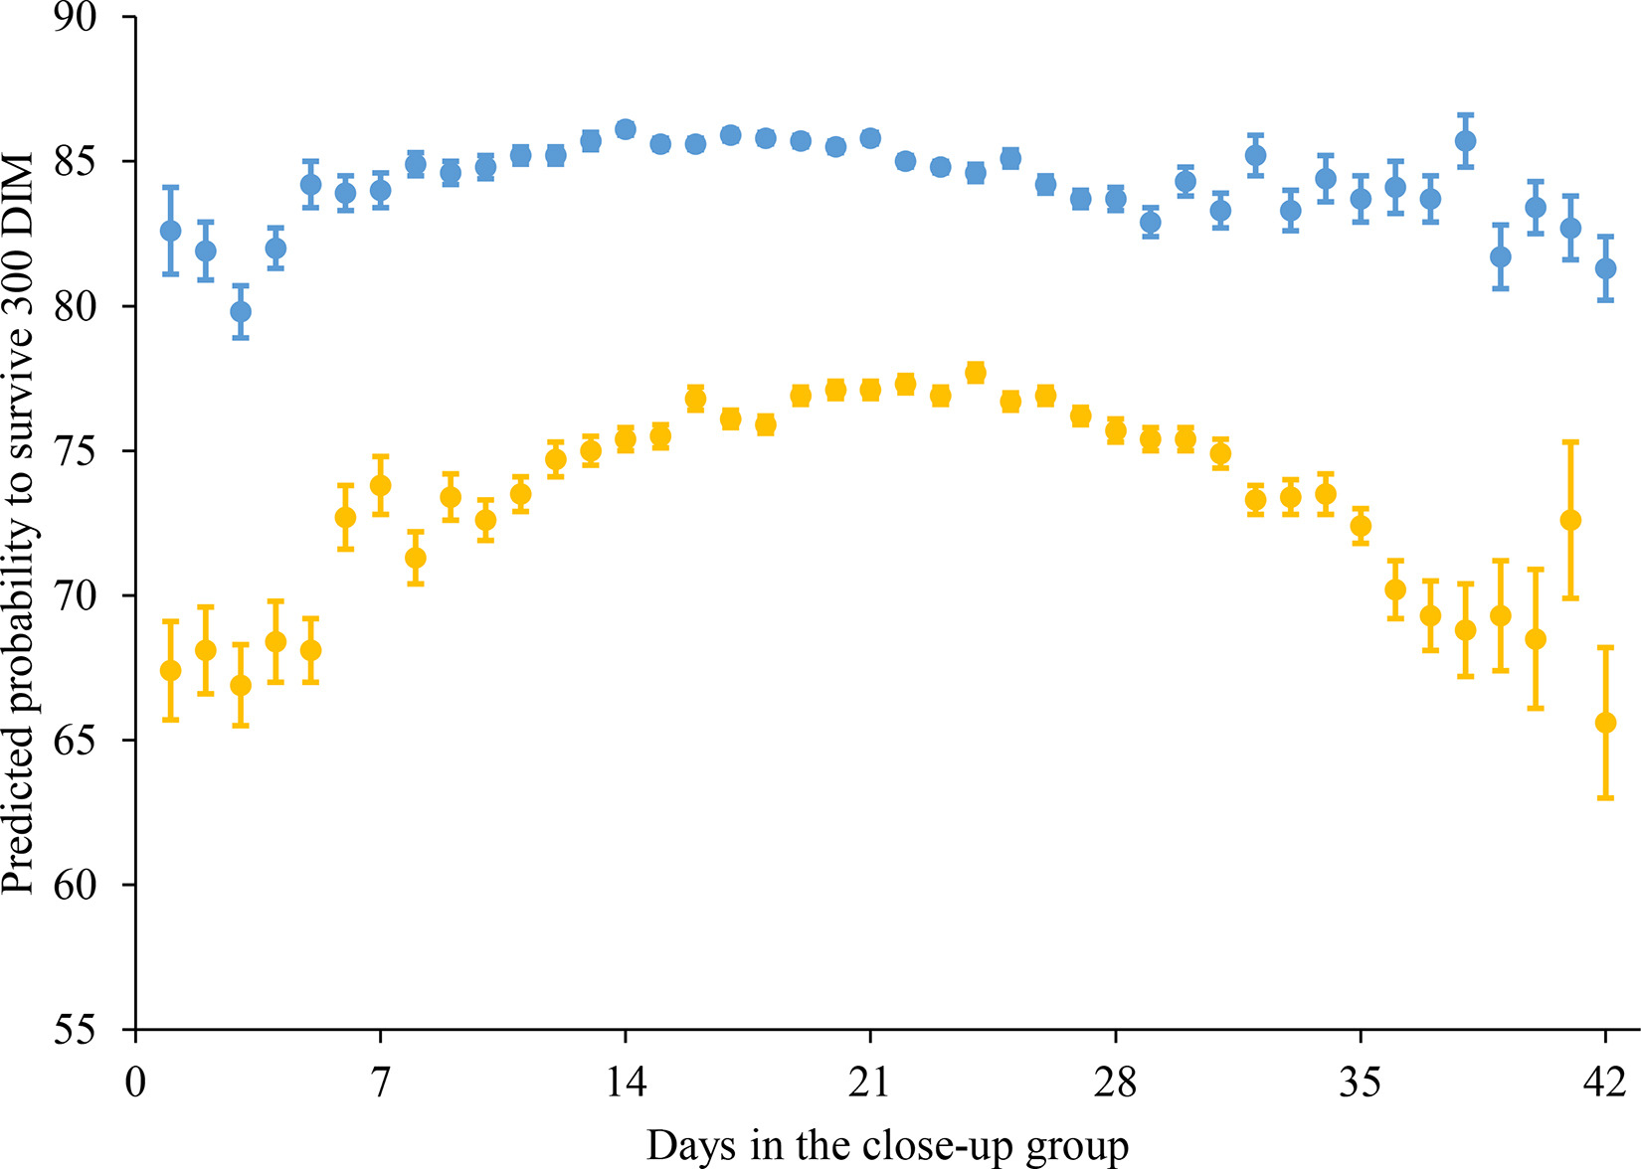
Inferences depend on the data analyzed
Lact =1
28,813 lactations from 14,155 cows on 2 farms in Germany and Slovakia, 2015 - 2020
Diseases not in the final model of culling risk to 300 DIM
DINCU associated with
  Milk yield
  MF
  RP
  Ketosis
  DA
  Mastitis
  Pregnancy at 1st AI
= “suitcase variable”
Lact ≥ 2
Venjakob et al JDS 2023

Slide 27
Transition health affects fertility even with Double Ovsynch
7 y of data from 1 herd in Germany; 15,040 cows; all Double Ovsynch for 1st AI ~ 72 DIM
-10 to -15 points P/AI
*
*
32 to 60 d
*
*
*
*
*
*
Frenkel et al JDSC 2024

Slide 28
Mechanisms of effects of reproductive disease
Connect over 1 to > 3 months
Despite apparent clinical resolution
Effects on
  Probability of ovulation
  Oocyte competence
  Progesterone production
  Embryo quality (e.g. Day 7)
  Embryo development (e.g. Day 15)
  Embryo survival (e.g. Day 30 to 60)
Follicular environment
Oocyte quality
Effects on sperm?
Uterine environment

Slide 29
Follicular development occurs over 2 to > 4 months
Britt hypothesis (1992)
Ewe model - Scaramuzzi et al RFD 2011

Slide 30
Follicular development occurs over 2 to > 4 months
Britt hypothesis (1992)
LeBlanc hypothesis (2024)
Inflammation
Ewe model - Scaramuzzi et al RFD 2011

Slide 31

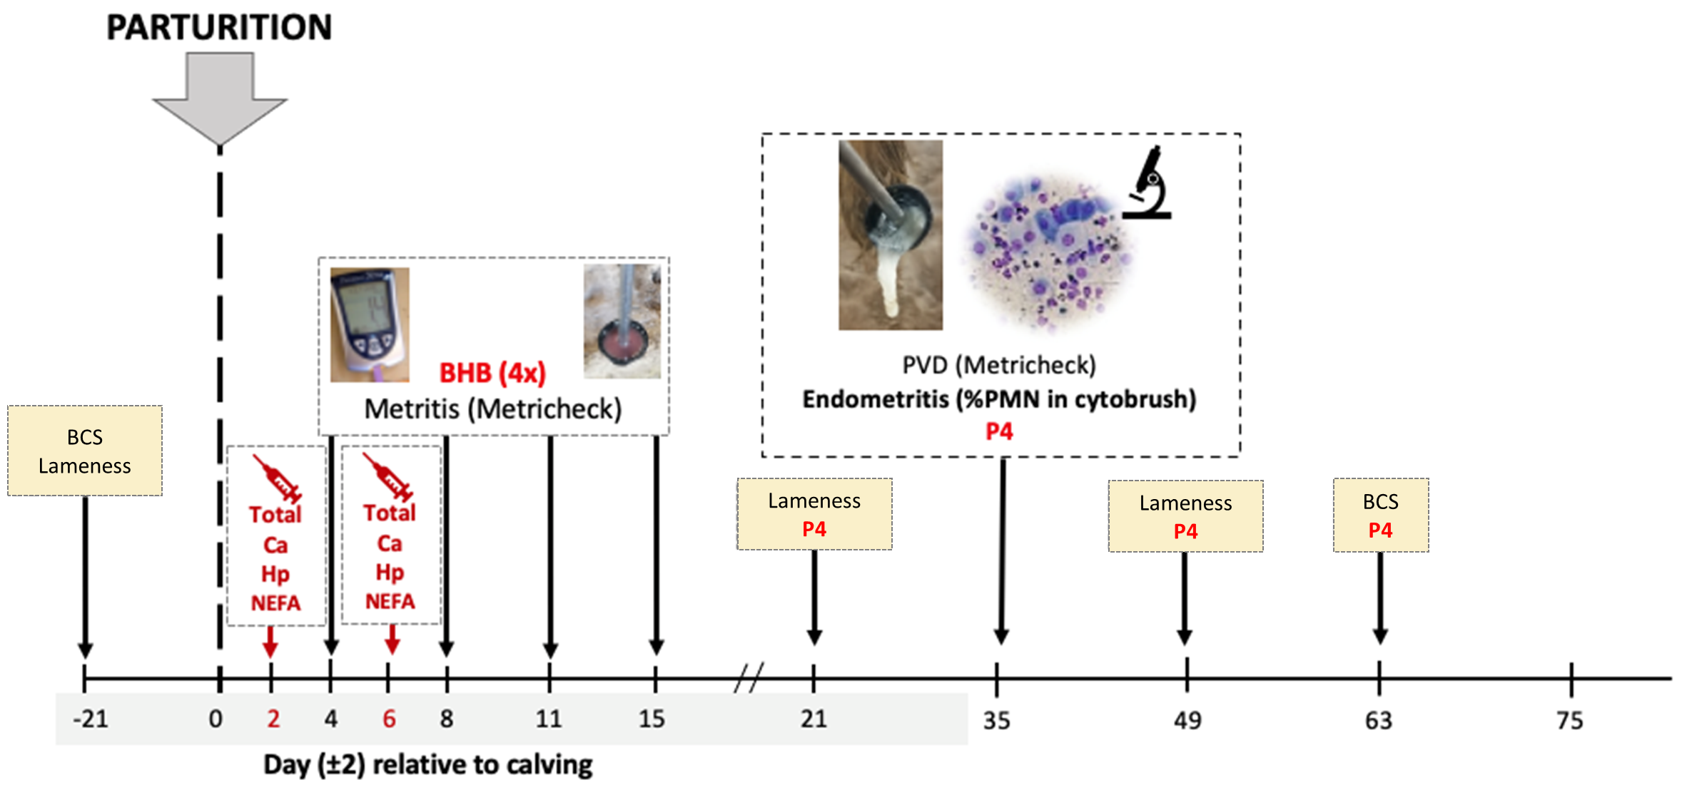
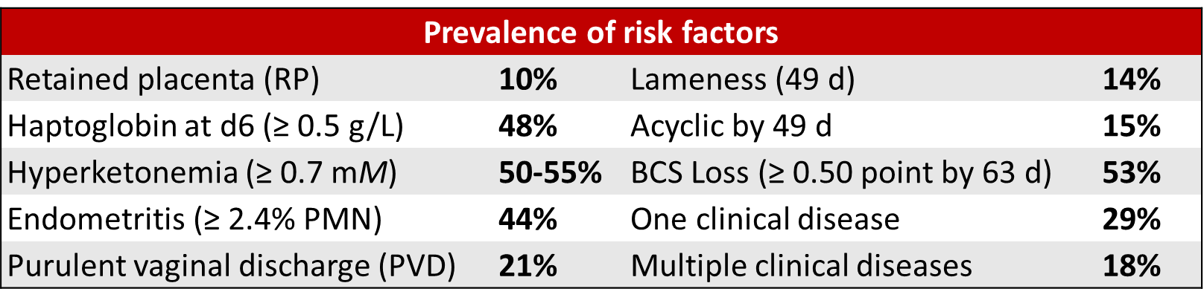
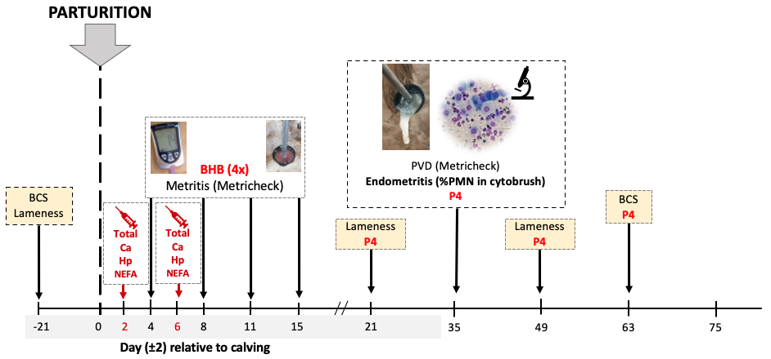

Transition health and estrus detection
Prospective observational study in 2 commercial dairy herds in Ontario, Canada (~450 lactating cows each) from May 2019 to April 2021
Prepartum Holstein cows (n = 1,357) were enrolled and examined
1st AI primarily based on detection of estrus by AAM from 50 to 75 d, or timed AI thereafter
Bruinjé
et al JDS 2024
BCS
Lameness
Lameness
P4
Lameness
P4
BCS
P4
Notes:
Loewiths and Wensink Loweiths – AFI - Wensink – Lely –
Lameness – score 3 or 4 (researcher scored)
Acyclic – low P4 at 21,35 and 49
KETOSIS – did a ROC curve for each predictor, and this cutpoint was a better predictor of estrus than a higher estrous
(same way to find cutpoints for haptoglobin and endometritis) – all lower than classic (PMN 5% classically, haptoglobin typically 0.8)
50-55% for ketosis is based on either 2 samples >0.9 in first week (50%) or >0.7 at later times (55%)
Clinical disease = RP, metritis, DA, mastitis, lameness, (there were clinical ketosis cases but not very many), pneumonia (not many)

Slide 32
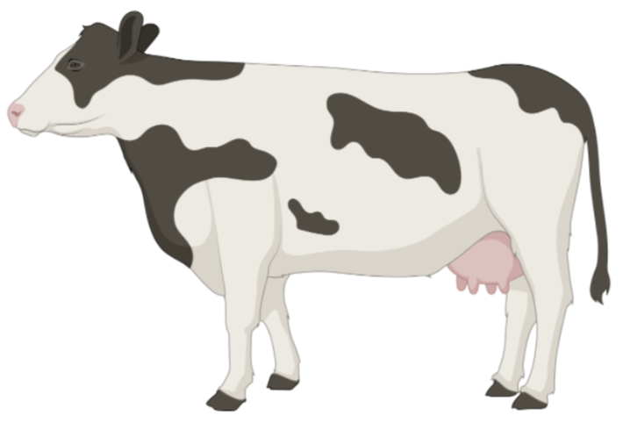

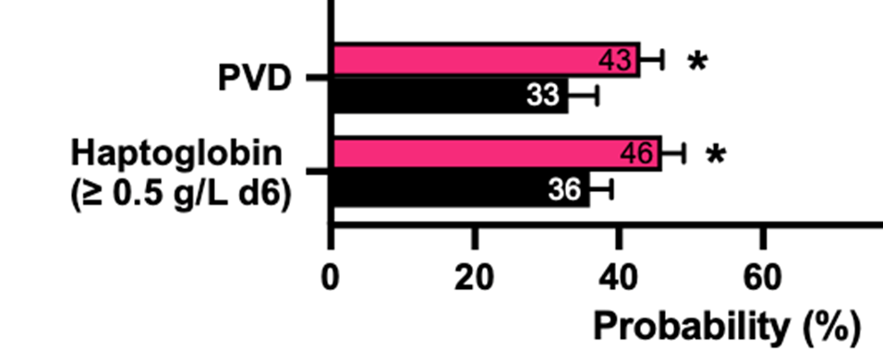
ONLY RISK FACTORS
DIAGNOSED ON FARM
Transition health associations with estrus and pregnancy at 1st AI
RP, PVD, lameness
BCS loss (≥ 0.50-point)
70% of cows detected in estrus by 75 DIM
n = 1,210
a
b
All P ≤ 0.05
c
(Freq. 32%)
(Freq. 22%)
(Freq. 46%)
Pregnancy at 1st AI
Elevated haptoglobin (HP): ≥ 0.5 g/L at 6 (± 2) DIM
Hyperketonemia: ≥2 samples of BHB ≥0.9mM (4 DIM) or ≥0.7mM (8, 11, or 15 DIM)
Endometritis: ≥ 2.4% PMN at 35 (± 3) DIM
Delayed cyclicity: Acyclic by 49 (± 3) DIM
BCS loss: ≥ 0.50-point loss from 3 wk prepartum to 9 wk postpartum vs. no loss

Slide 33
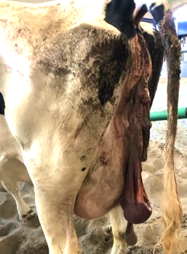
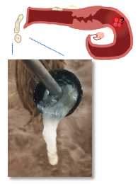
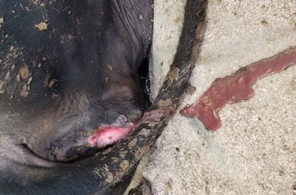
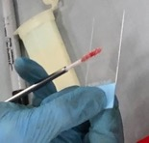
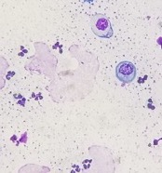
Postpartum Health & Pregnancy Loss
1. RP
2. Metritis
3. PVD
4. Endometritis (cytology)
Bruinjé et al JDS 2024

Slide 34
Fixable problems
Currently ± unfixable problems
Metritis
Early-stage lameness
Some first cases of mastitis
Purulent vaginal discharge (PVD)
Chronic mastitis
  Mycoplasma, Prototheca, Klebsiella (?) mastitis
Chronic lameness
Johne’s disease
Leukosis
Endometritis

Slide 35
Premises
Culling is an economic decision*. Sell a cow when her net present value is < an available replacement animal
  * Or a decision to override economic rationale
Poor health will reduce productive lifespan, but longevity is a poor measure of health or welfare
Ethics and social license require quality of life for cows, not quantity
‘Metabolic athletes’ live demanding, not distressed lives

Slide 36
Conclusions
There are not enough large, validated, comprehensive datasets to fully disentangle the effects of health disorders on milk yield and culling
  Harder than it sounds. Reliable, standardized, complete health data are limiting.
Milk price, heifer supply and price, and beef price confound these relationships
Prevention of disease is a primary goal
Lameness and mastitis are likely main contributors to erosion of profitable lifespan at the herd level
  Importance = % cows affected * impact per case

Slide 37
Ahead…?
“Resilience” phenotype?
Recovery from health disorders
Many models on optimal lifespan or herd structure don’t consider the risk of health problems associated with calving
Best Management Practices reduce many risks at calving
Disease risk should not dictate planned lifespan or herd structure
Social science/behavioral economics investigation of culling decision making

Slide 38
When do you want cows to be pregnant?

Slide 39
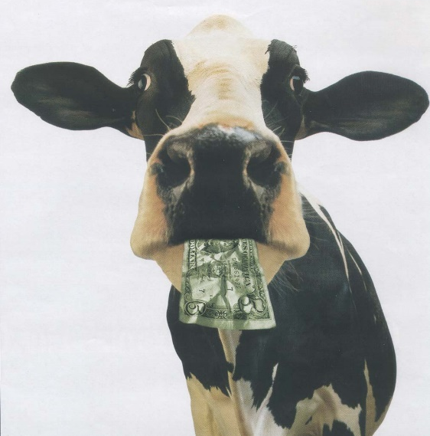
Ways to lose money on reproduction – Simplistic view
Opportunity cost of days open past ~100-120 DIM
  Forgone profit from not having cows spend more of their lifetime in the most profitable part of the lactation curve
  Approximately $1-4 cow/day >100 DIM
Culling of otherwise profitable cows due to inability to get them pregnant
  =[(Cost of new heifer – cull price) × remaining proportion of expected herd life]

Slide 40
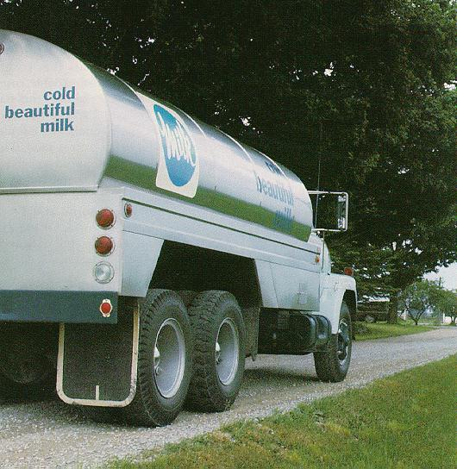
Where does the money go?
Semen
Labour
Drugs
Vet
Culling
*MILK cheque*
Opportunity cost

Slide 41
Dairy Cow Lactation Curve
Revenue
Profit
Cost
Days in Milk
The objective is to optimize profit/slot/year by maximizing the proportion of a cow’s life in the most profitable stage of lactation

Slide 42
Show me the money
Payback comes from
  1) Marginal milk
    = a more productive, nearer-peak cow filling the average slot on the farm
    Reflected in lower herd DIM and increased milk/d per cow in the herd (in fact, more milk per slot)
  2) More selective culling – as more pregnant cows are produced, tail-end producers can be removed, contributing to more milk per slot as herd distribution shifts
  3) More heifer calves
  4) Fewer long-DOPN fat cows in 1-group TMR herds ➔ better transition
When pregnancy rate increases,
  Cows spend more of their life in early lactation
  Replacement is likely to be more optimum as to which cows are replaced and when

Slide 43
VWP principles
Economic optimum has been to have cows get pregnant between ~ 80 and 125 DIM based on maximizing lifetime profit
  Most time spent near peak
  Optimize profit per ‘slot’ per year
Lower end set by biology (and management – transition health)
Upper end set by economics - Depends on:
  Milk price
  Milk yield
  Persistency
  Insemination rate and probability of pregnancy/AI
  Health risk at calving
  Calf value
Practice set by low efficiency of insemination and low probability of pregnancy/AI
Does that change if “100%” of cows are bred by a deadline?
  With up to 50% (?) P/AI?
Controlled trial in NY (Stangaferro et al 2018)
2426 cows – Double Ovsynch then ED and ReSynch
First AI at 60 or 88 DIM
Minimal $ differences over 18 months
Slightly favors 88 d VWP in Lact=1, 60 d in older

Slide 44
What metric(s) should be used to assess whether to extend lactation?
Milk per cow per year?
Milk per cow per 2 or 3 years? Expected lifetime?
Conception risk?

Slide 45
What metric(s) should be used to assess whether to extend lactation?
Profit per most limiting resource
  Per “slot”
    Stall
    Milking space in the parlour or robots
  Per kg of quota
  Per hectare
  Per tonne of N or P
  Per tonne of GHG
Not per cow
Not per insemination

