Slide 1
The Importance of a Marketing Plan in Good Times & Bad
January 20, 2025

Slide 2
Main Points to Consider at a Critical Time
Are corn and bean lows in?
What has changed?
Risk-management is more than corn/bean prices
What adjustments do I need to make with lower commodity prices?

Slide 7
SX5/CZ5 are near seasonal lows. US & Global supplies suggest corn is tighter than beans. Market is trying to buy corn acres

Slide 8
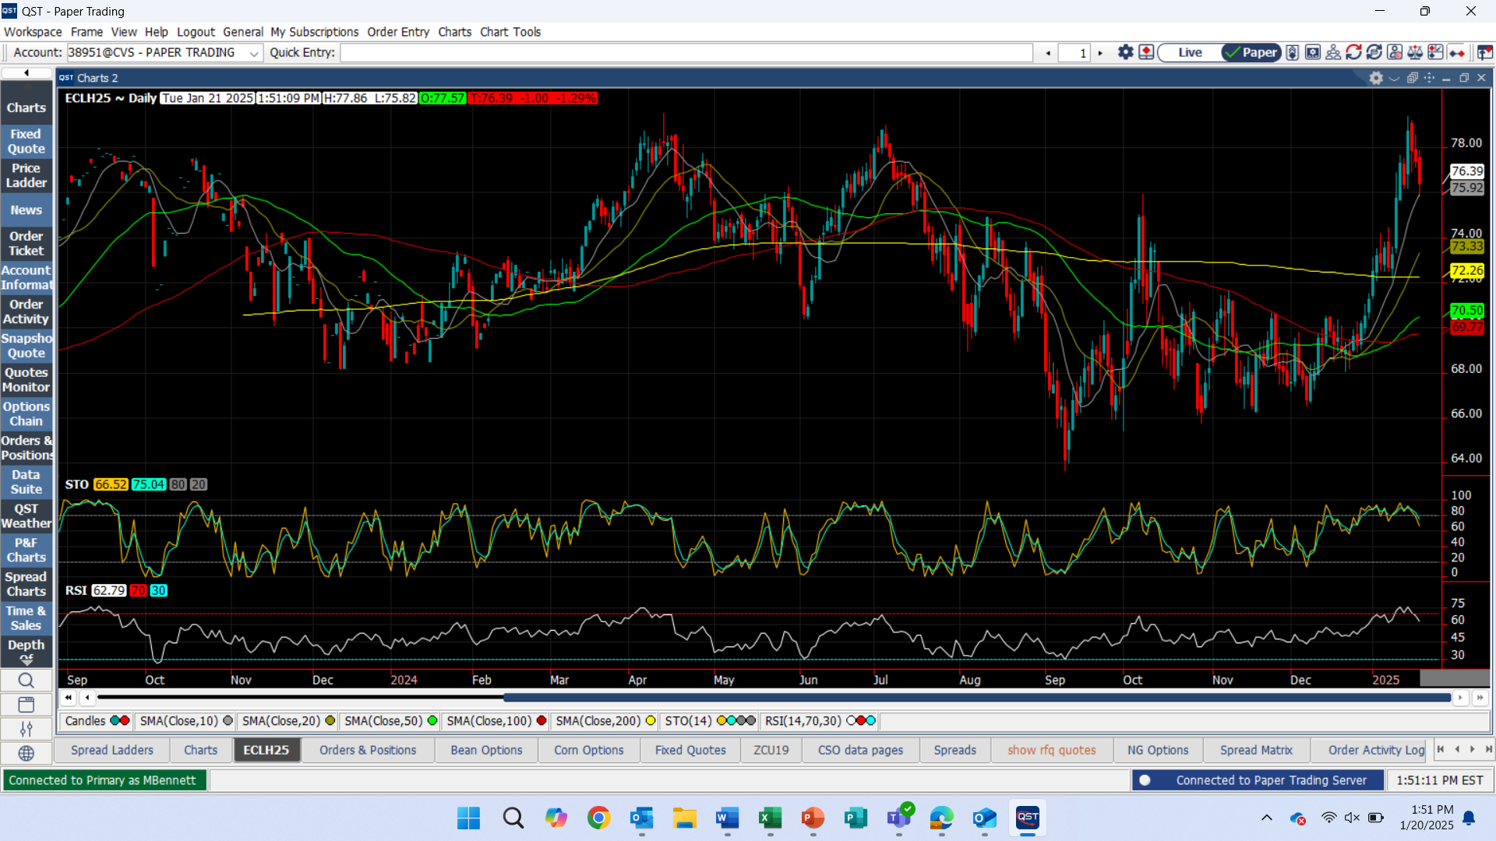

Slide 9
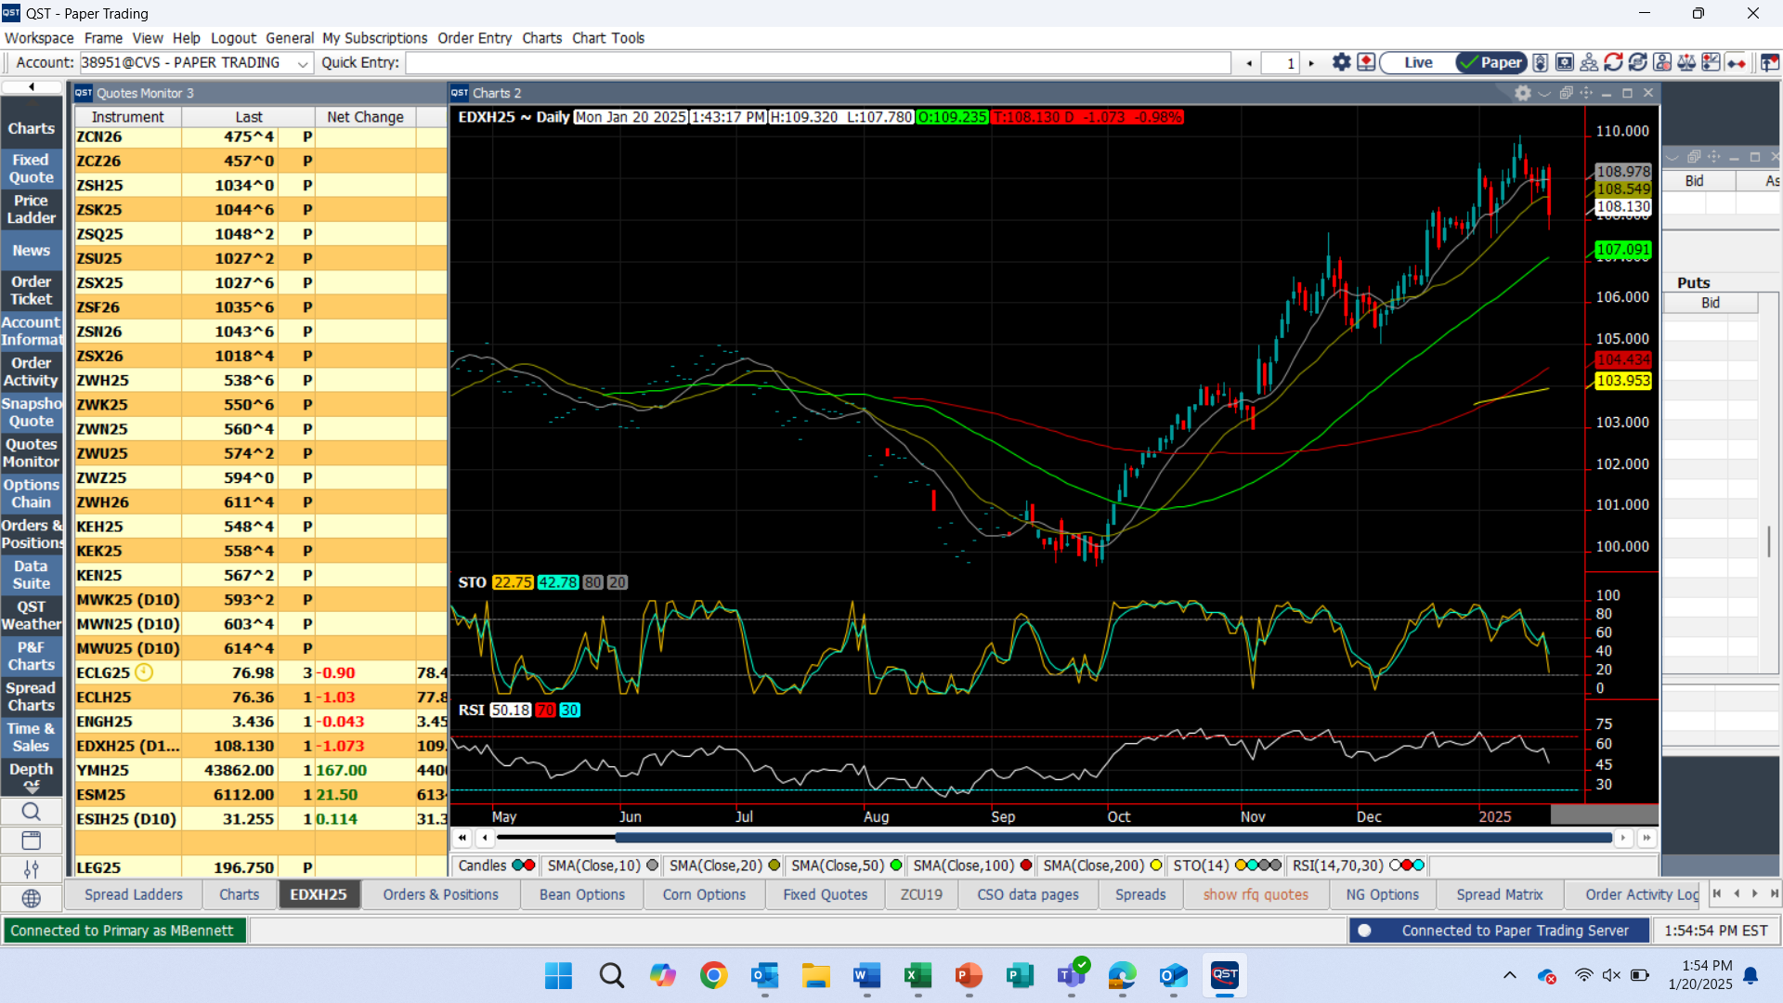
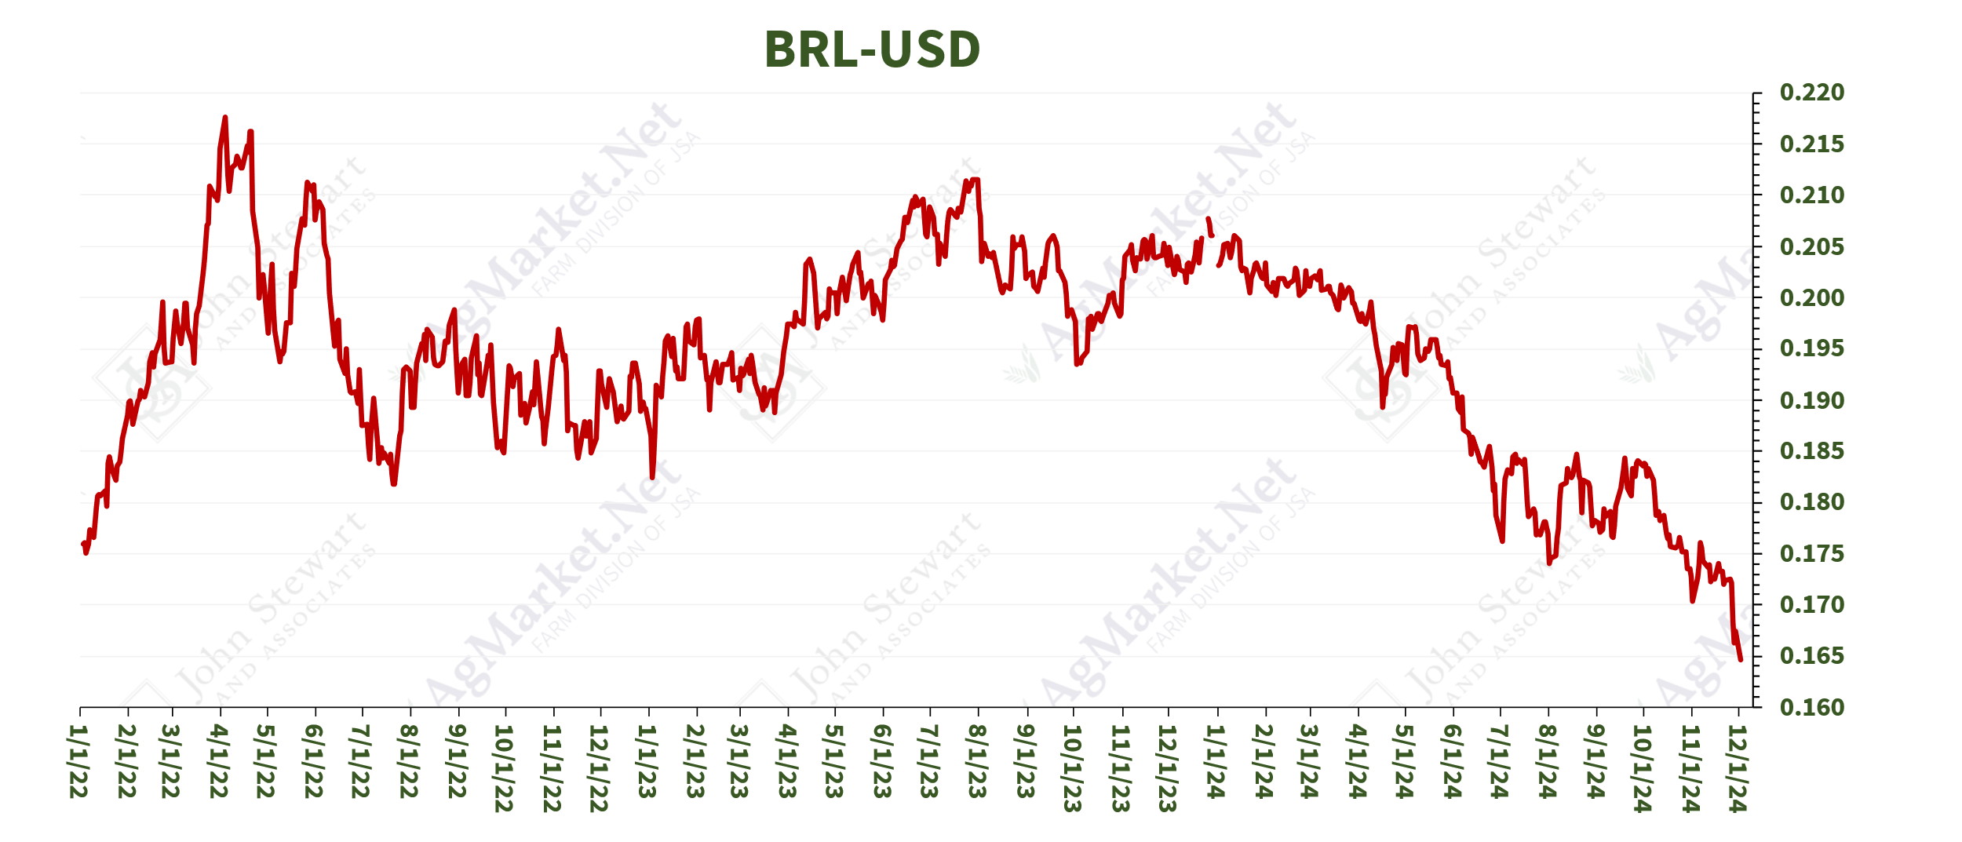
US commodity prices are cheap, but BRL devaluation vs USD is encouraging sales from Brazilian farmer. Real has recently stayed at 22-year low vs USD

Slide 10
Fund positions show big-time buying

Slide 11
Corn

Slide 12
Producer attempt at profitability in 2024

Slide 15
Corn S & D

Slide 16
95?

Slide 18
Yield Reductions for Corn and Soybeans were the biggest surprise of the report – 2nd largest cut for both in the last 20+ years

Slide 19
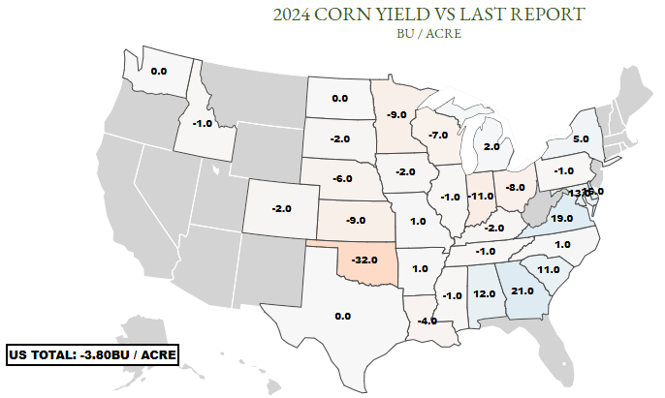
Most of the corn belt lost significant bu/acre in the January report. State records remain in IL, IA, MI, SD

Slide 21
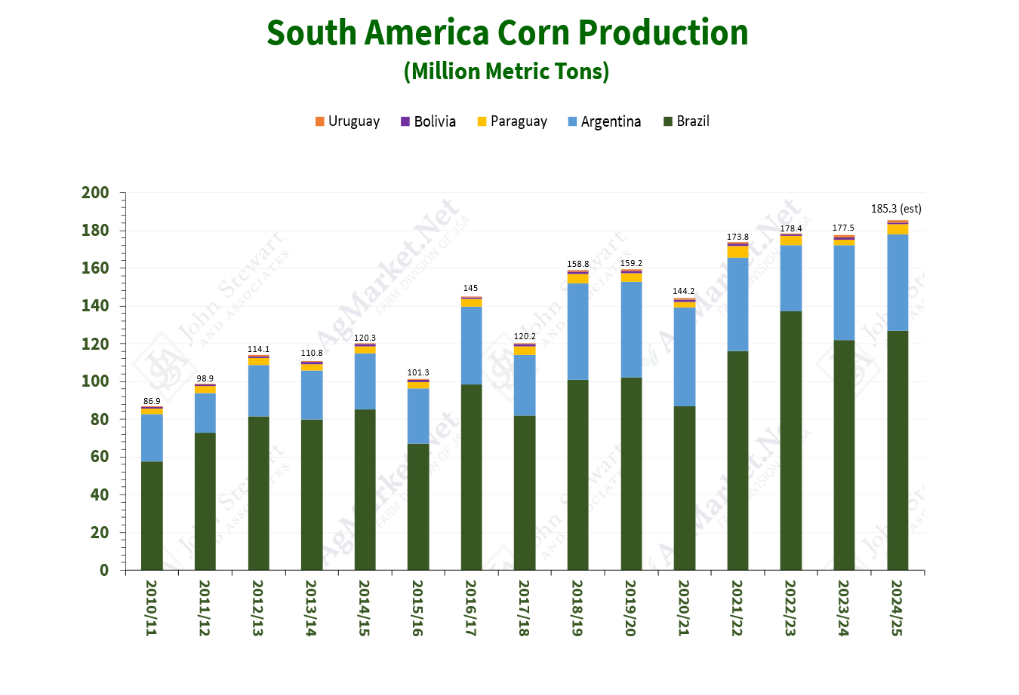
9% increase for US production since 2015 83% increase for South America
**Production estimated to be up 4.3% from LY

Slide 22
Trend of higher stocks and stocks/usage has stalled with this year’s big export program
Global stocks/use continues to decline – under 25% for first time since 2013
2021 is the only year in the last eight we have seen a year over year improvement in world stocks/use

Slide 25
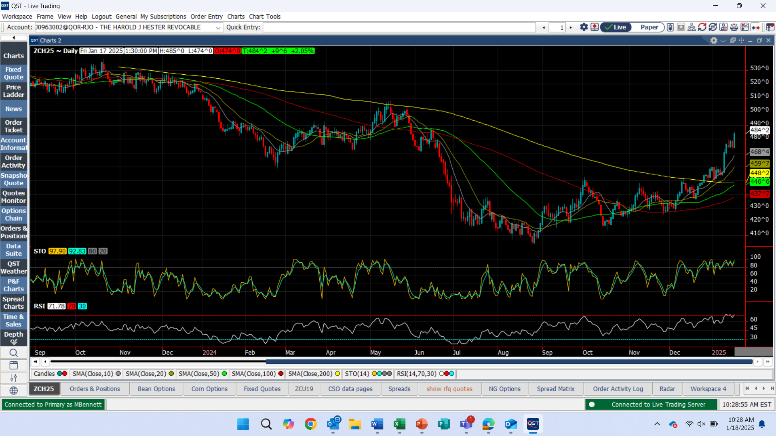
March 2025 Corn Chart

Slide 26
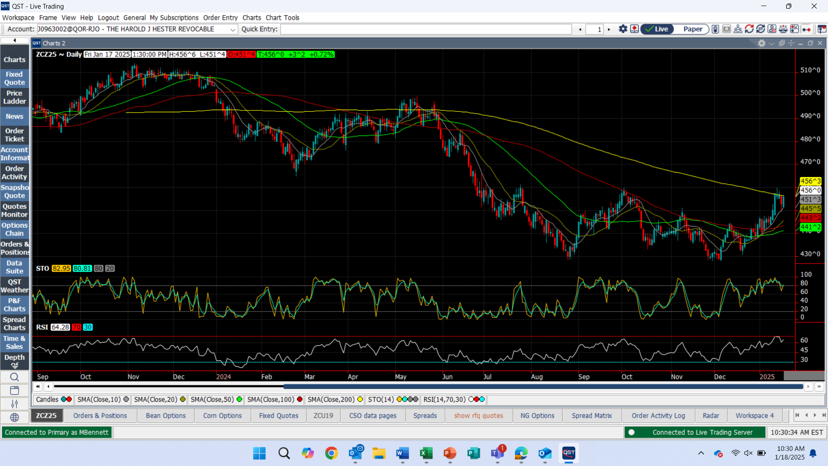
December 2025 Corn Chart

Slide 27
Soybeans

Slide 31
Soybean S & D

Slide 32
Soybean production 95 mbu lower than last month, but still 204 mbu larger than last year given the larger acreage. MN and OH stick out as down years due to flooding in the north and drought in the east

Slide 33
Trend of higher stocks and stocks/usage ratios continues
Possibly the highest stocks and stocks/usage ratios ever

Slide 34
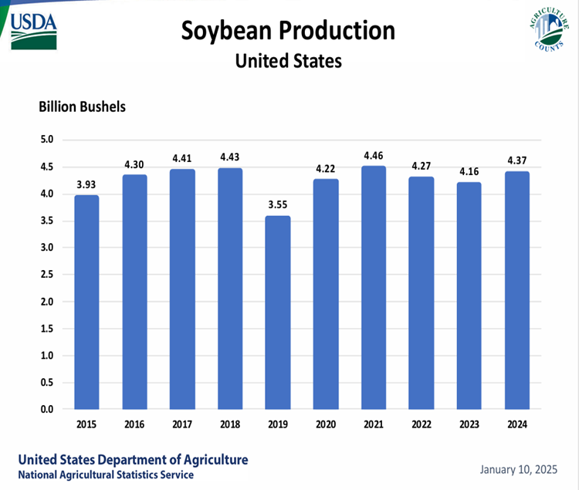
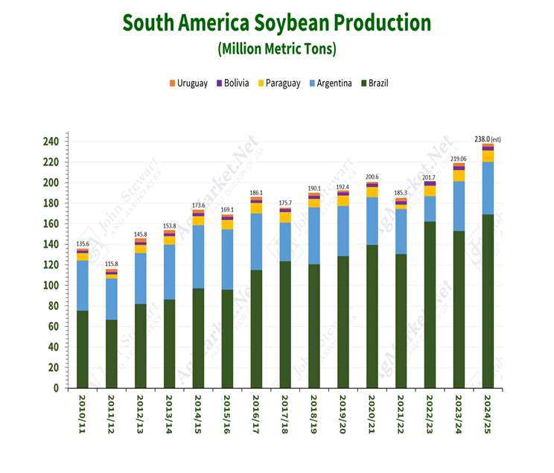
11% increase for US production since 2015 42% increase for South America

Slide 35
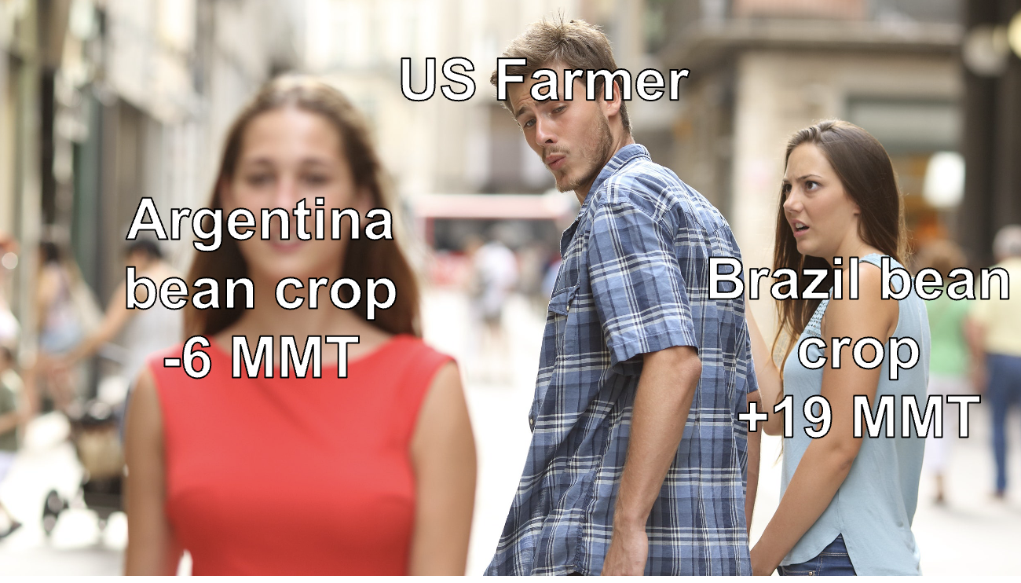

Slide 38
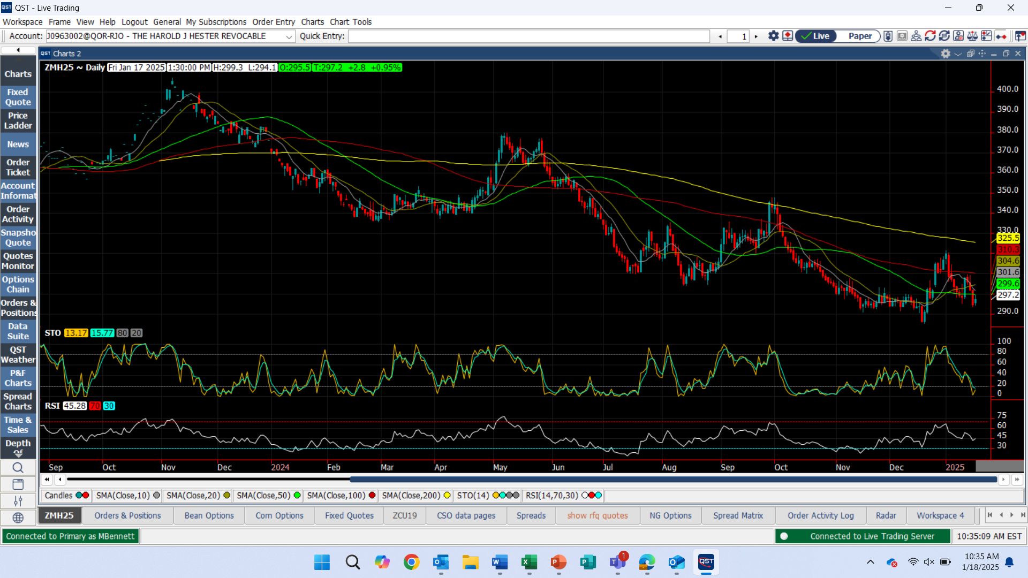
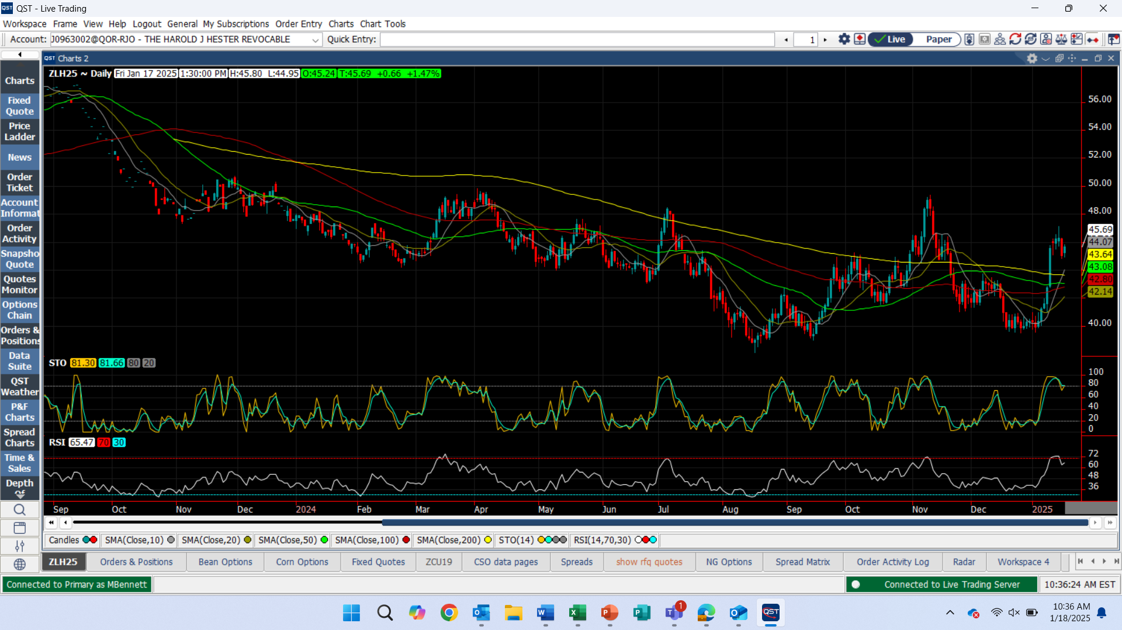
SBM appears to have topped out for the time being. Heavily dependent on Argentine weather
SBO back to rally mode?

Slide 40
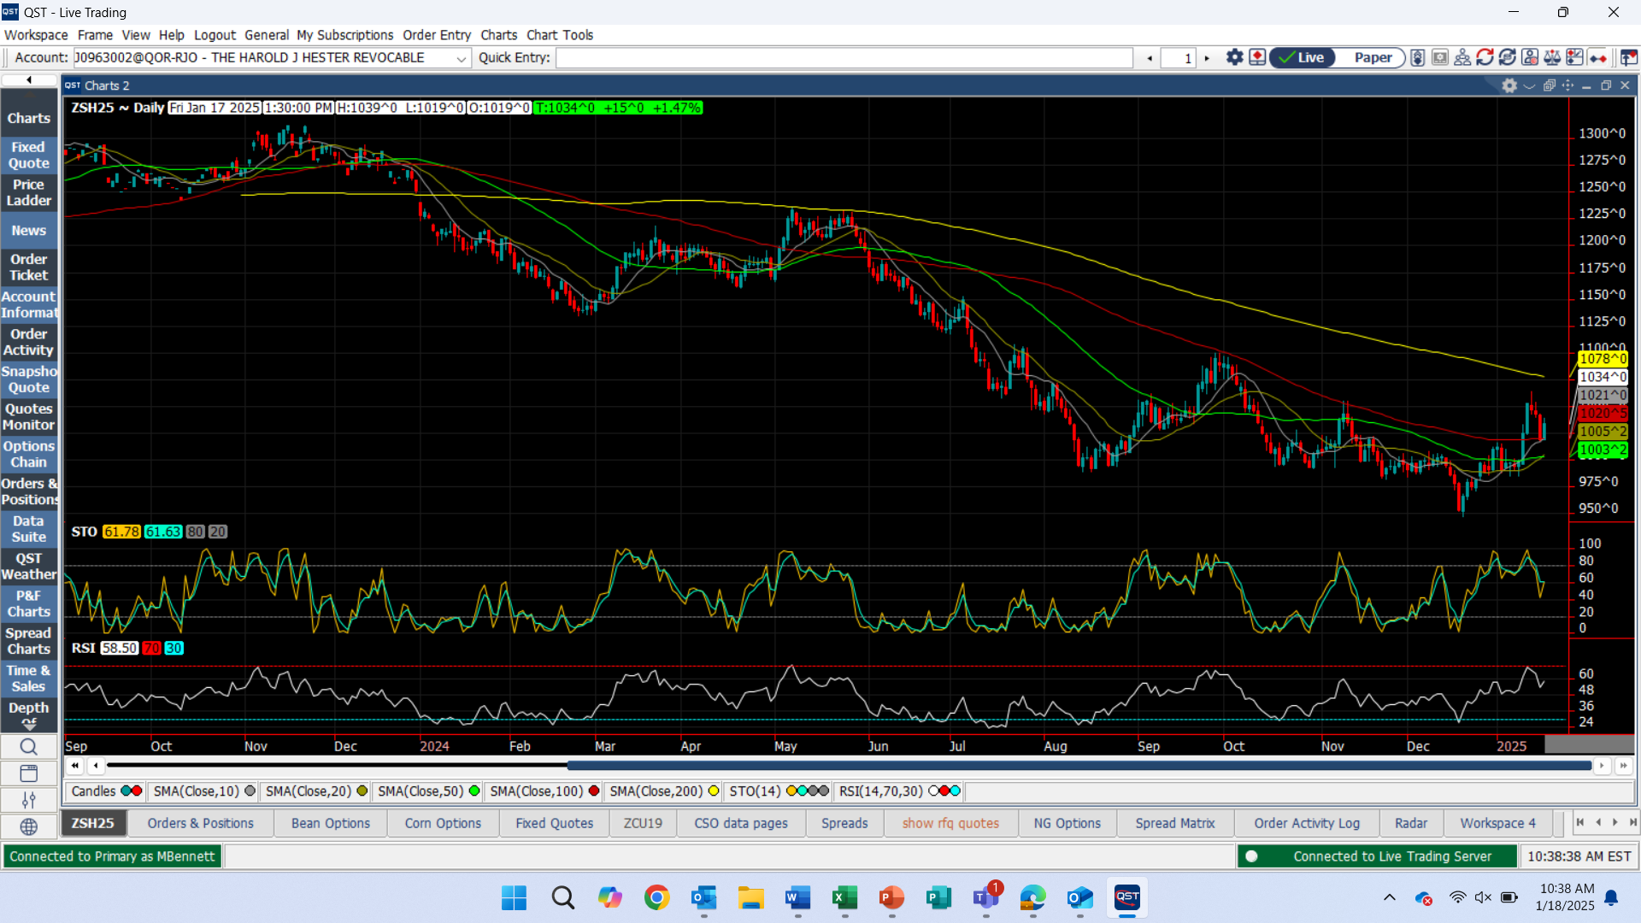
March 2025 Soybean Chart

Slide 41
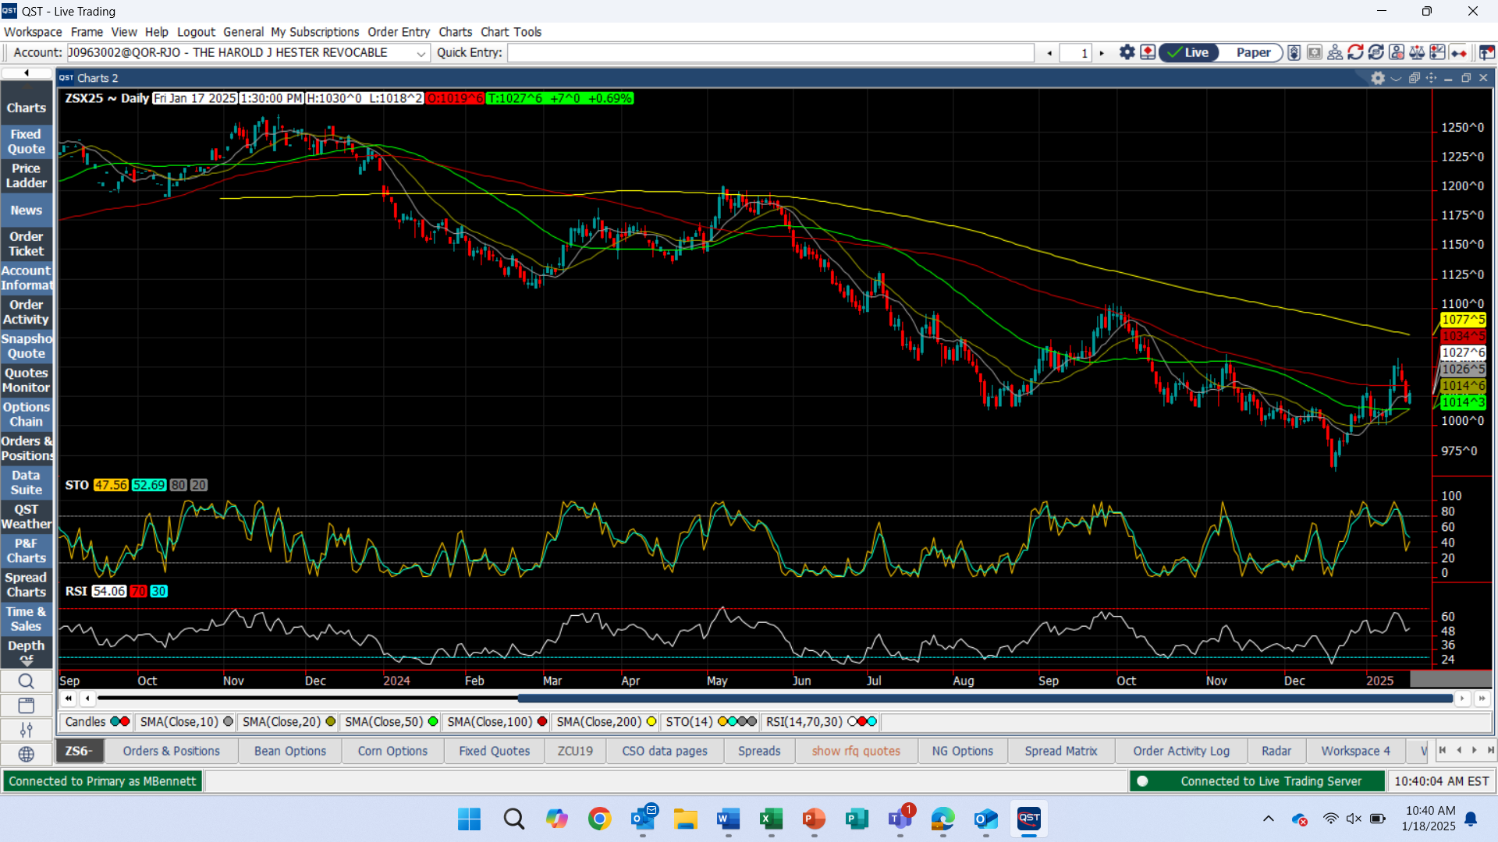
Nov 2025 Soybean Chart

Slide 42
Managing Risk Some good & bad - & ideas on how to adjust

Slide 43
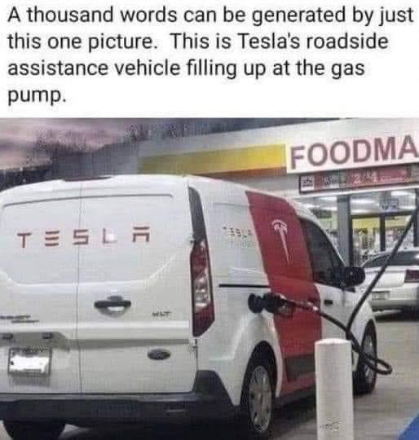
Tesla’s Roadside Assistance Vehicle

Slide 45
45Z Guidance remains a question mark on what will qualify for tax credits, with guidelines on CSA and updated GREET model yet to be outlined. Only producers of eligible clean fuel can receive credit – not blenders. And UCO imports are not eligible

Slide 46
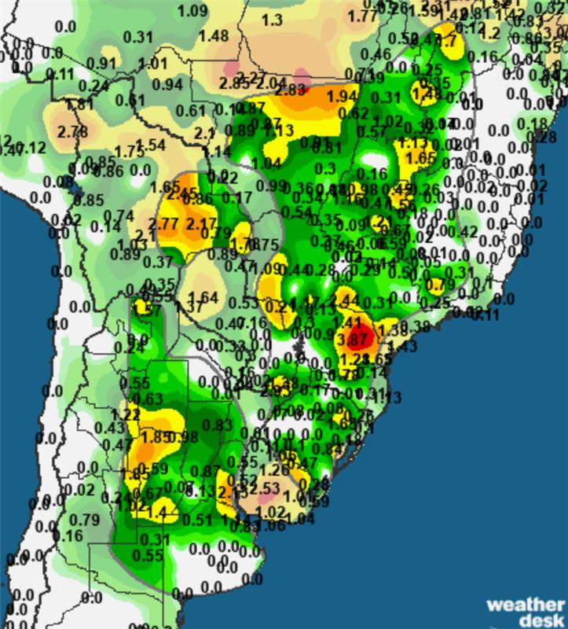
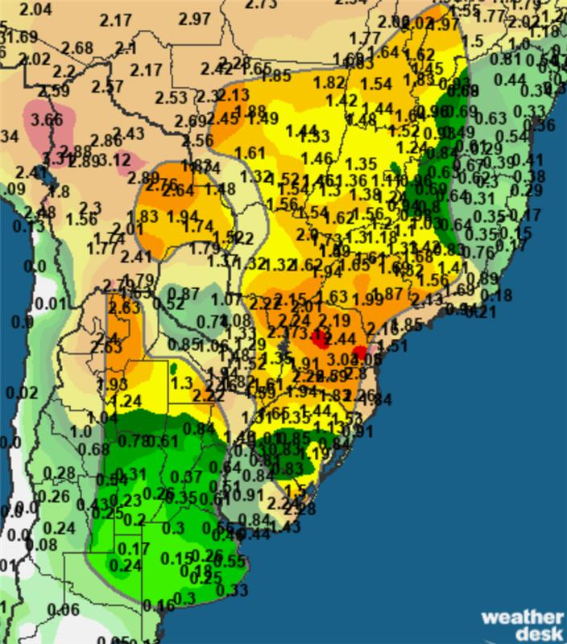
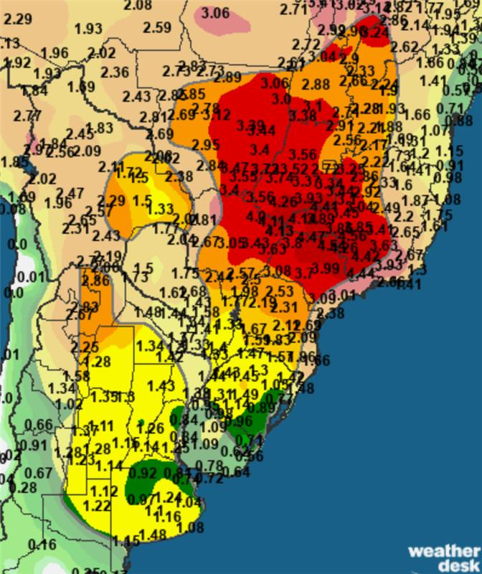
Argentina dryness over last 40+ days highlighted.
Central and Northern Brazil continue to be wet, with forecasts improving for S Brazil and Argentina

Slide 52
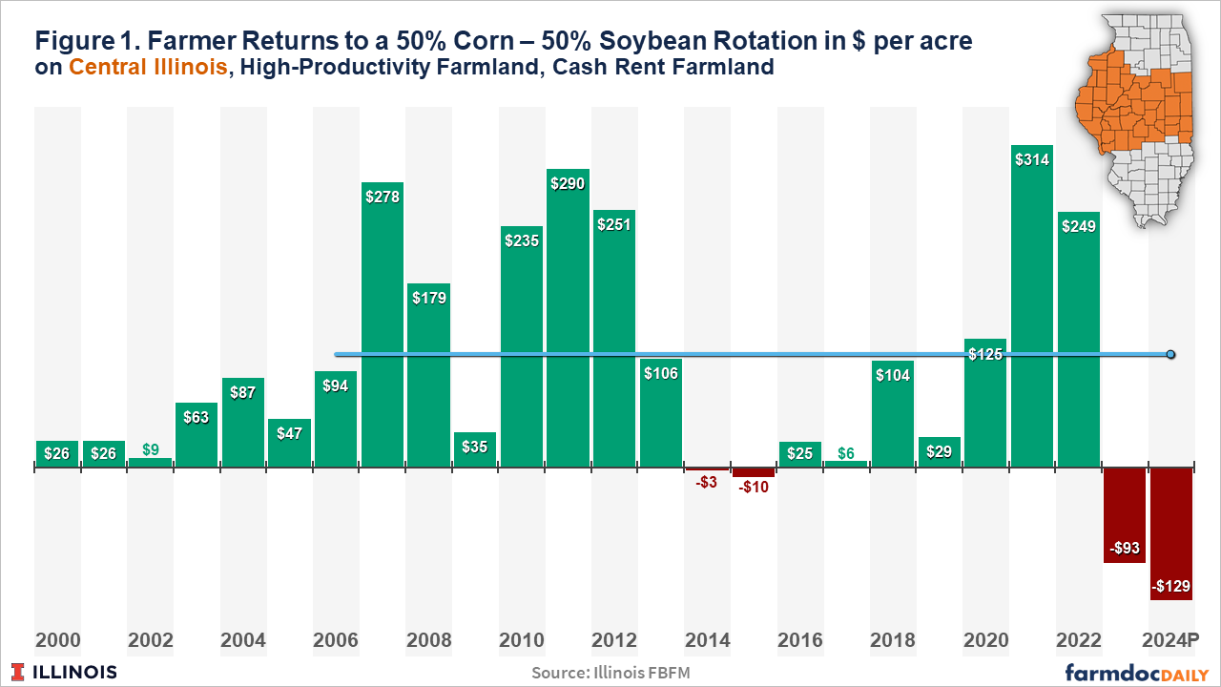

Slide 53
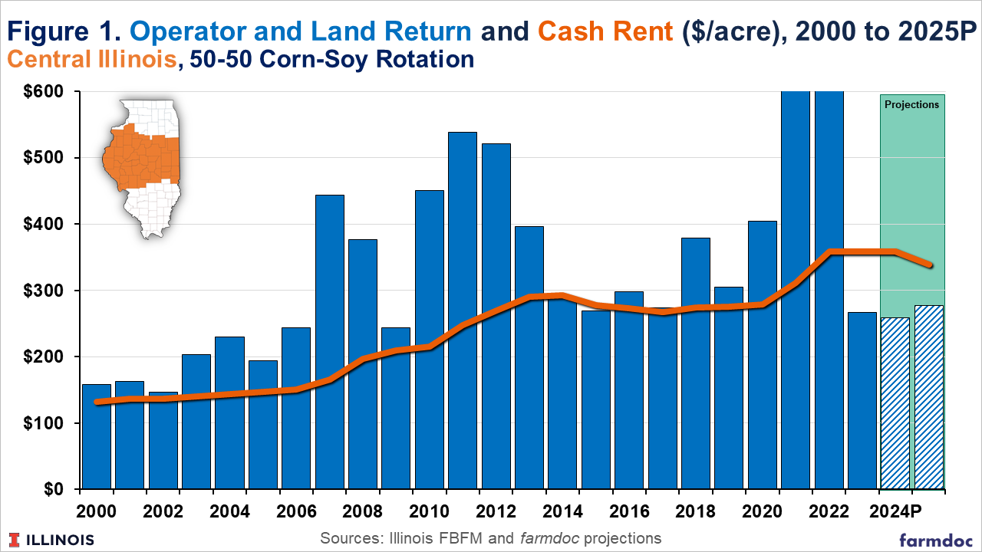

Slide 57
In Closing
Farm Income likely lower in ‘24 & ‘25 than the last 3-4 years
Given low income for grain farmers, used equipment likely soft
Tough for growers to break even without the bushels
Stay disciplined in your marketing

Slide 58
If you want the presentation, click here

Slide 59
Questions – Comments Mbennett@AgMarket.Net Website –www.AgMarket.Net Phone – 844-4Ag-Mrkt Twitter - @chief321 Profitability App - AgMarket.app

Slide 60
Risk Disclaimer The risk of loss in trading futures and/or options is substantial and each investor and/or trader must consider whether this is a suitable investment. AgMarket.Net® is the Farm Division of John Stewart and Associates (JSA) based out of St Joe, MO and all futures and options trades are cleared through RJ O’Brien in Chicago IL. This material has been prepared by an agent of JSA or a third party and is, or is in the nature of, a solicitation. By accepting this communication, you agree that you are an experienced user of the futures markets, capable of making independent trading decisions, and agree that you are not, and will not, rely solely on this communication in making trading decisions. Past performance, whether actual or indicated by simulated historical tests of strategies, is not indicative of future results. Trading information and advice is based on information taken from 3rd party sources that are believed to be reliable. We do not guarantee that such information is accurate or complete and it should not be relied upon as such. Trading advice reflects our good faith judgment at a specific time and is subject to change without notice. There is no guarantee that the advice we give will result in profitable trades. The services provided by JSA may not be available in all jurisdictions. It is possible that the country in which you are a resident prohibits us from opening and maintaining an account for you. 2025

